Slide 1
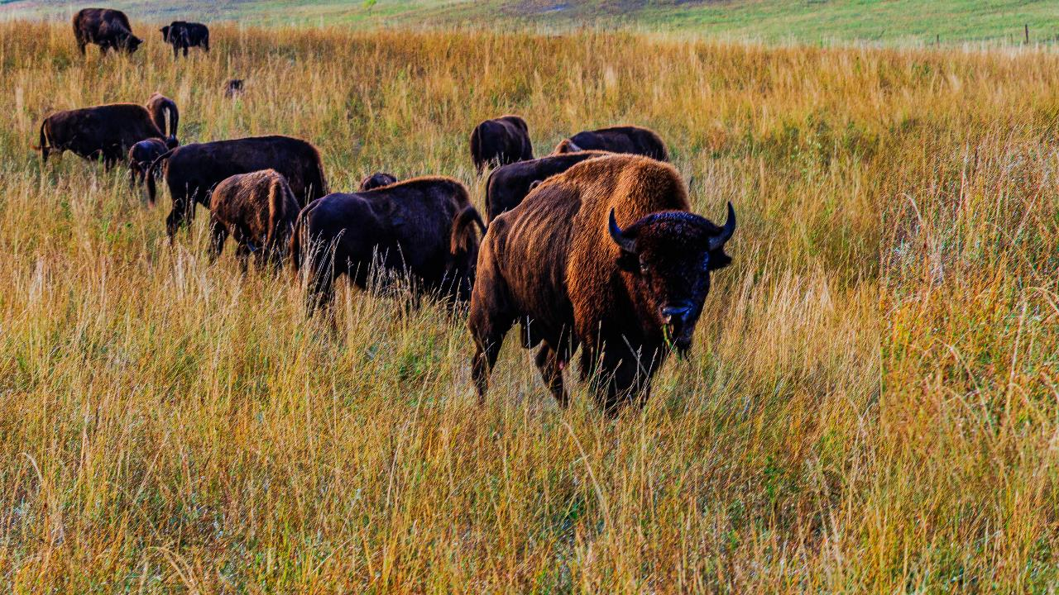

AgriStability – How Bison Producers Can Get the Most Out of It
A Presentation for the Canadian Bison Association National Convention
Presenter: Steve Funk, Director, Ag Risk Management Resources, MNP LLP
November 28, 2022
Notes:
AgriStability program is not self-revealing. There is a strong tie in to financial literacy.

Slide 2


Mathematical Calculations
474,872
213,657
109,135
64,730
87,350
Question:
What needs to happen to these two numbers for the $87,350 to go down?
474,872
387,522
87,350
ANSWER:
Either the $474,872 needs to go down and/or the $387,522 needs to go up.

Slide 3
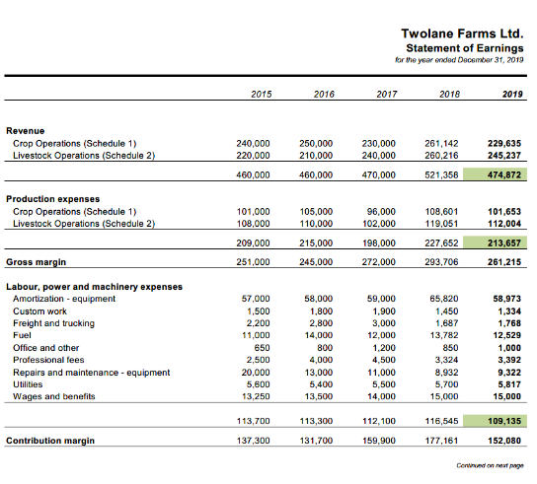

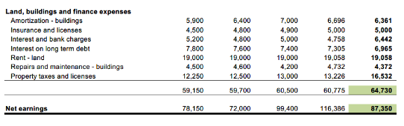
Now, let’s look at the context… the Income Statement
474,872
213,657
Question:
Within the context of this farm, what types of things would make the $474,872 go down and/or the $387,522 go up?
109,135
To clarify, what is included in these numbers?
64,730
87,350

Slide 4
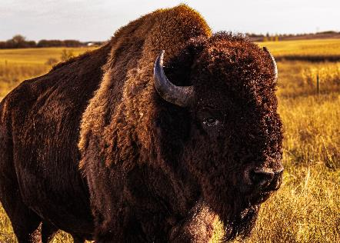
Cash vs Accrual
Cash based accounting:
- Records income when cash is received and expenses when cash is paid out
Accrual based accounting:
Income and expenses are recorded when they are earned or incurred
  Inventory changes
    Breeding Herd
    Feed
    Saleable animals and meat
Balance Sheet: Financial “picture” of assets under management, liabilities owing on those assets and net equity or actual ownership of the assets at a point in time.
Income Statement: Financial “movie” of revenues or sales less expenses or costs over a period of time; the net income or loss for the period feeds into the balance sheet.

Slide 5
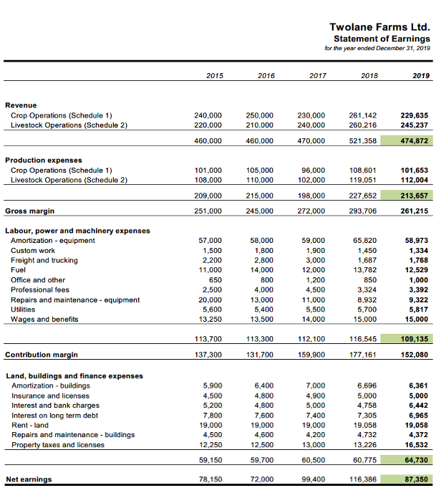




Income Statement
Question:
Within the context of this farm with accrued financial statements, what types of things would make the $474,872 go down and/or the $387,522 go up?
Factors that make production and/or price (revenue) drop or expenses increase
A small % decrease to revenue always yields a larger % decrease to net income
For example, an 18.4% decrease to revenue yields a 100% decrease in net income
The same may or may not hold true for expenses depending on how large they are compared to the net income

Slide 6
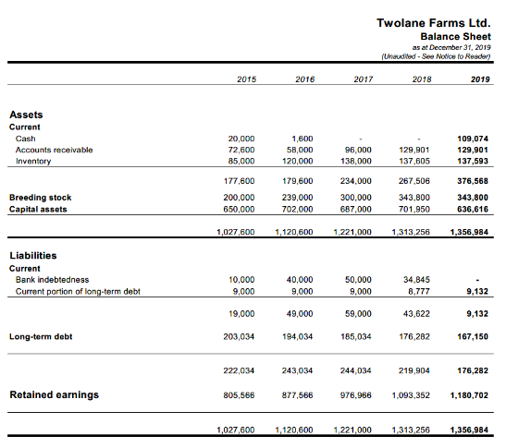
… and let’s continue with some further context… the Balance Sheet
Balance Sheet shows what makes up the equity (retained earnings) at a point in time
Assets are at historical cost, so increases in land value are not factored in
You want your equity to increase over and above any increases in land value
Anything that hurts your Income Statement also hurts your Balance Sheet
How much equity do you want to put at risk?
When am I going to start talking about AgriStability?
I already have been

Slide 7
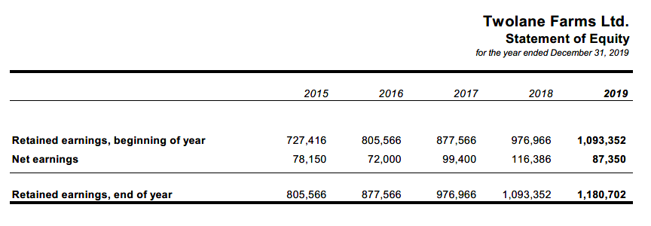

Why is generating accrued Net Income important for the farm?
A:
Keeping track of your multi-million dollar investment in your farm using accrual accounting is good financial stewardship.
It covers all expenses, including paying yourself, while allowing some excess for loan payments, expansion and transition.
Net Income transfers onto the Balance Sheet in a positive way; Net Loss transfers onto the Balance Sheet in a negative way.
It can make the difference between building your farm and tearing it down.
stewardship
[ stoo-erd-ship, styoo- ]
noun
The responsible overseeing and protection of something considered worth caring for and preserving.

Slide 8
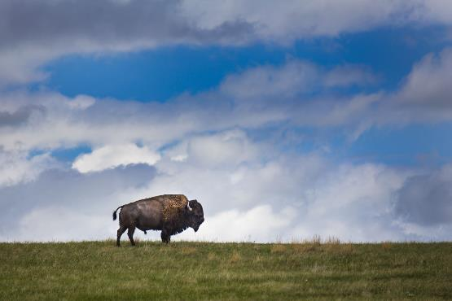
AgriStability
A means of insuring the income stream for your farm
  Whole farm, margin-based insurance program for farms of all types in Canada
  Whole farm – everything grown or raised on the farm is rolled up to calculate the results – that’s why diversified farms are less likely (not unlikely) to qualify for benefits
  Margin based – sales of commodities minus direct costs of production
  Accrual Adjusted – When you grew it, not necessarily when you sold it

Slide 9
Some different Mathematical Calculations
474,872
213,657
35,114
226,101
Question:
What needs to happen to these two numbers for the $226,101 to go down?
474,872
248,771
226,101
ANSWER:
Either the $474,872 needs to go down and/or the $248,771 needs to go up.

Slide 10
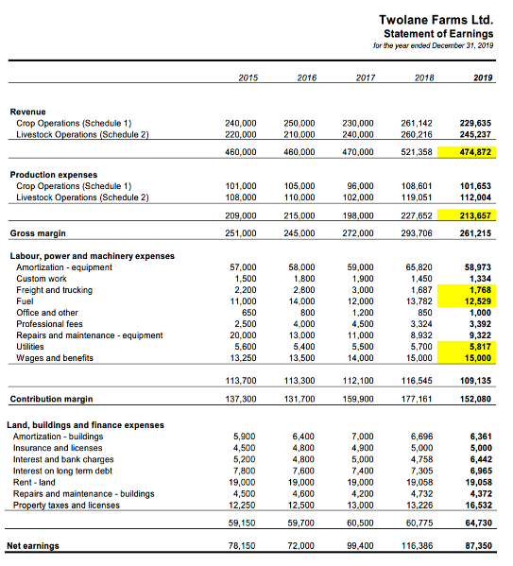

Income Statement
226,101
474,872
213,657
Question:
Within the context of this farm, what types of things would make the $474,872 go down and/or the $248,771 go up?
35,114

Slide 11
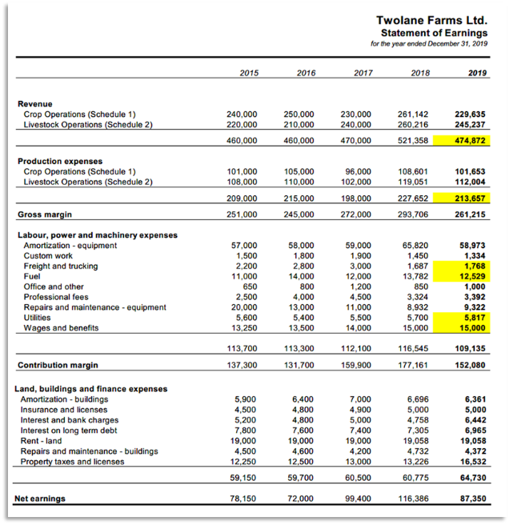





Income Statement
Question:
Within the context of this farm, what types of things would make the $474,872 go down and/or the $248,771 go up?
Factors that make production and/or price (revenue) drop or specific expenses increase.
This is a quick way to determine your AgriStability margin based on an accrued Income Statement.
There might be some inventory pricing differential between this and the actual AgriStability margin, especially for breeding herd.
Some items on the Income Statement are allowable for AgriStability, others are not.
The AgriStability margin doesn't fall out of this Income Statement without some significant dialogue between you and your accountant.

Slide 12
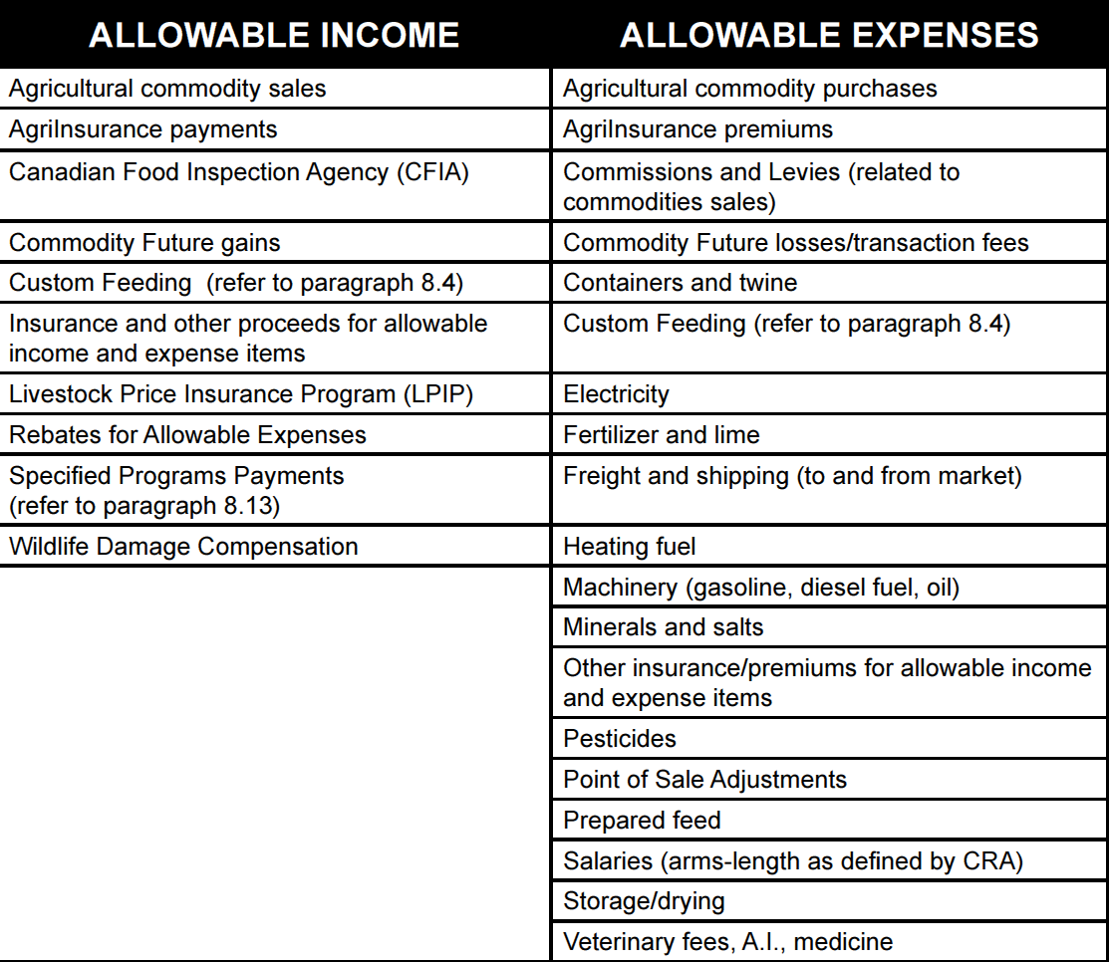
AgriStability – How It Works
Margins are accrual adjusted.
Animal Sales
Animal Growth
Meat Sales
Meat Production
Feed
Breeding Stock
Feeders
Notes:
The 2020 and future year’s rule on private insurance is that payouts are not included in the current year margin, but are reinstated once the related year is relegated to the reference margin. Private insurance premiums are still allowable in all years.
The red line indicates treatment of WLPIP, GARS, Just Solutions and private hail income in the current year that we are doing modelling for. Income from these programs would be included in the reference margin.

Slide 13
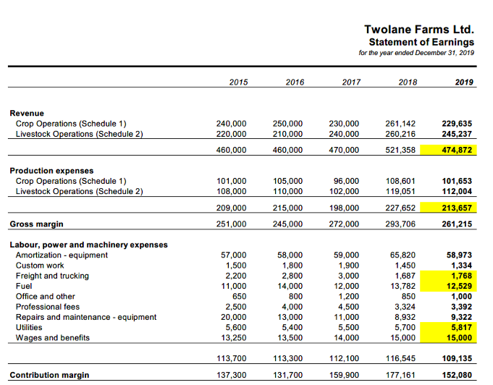
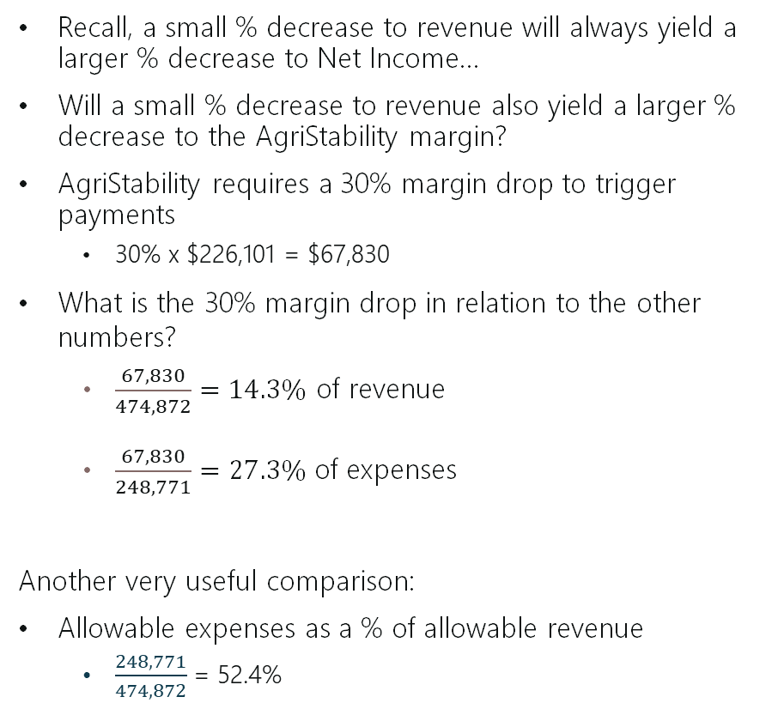
AgriStability – Margin Sensitivity
Recall, a small % decrease to revenue will always yield a larger % decrease to Net Income…
Will a small % decrease to revenue also yield a larger % decrease to the AgriStability margin?
AgriStability requires a 30% margin drop to trigger payments
  30% x $226,101 = $67,830
What is the 30% margin drop in relation to the other numbers?
  $\frac{67,830}{474,872}=14.3\%$ of revenue
  $\frac{67,830}{248,771}=27.3\%$of expenses
Another very useful comparison:
Allowable expenses as a % of allowable revenue
  $\frac{248,771}{474,872}$= 52.4%

Slide 14
Industry Sectors:
Group 1
Beef/Bison - Feedlot
Greenhouse
Hog - Farrow to Finish
Nursery
Tree Fruits
Poultry
Group 2
Beef/Bison - Cow/Calf
Dairy
Grain/Oilseed
Hog - Farrow to Wean
Diversified Farm
Group 3
Apiary
Bee Pollinator
Cranberry
Maple Syrup
Organic Crop
Twolane Farms Ltd = .524 or
14.3% Revenue Drop
Low Cost Structures
Group 3 Group 2 Group 1
High Cost Structures

Slide 15
AgriStability
Producer Share
Government Share
A means of insuring the income stream for your farm
2017
2018
2019
2020
100%
Tier 1
Loss
2021
30%
Tier 2
70%
Reference margin
the average of 3
production margins
Program year margin

Slide 16
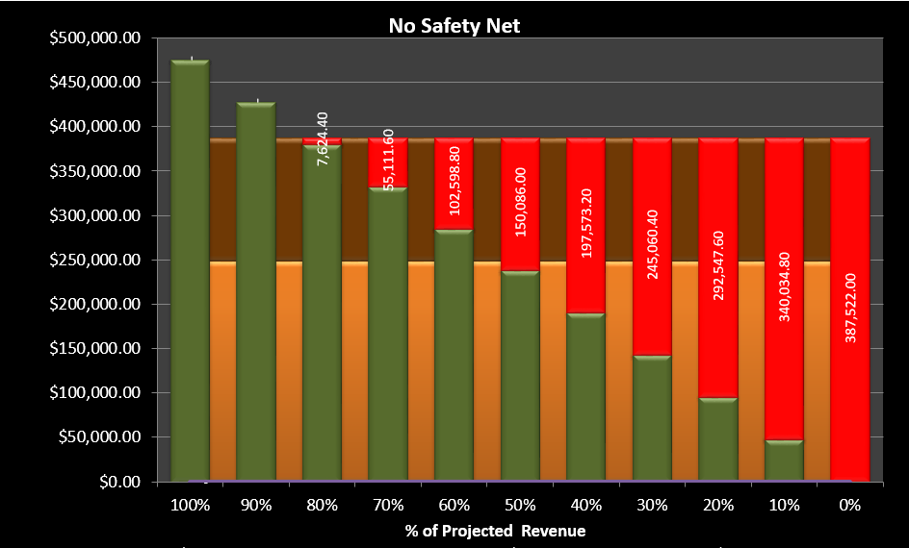
Ag Risk Management Projector™ Modelling
Twolane Farms Ltd. – No Safety Net
Accrued Income Statement projection
Revenue projected from 100% ($474,872) to 0%
Green (revenue) must exceed brown and orange (non-allowable and allowable expenses) to maintain profitability
Losses appear in red
AgriStability estimated reference margin is programmed in
How can AgriStability be used to prevent or minimize the red loss scenarios?

Slide 17
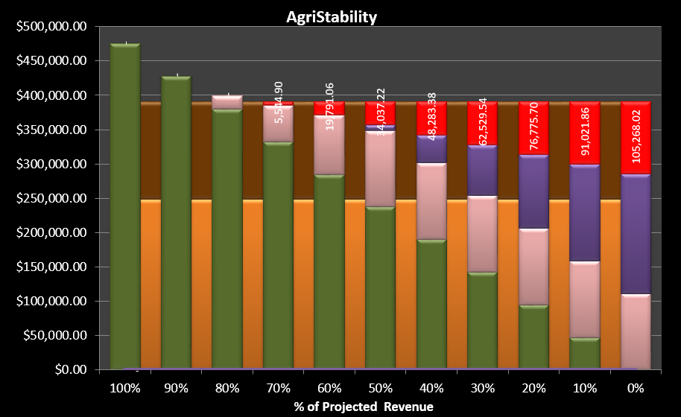
Ag Risk Management Projector™ Modelling
Twolane Farms Ltd. – AgriStability
Reference Margin of $227,317
AgriStability coverage is pink and purple
AgriStability triggers at approximately 15% revenue loss for this farm (with costs remaining equal in the background)
AgriStability pushes the first loss scenario into profitability and many of the red losses have disappeared.
Any kind of modelling is possible, but it needs to be done for YOUR specific farm; everyone’s results are different!

Slide 18
False vs True
FALSE:
A lot of Bison producers are not in AgriStability because it wouldn’t trigger/doesn’t work for them.
TRUE:
AgriStability never triggers/doesn’t work for Bison producers when they are not enrolled in the program – the program never works for producers who don’t enrol. In the past, AgriStability may not have been as responsive for certain Bison producers because their reference margins were limited, but limiting of reference margins has been gone since 2019.

Slide 19
Common AgriStability Errors
“Wow, I’ve had my worst year ever and I’m not getting an AgriStability payment!
What might be wrong?”
01
02
03
04
A problem with structure change.
Structure change detail can be requested from your AgriStability Administration and review the productive units to make sure they are accurate.
Allocation errors between allowable and non-allowable income & expenses.
Producers should learn what the allowable and non-allowable items are and set up their chart of accounts so they are kept separate.
Inventory isn’t priced correctly (non-published commodities).
Producers should always provide a price for non-published commodities and send in support for the price as additional information.
Accrual adjustments are wrong.
Producers should learn something about accrual accounting and utilize a method of preparing the AgriStability application that will incorporate some checks and balances * If mistakes were made, you have only 18 months to correct them by Adjustment Request.
… or you didn’t really have the worst year ever and actually lost less money/made more money than you thought
Notes:
Mention the fact that MNP offers a full-service approach to AgriStability (outside Quebec only)

Slide 20




Appropriate Use of Advisors
When selecting a financial consultant or financial advisor, be sure to choose one who has the heart of a teacher. ~ Dave Ramsey ~
…Consider the following statements as clients of a financial advisor…
Is the financial advisor helping the client increase knowledge and improve records?
Does the financial advisor help the client understand accrued financial statements and use them as a tool to manage and improve the business?
Does the financial advisor help the client understand the various business risk management programs and how to utilize them as risk management tools?
Does the financial advisor ask questions about the client’s business / accrued financial statements / business risk management programs, which in turn gets them asking questions and engaging in those various processes?

Slide 21
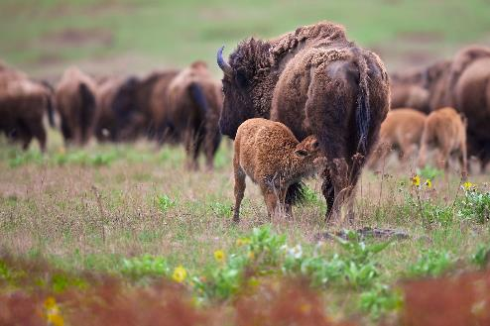
Concluding Remarks
What is the maximum amount of equity you are prepared to put at risk on an annual basis?
Any potential benefits from AgriStability are predictable
If you don’t understand;
  Your accrued financial statements
  Why AgriStability didn’t work in the past;
  The impact of recent program changes to your margin;
  The circumstances that it could work for your farm;
  You can’t say it won’t work in the future.

Slide 22
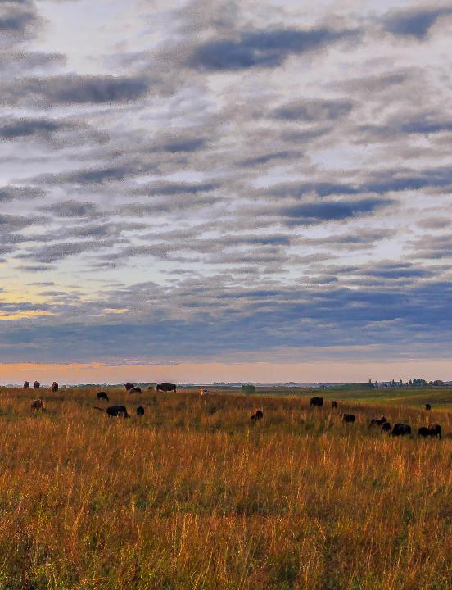
When considering the circumstances under which AgriStability could work for your farm, plan for the unforeseeable. For example…
“I am a dairy farmer and we have supply management, so we will never need AgriStability.”

Slide 23
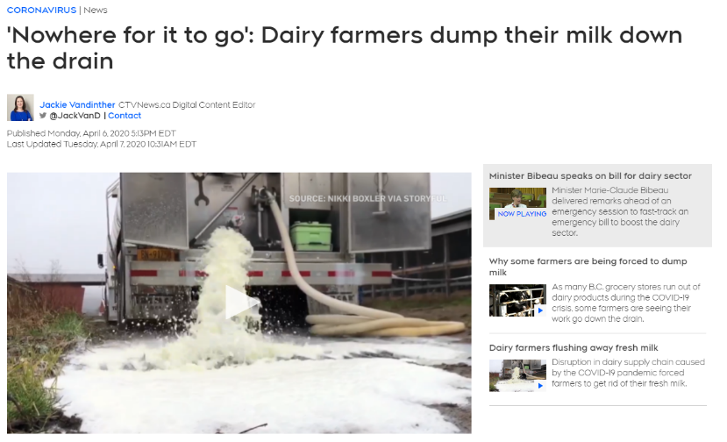
…and then this happened…
Vandinther, J. & CTVNews.ca (Eds.). (2020, April 7). “Nowhere for it to go”: Dairy farmers dump their milk down the drain. Coronavirus. Retrieved October 19, 2022, from https://www.ctvnews.ca/health/coronavirus/nowhere-for-it-to-go-dairy-farmers-dump-their-milk-down-the-drain-1.4884951

Slide 24
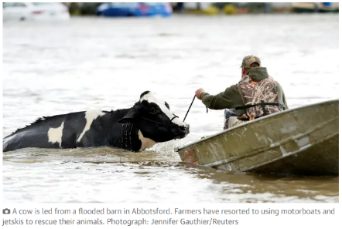

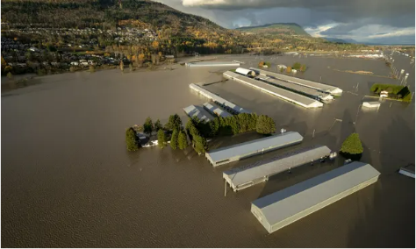
…and then this happened…
Cows that were stranded in a flooded barn are rescued by people in boats and a sea doo after rainstorms lashed the western Canadian province of British Columbia, triggering landslides and floods, and shutting highways, in Abbotsford, British Columbia, Canada November 16, 2021. REUTERS/Jennifer Gauthier
(Above) Canada floods leave thousands of farm animals dead and more trapped. (2021, November 22). The Guardian. Retrieved October 19, 2022, from https://www.theguardian.com/environment/2021/nov/18/canada-floods-leave-thousands-of-farm-animals-dead-and-more-trapped
(Above) Canada floods leave thousands of farm animals dead and more trapped. (2021, November 22). The Guardian. Retrieved October 19, 2022, from https://www.theguardian.com/environment/2021/nov/18/canada-floods-leave-thousands-of-farm-animals-dead-and-more-trapped

Slide 25
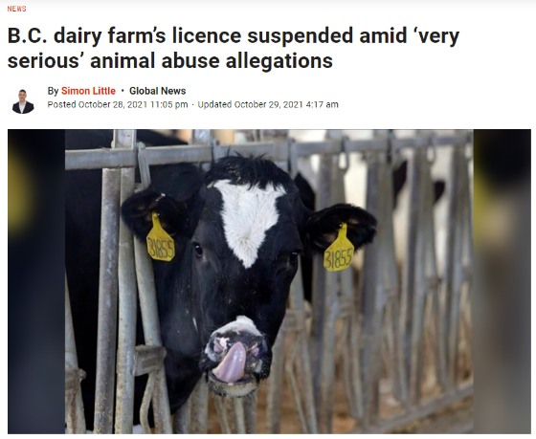
…oh yeah, and this could happen too…
A dairy cow is seen in this undated file photo. THE CANADIAN PRESS/AP/Michael Conroy
B.C. dairy farm’s licence suspended amid ‘very serious’ animal abuse allegations. (2021, October 29). Global News. Retrieved October 19, 2022, from https://globalnews.ca/news/8334418/bc-dairy-farm-animal-abuse-allegations/

Slide 26
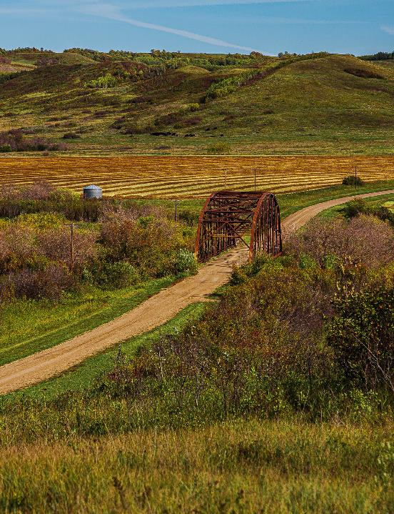
…but if you can’t predict the unforeseen things for the Bison sector, how can you plan for them? Consider this…
If you understand what drives your profitability and AgriStability margin, and know the sensitivity of those things to change, you will understand that a 15% revenue drop, give or take, is not much. So AgriStability is part of taking care of your unforeseen.

Slide 27

AgriStability, AgriInvest and Risk Management Resources

Slide 28
AgriStability
A means of insuring the income stream for your farm
  Deadline to sign up for the 2023 AgriStability program is April 30, 2023
  There is a government fee of $315 per $100,000 of margin coverage to be paid up front by a specified deadline.
  Deadline to submit the final program application for 2022 AgriStability is September 30, 2023 (June 30, 2023 in Ontario.
  Potential government support would be in the tens of thousands, hundreds of thousands, or up to $3 million dollars, depending on farm size and types of other coverage available.
  It is very important to know what your AgriStability reference margin is, what makes it up and the sensitivity of various components to create margin drops of greater than 30%
Reference Sources:
Source #1: AFSC How AgriStability Works Video 2020 to 2022 program years (an Alberta video, but still very good for learning)
Source #2: CAP AgriStability Program Handbook (Agriculture and Agri-Food Canada or AAFC) https://agriculture.canada.ca/en/agricultural-programs-and-services/agristability/resources/agristability-canadian-agricultural-partnership-program-handbook

Slide 29
AgriStability Enrolment
Province | Toll-free | Website
Alberta | 1-877-899-2372 | Agriculture Financial Services Corporation
British Columbia | 1-877-343-2767 | British Columbia Business Risk Management Branch
Ontario | 1-888-247-4999 | Agricorp
Prince Edward Island | 1-855-251-9695 | Prince Edward Island Department of Agriculture and Land
Quebec | 1-800-749-3646 | La Financière agricole
Saskatchewan | 1-866-270-8450 | Saskatchewan Crop Insurance Corporation
Manitoba, New Brunswick, Nova Scotia, Newfoundland and Labrador, Yukon | 1-866-367-8506 | Agriculture and Agri-Food Canada
AgriStability is delivered in Manitoba, New Brunswick, Nova Scotia, Newfoundland and Labrador and Yukon by the federal government. In British Columbia, Saskatchewan, Alberta, Ontario, Quebec, or Prince Edward Island, AgriStability is delivered provincially.

Slide 30


AgriInvest
A means of building a savings account for your farm
Each year you can contribute 1% of your Allowable Net Sales to an AgriInvest bank account.
The government matches the contribution.
Allowable Net Sales are gross sales minus purchases of allowable commodities grown on your farm.
Steps to apply: 1. Complete the AgriInvest form (a cash basis income statement); 2. File the form by the deadline – September 30 of the following year (June 30 in Ontario).
Then follow the instructions and deadline on the Deposit Notice that comes by mail.
Withdrawals can be made at any time.
If you are not in this program, you probably should be!
Reference: AgriInvest CAP – Handbook (AAFC) https://agriculture.canada.ca/en/agricultural-programs-and-services/agriinvest/resources/agriinvest-canadian-agricultural-partnership-program-handbook
Government Matching
Farmer
BANK
$$$

Slide 31
MNP’s Full-Service Approach to ARMR
AgriStability
Ag Risk Management Projector
Our AgriStability applications include calculation of the reference margin and payment potential, including structure change impacts
Provides a valuable means of comparison with the Administration assessments
Helps you to manage your reference margin and better manage your farm
An accrued financial statement projection on which we can overlay AgriStability and other risk management programs to determine how those programs might work together to help mitigate losses for a specific farm and year
Helps you to manage risk and the profitability potential of your farm
Notes:
This slide is for presentations outside of Quebec only

