Slide 1
Drought Proofing Farm or
Reducing the Risk of Drought
(for a year)
Canadian Bison Association 39th Annual Convention
Nov 27-29, 2022
Lorne Klein
306-861-9235

Slide 2
Thankyou!
Saskatchewan Ministry of Agriculture
Rangeland and Forage Agrologist
1992-2020
regular contact with producers, researchers, ministry and industry agrologists

Slide 3
Presentation Content
75% Learned at Ministry of Agriculture
25% Learned at Home

Slide 4
Two categories of reducing risk
Physical Management of the Land and Resources
Administration Management
1. SCIC Rainfall Insurance
2. Livestock Decisions

Slide 5
Our Operation
Francis, Sask – 40 miles SE of Regina
Moist Dark Brown Soil Zone
Soil Textures: loam, silty clay, clay
Moderate Salinity

Slide 6
Our Operation - 2022
105 Bison Cows
Yearling Heifers grazed through summer
880 acres fenced (160 rented)
900 acres hayed (800 buy standing)
poor quality soil – cut half each year
160 acres cropland in reserve

Slide 7
18 Paddocks, 6 Dugouts
20-160 acres
Grazing period range 7-30 days
All paddocks grazed once during May 1 to Oct 31
Five paddocks grazed again during winter bale feeding
Winter feeding paddocks are grazed later next spring

Slide 8
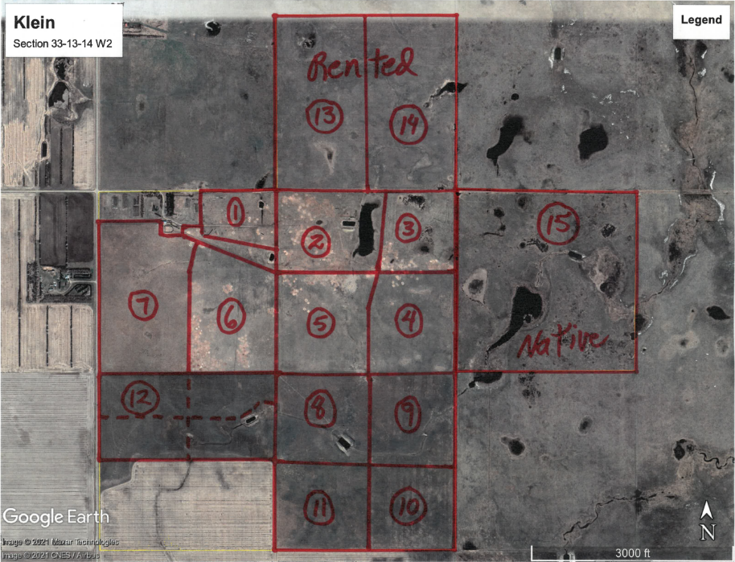

Slide 9
Reducing the Risk of Drought
Plans need to be in motion during normal moisture years

Slide 10
Reducing the Risk of Drought on Pasture
Every Year in April my thoughts are:
Expect it
Plan for it
Manage for it

Slide 11
In a Nutshell
Retain moisture when and where it falls
Rapidly growing plants – dry out soil – soak up next rain

Slide 12
Trap Snow

Slide 13
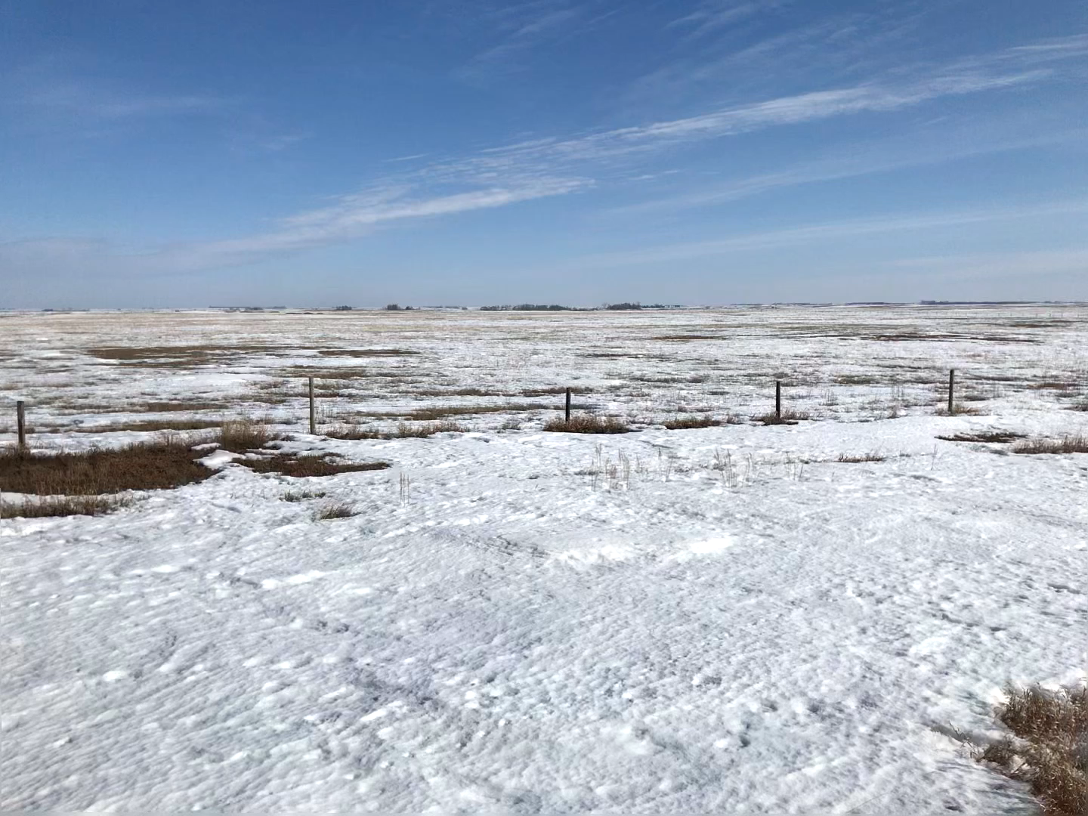
April 2022
Field grazed July only

Slide 14
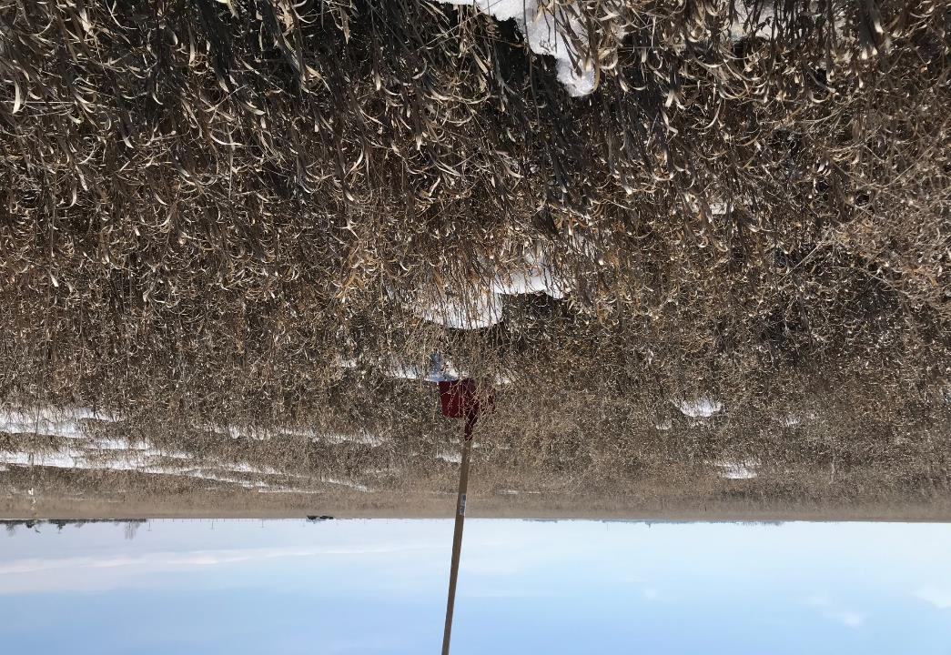
Paddock 7
April, 2022
Snow had been
Approximately
18 inches
Field grazed
May only

Slide 15
You can create your own drought
Lack of soil cover, standing vegetation
Higher evaporation due to higher soil temperature and wind speed

Slide 16
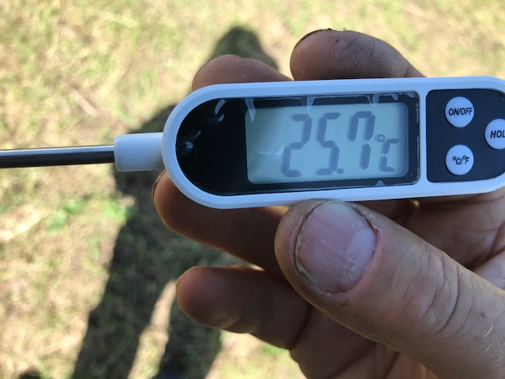
Air Temperature
In Shade
25.7°C

Slide 17
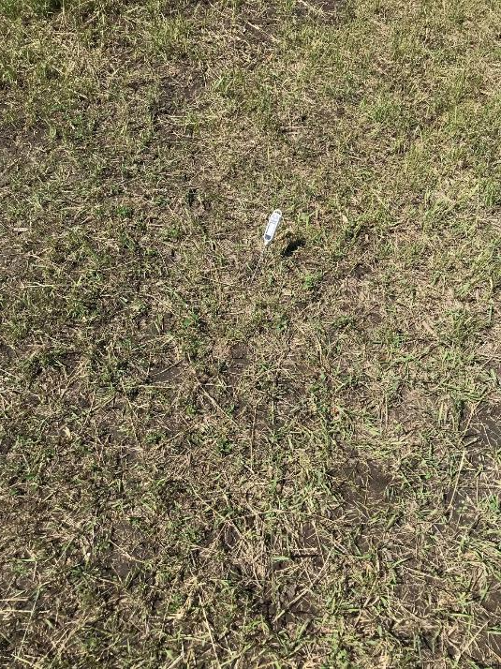

Slide 18
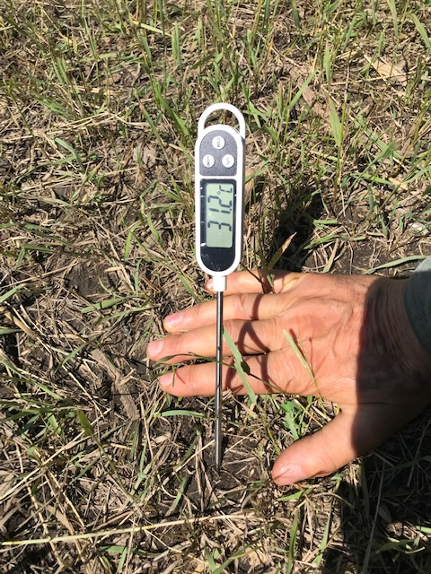
31.2°C

Slide 19
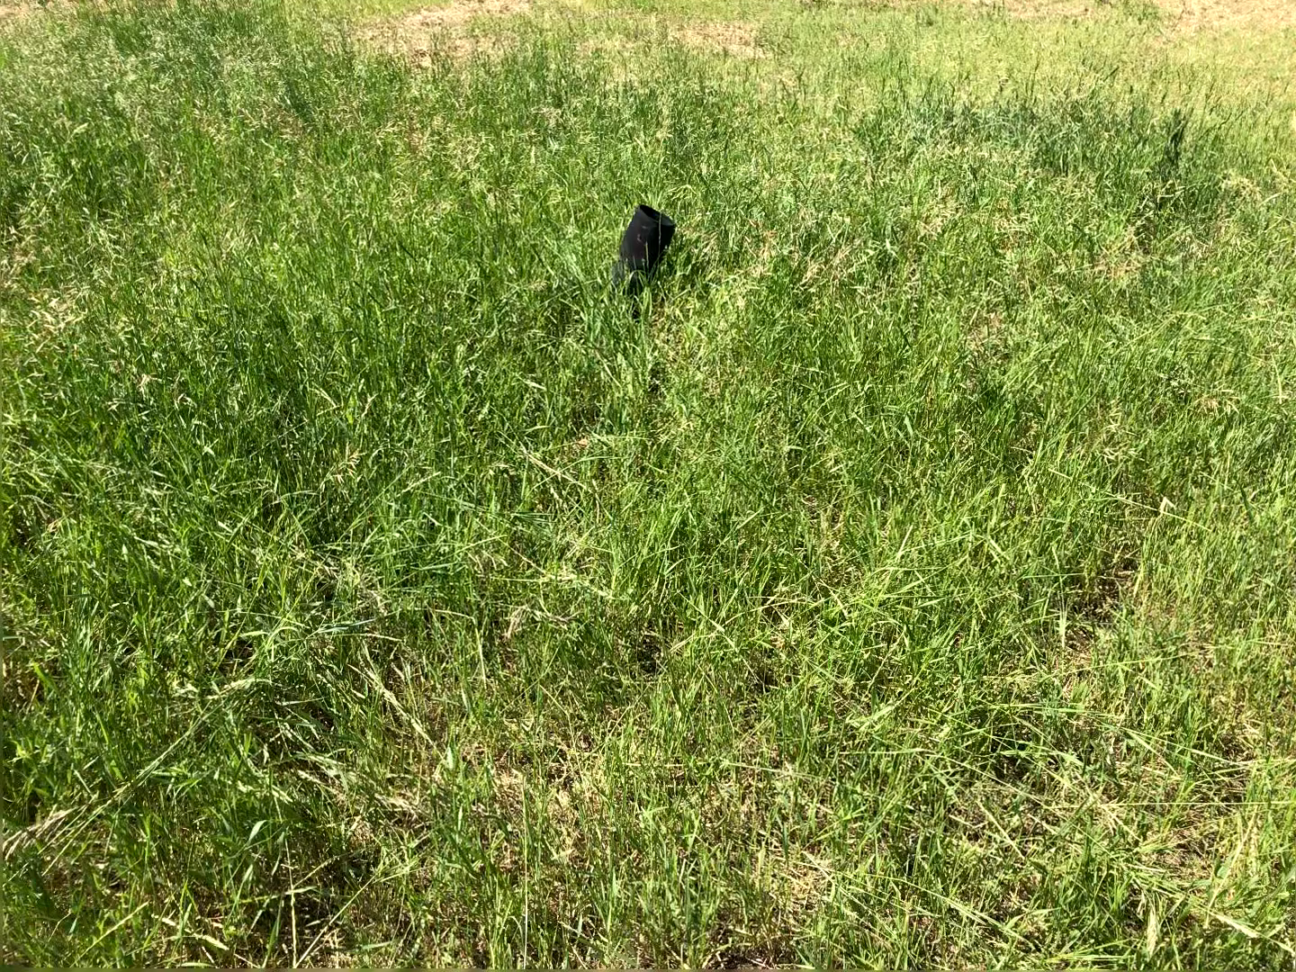

Slide 20
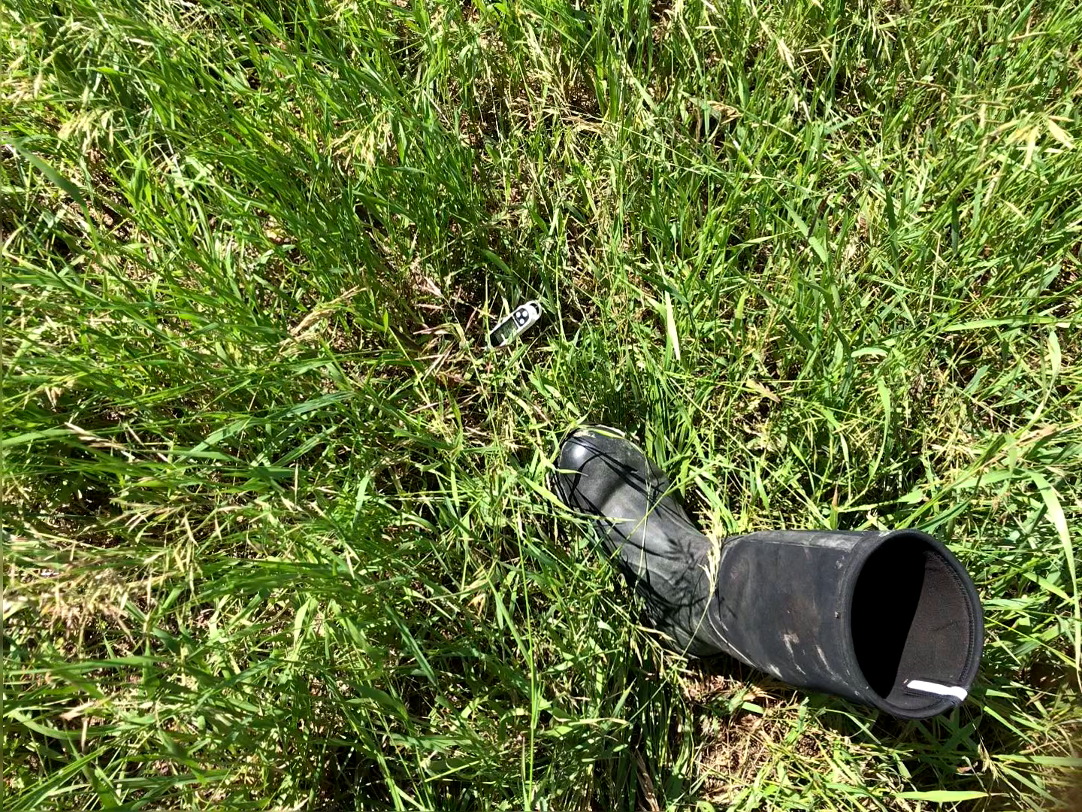

Slide 21
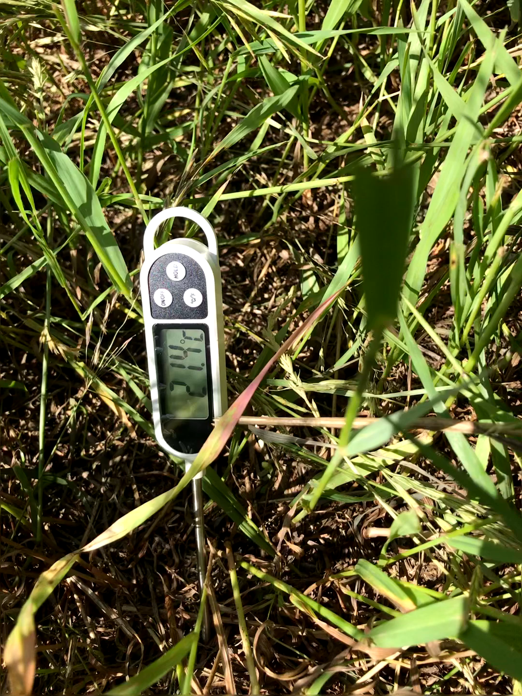
21.4°C

Slide 22
Carryover Feed
Standing Grass
Hay Bales
Pellets
Oats

Slide 23
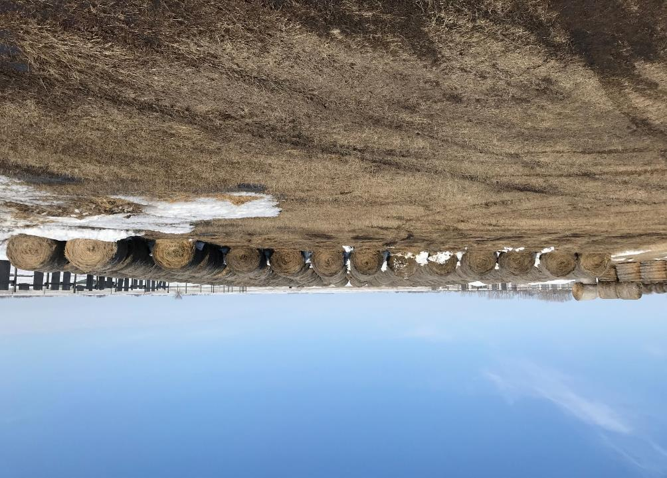
Hay Yard
End of Winter
April 2022

Slide 24
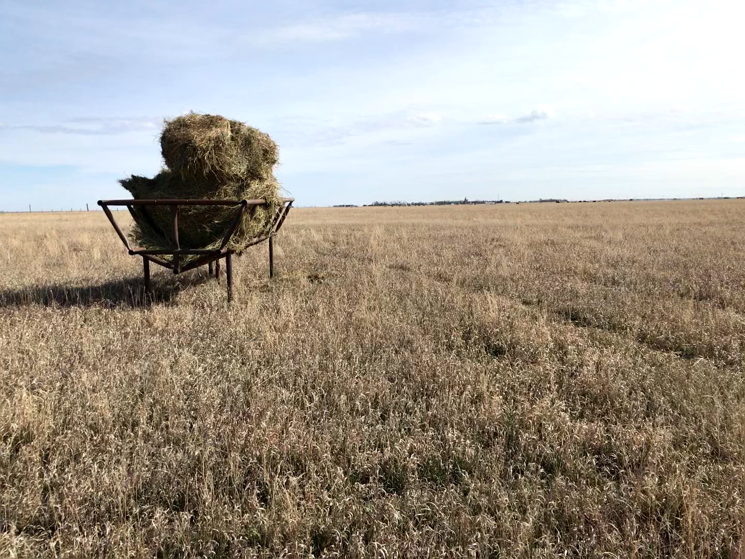
Paddock 7
Early May, 2022
Supplement
Best Quality Hay
10% of intake

Slide 25
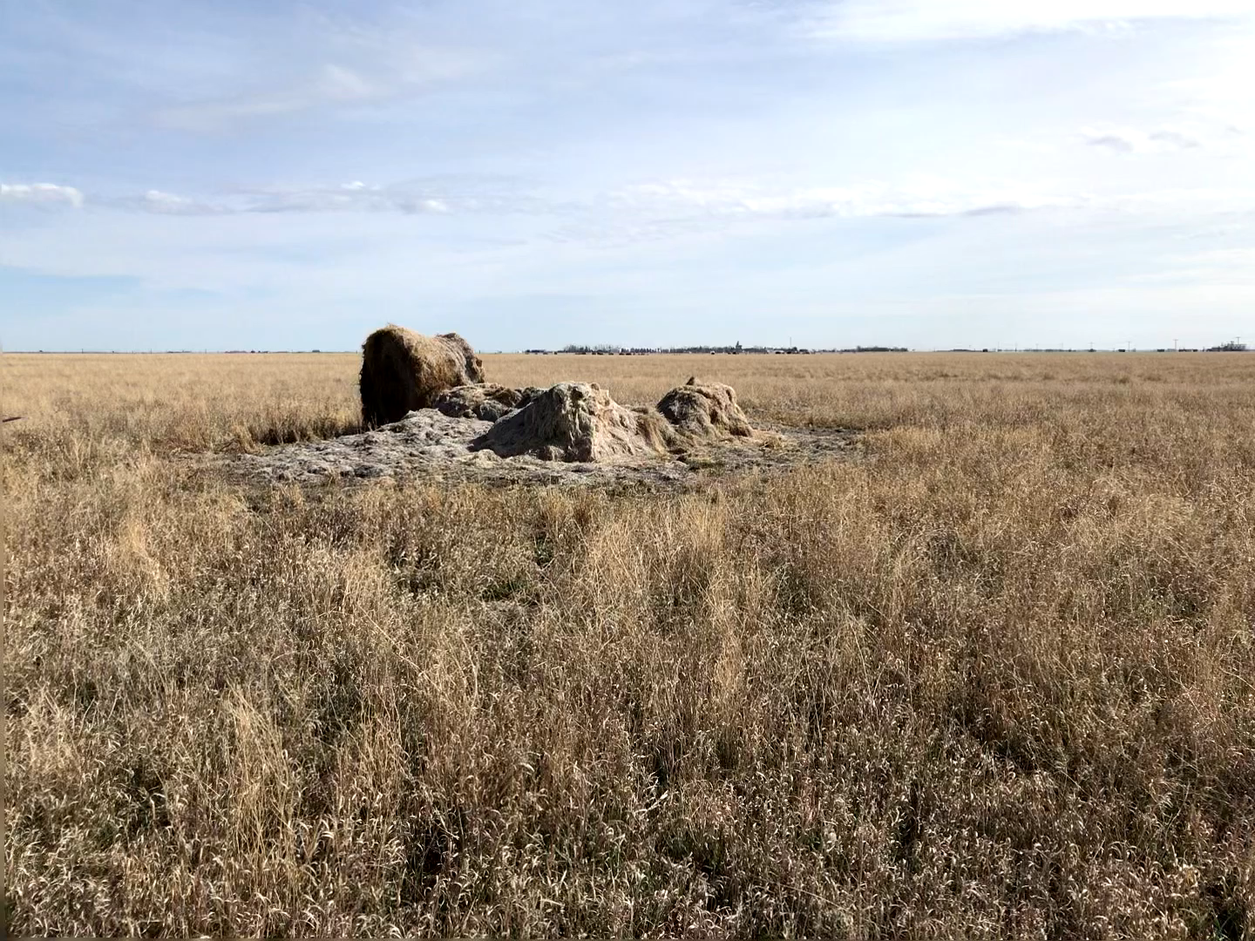
Paddock 7
May 1, 2022
Flax Straw

Slide 26
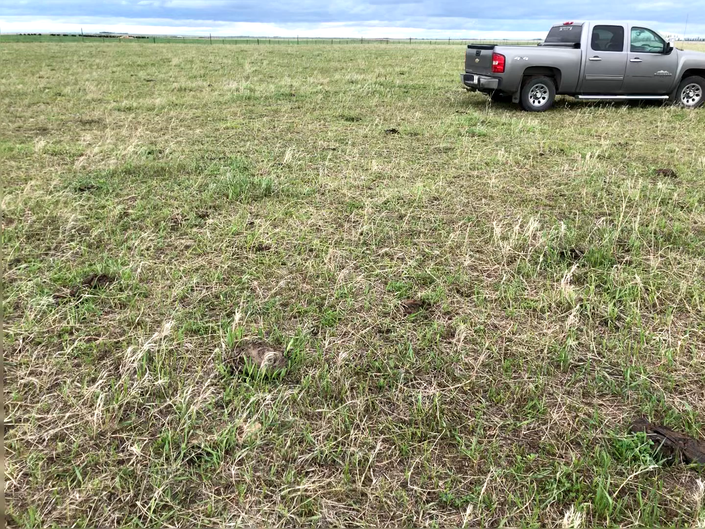
Paddock 7
May 31, 2022

Slide 27
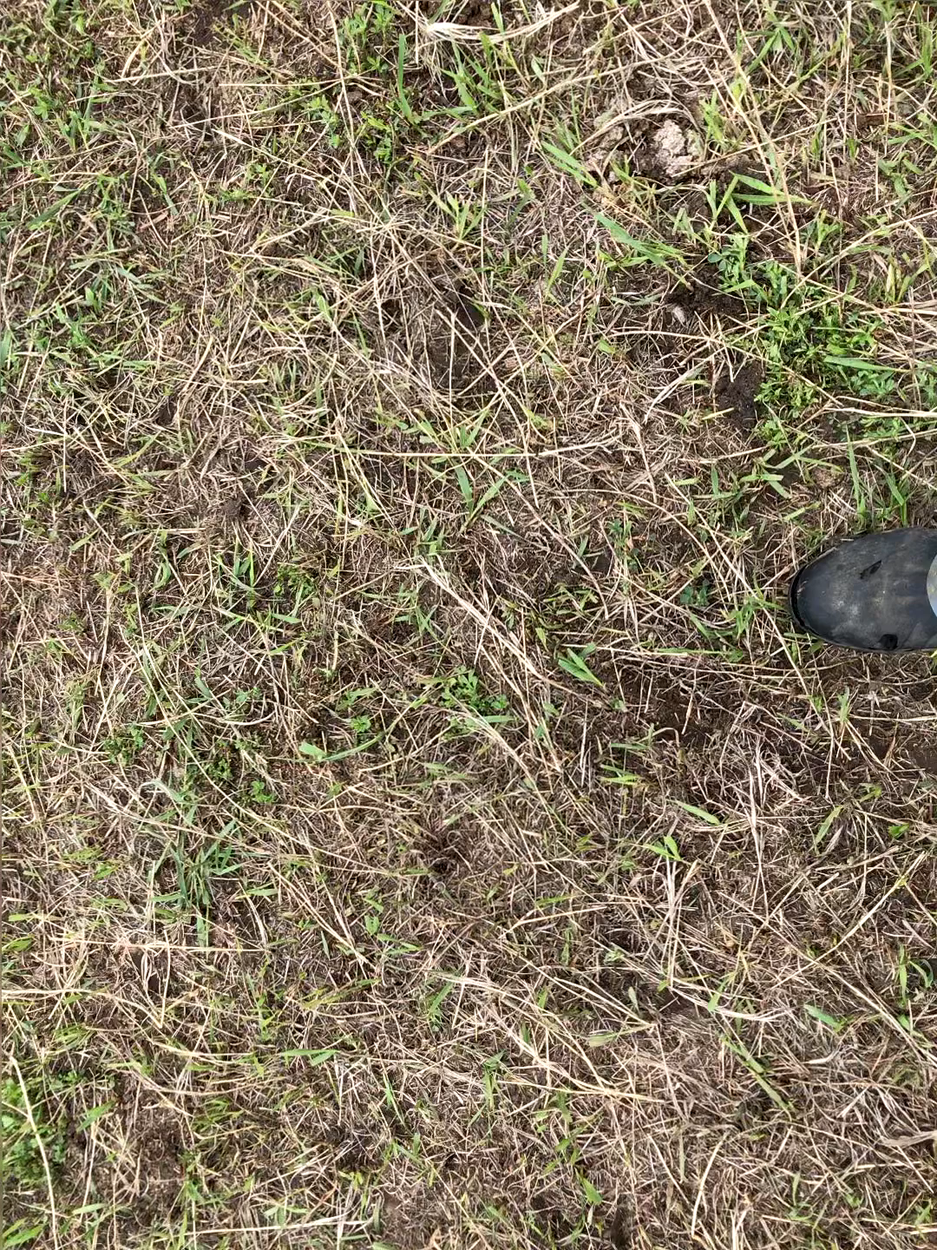
Paddock 7
May 31, 2022

Slide 28
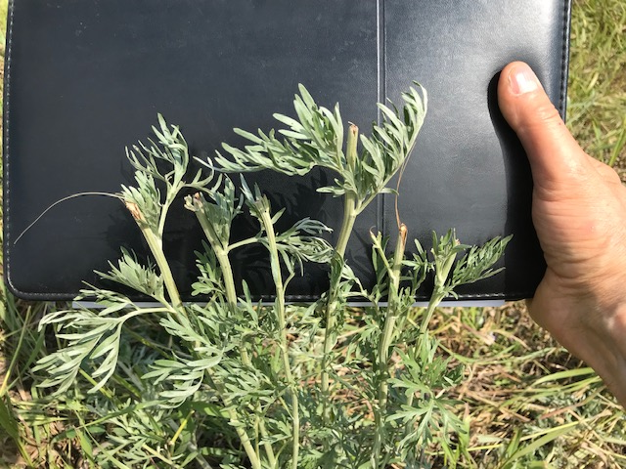
Absinth
Top 20% grazed
Trampling

Slide 29
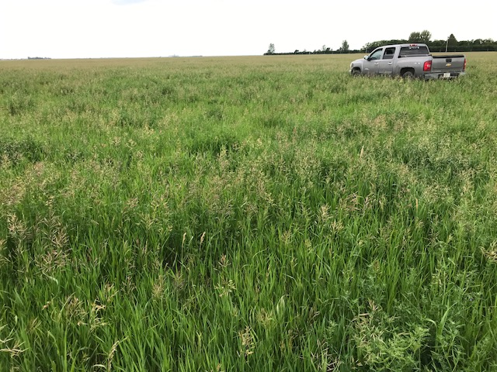
Paddock 7
July 1, 2022
30 days regrowth

Slide 30
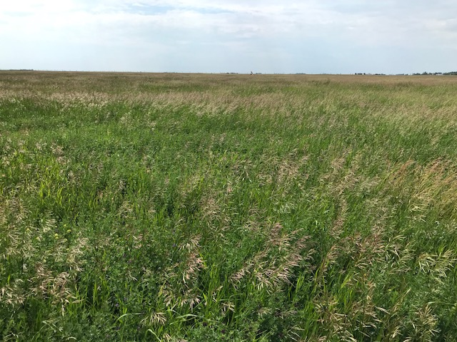
Paddock 11
40 acres
July 1, 2022
Rest in 2022 ??

Slide 31
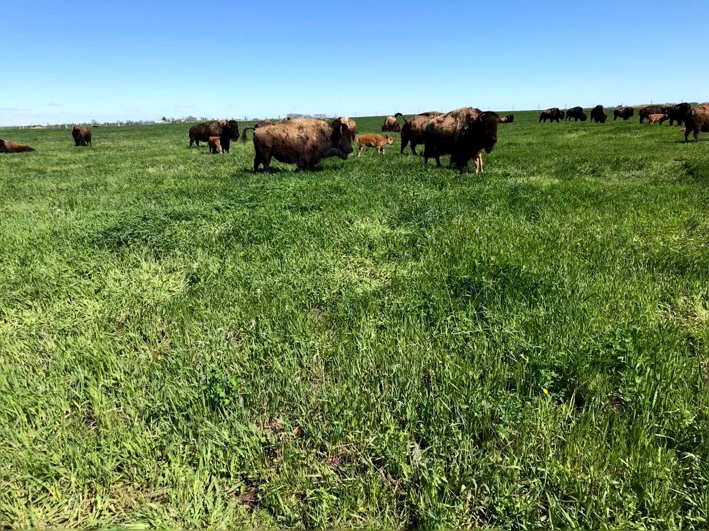
Second
Paddock of
Season
Early June 2022

Slide 32
Have as many acres as possible ready to absorb the downpour
Rapid growing plants to get the soil dry
Litter/Trash/Residue

Slide 33
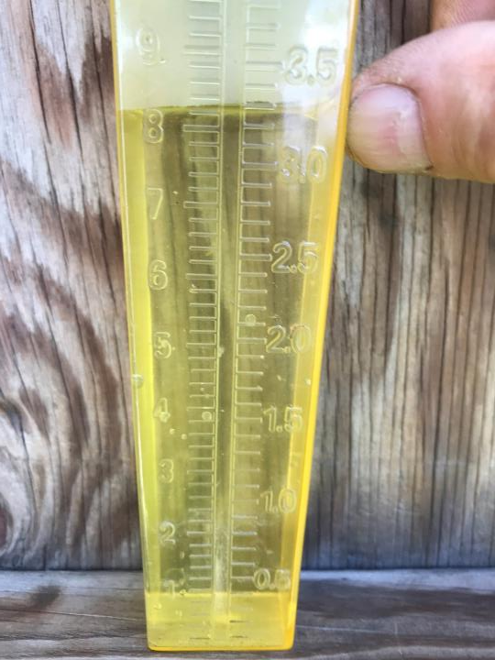

Slide 34
Grassers
30% of grazing pressure – readily marketable livestock

Slide 35
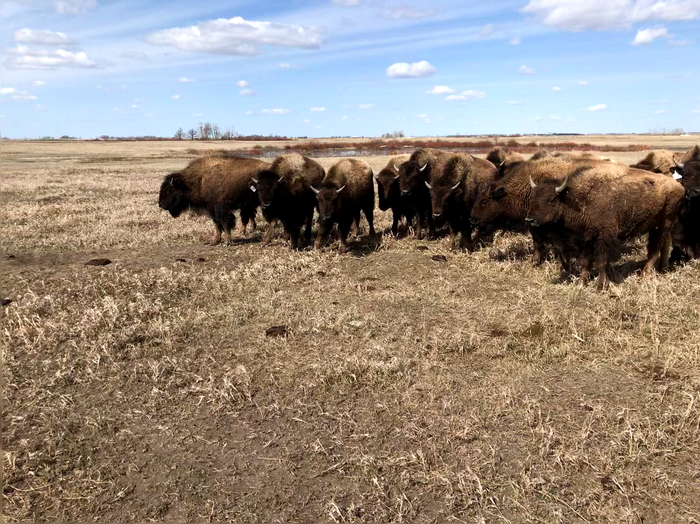
Yearling Females

Slide 36
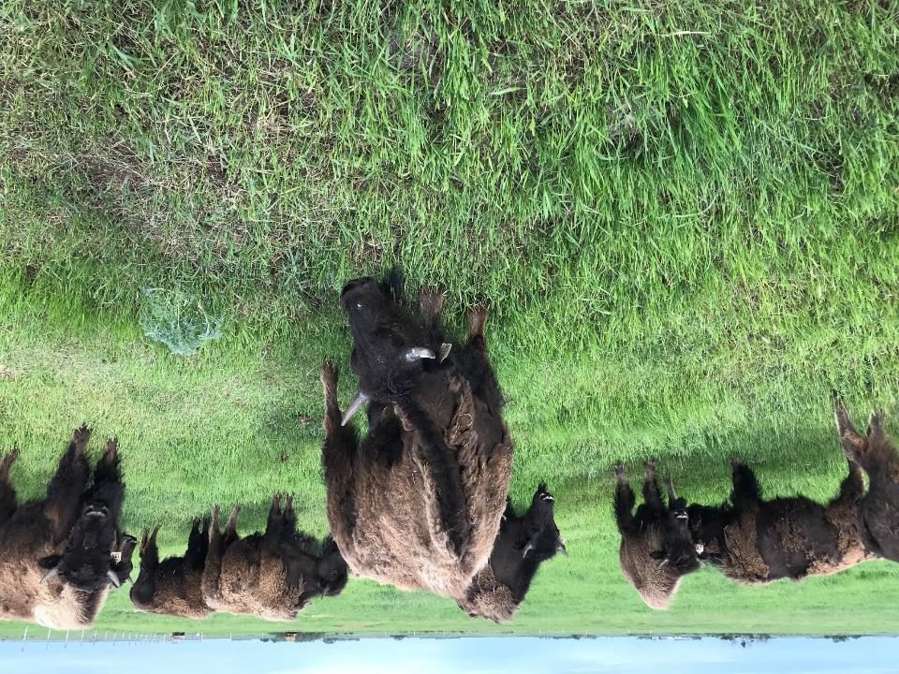

Slide 37
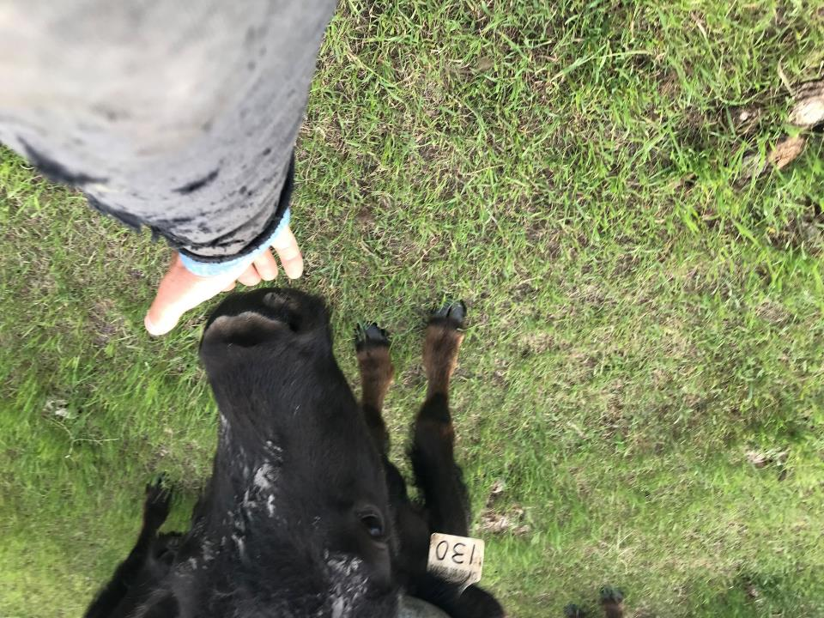

Slide 38
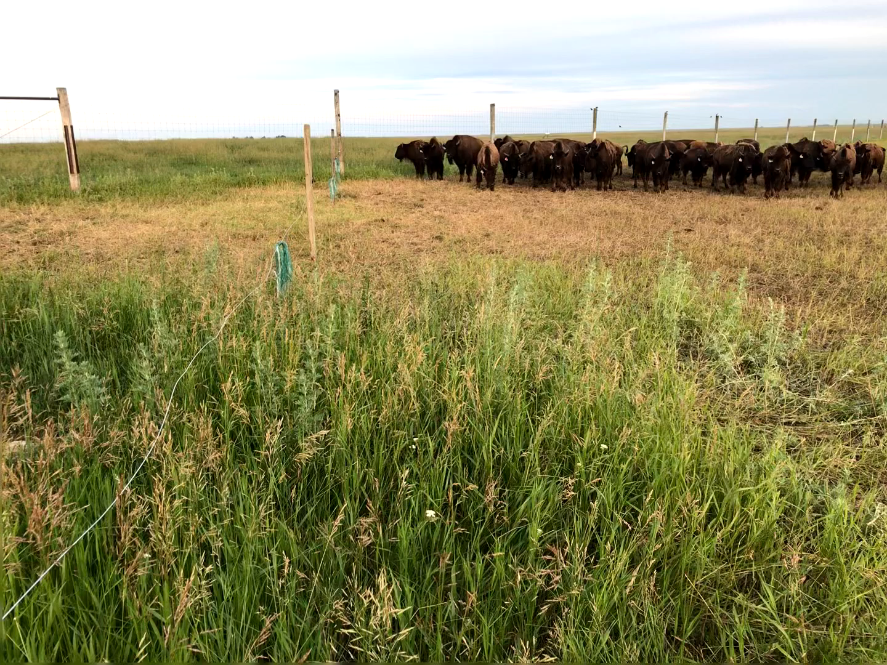
Yearling
Females

Slide 39
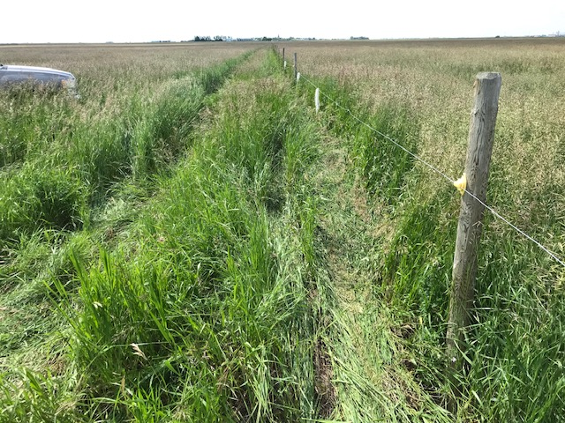
Electric fence
July 1, 2022

Slide 40
Livestock Water
All six dugouts are fenced and water is pumped
You can pump the last foot - can’t have them walking in for the last foot

Slide 41
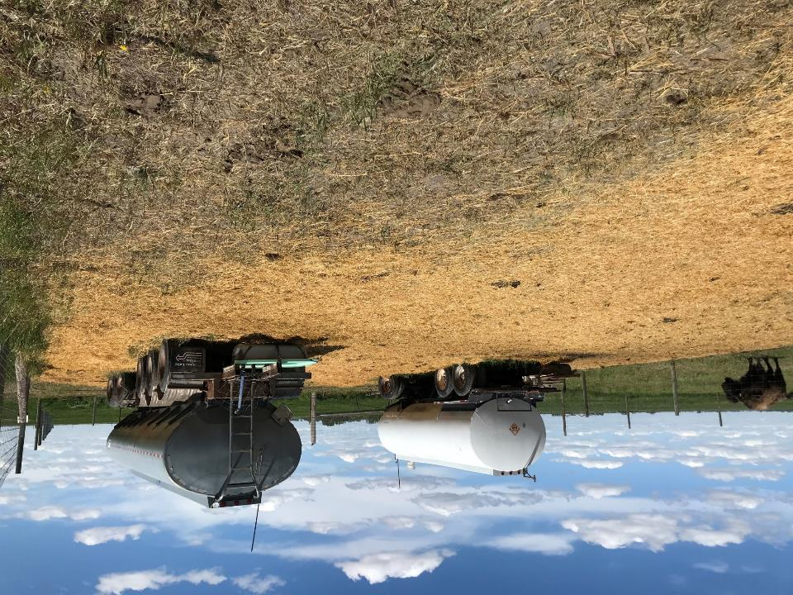

Slide 42
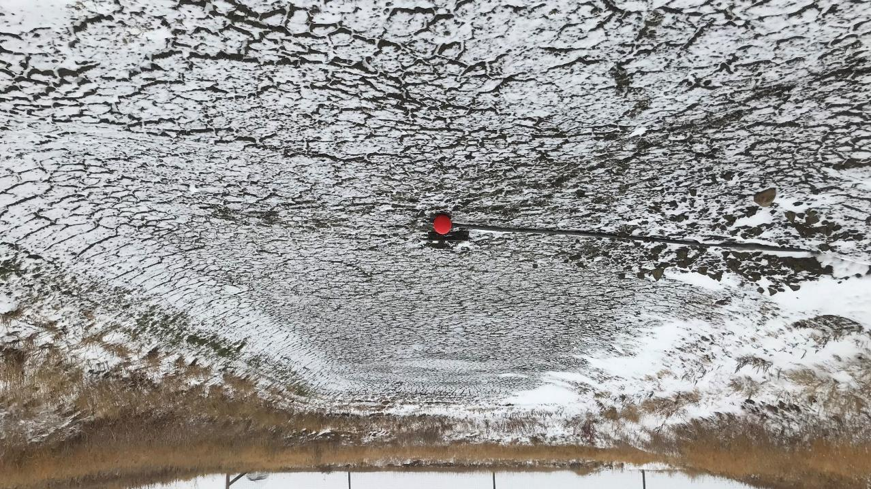

Slide 43
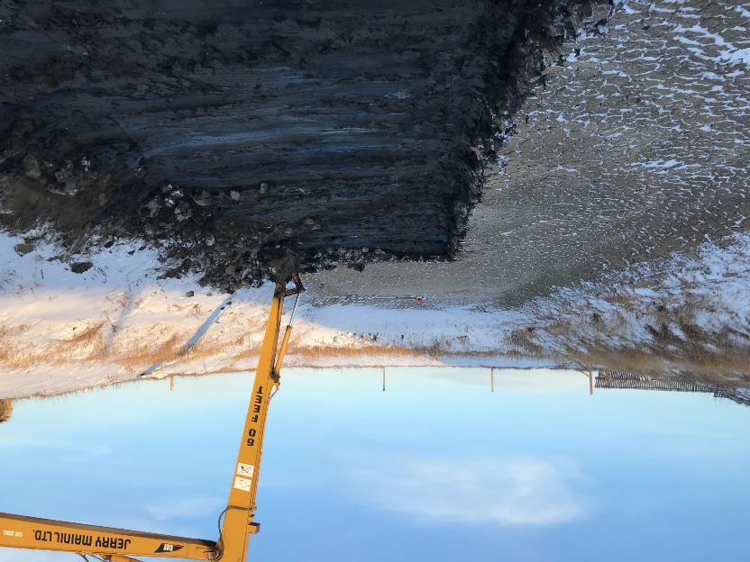

Slide 44
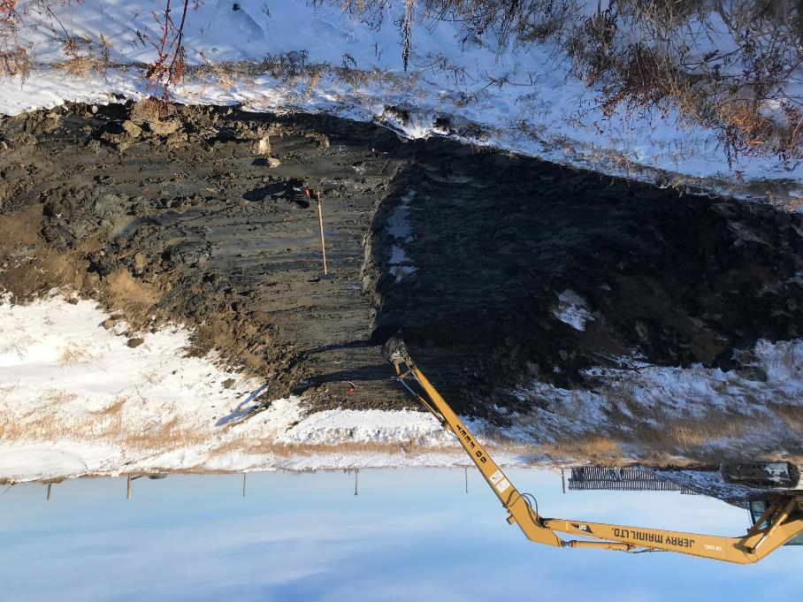

Slide 45
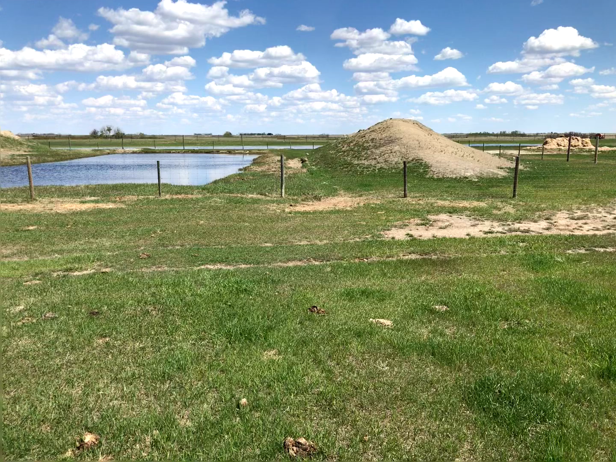

Slide 46
Soil Fertility
Have spread commercial fertilizer
Main Practice – winter feed on pasture
Western Beef Development Centre
Winter feed on pasture – ___% nitrogen recovery
Winter feed in corral, spread manure –
____% nitrogen recovery

Slide 47
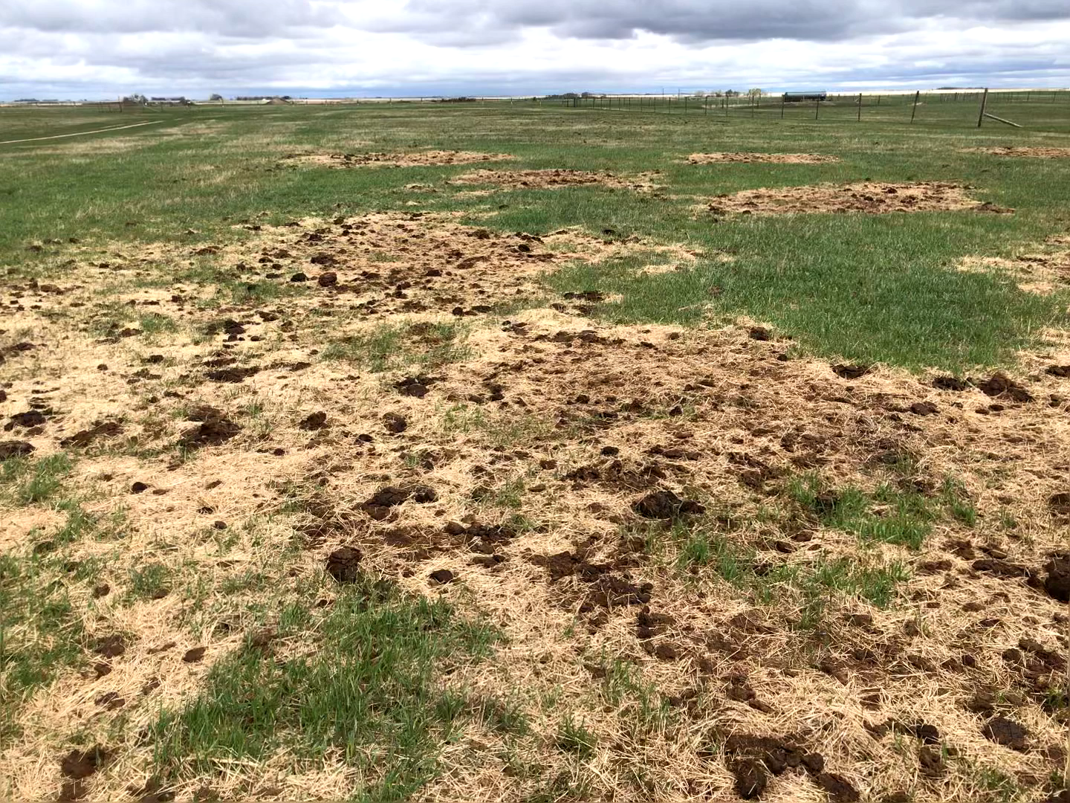

Slide 48
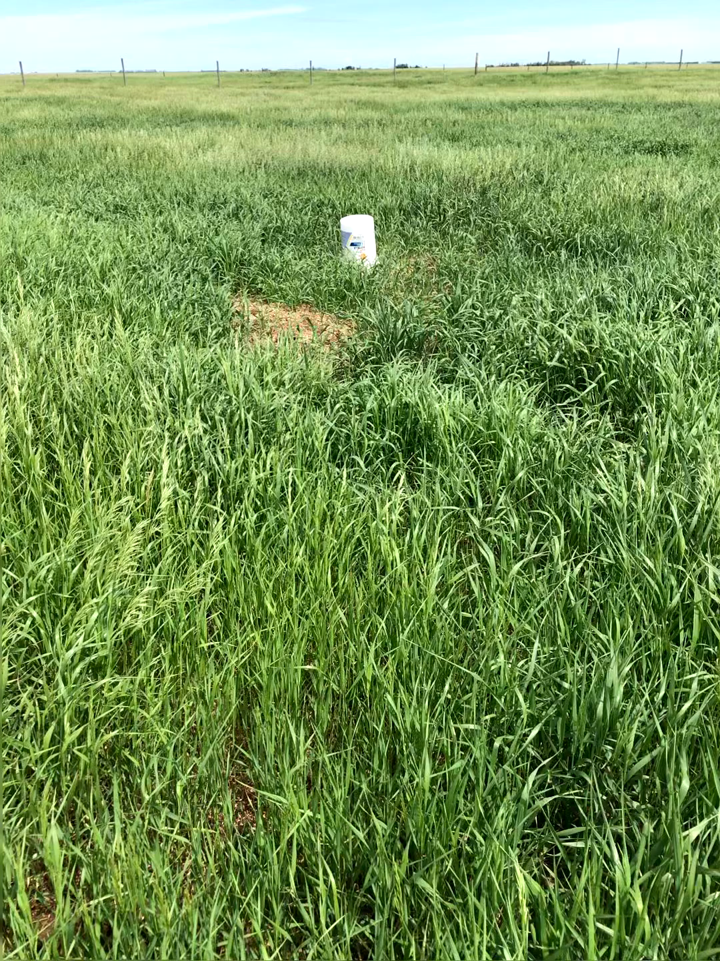
Bale Graze
Excessive residue at pail
1-2 years to recover

Slide 49
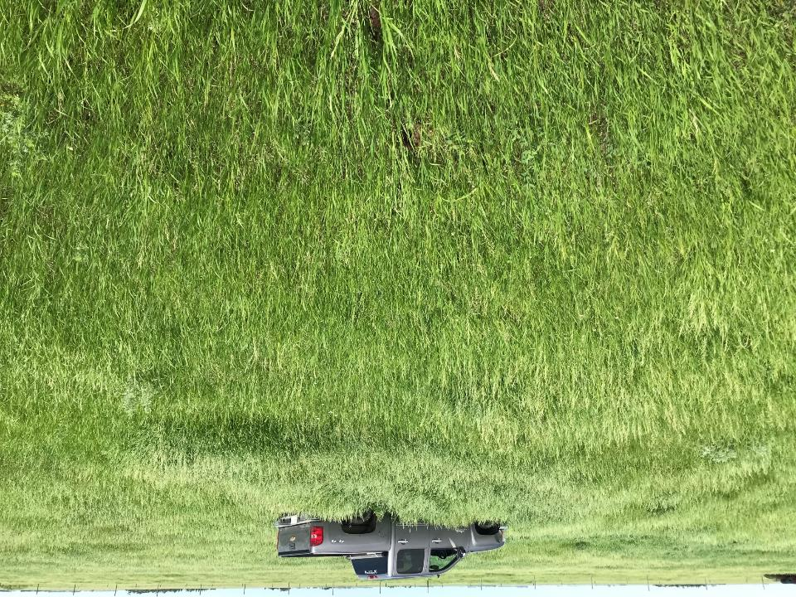
Bale Graze
70 year minimum
smooth brome

Slide 51
Early Wean
Beef calves are fully functioning ruminants
@ 90 days
Wean and dry up cow
Wean and market cow

