Slide 1
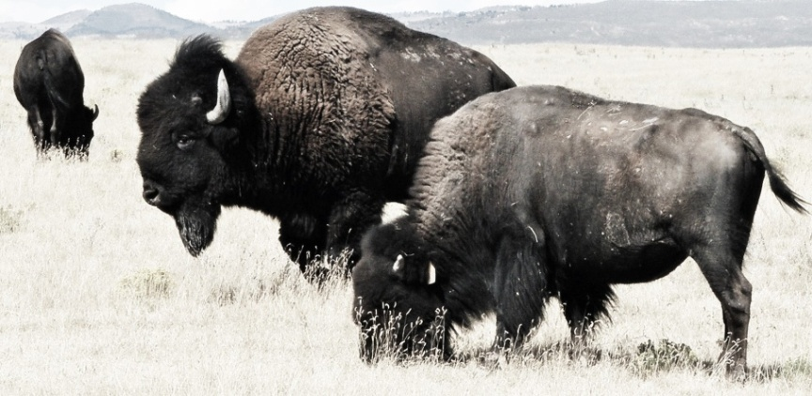
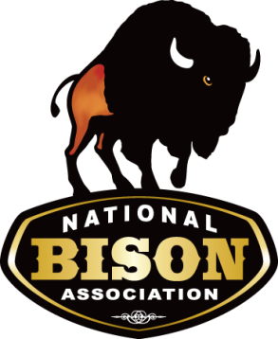
National Bison Association Industry Update
Jim Matheson, NBA Executive Director
Canadian Bison Association – November 2022

Slide 2
Current Bison Marketplace
  October 2022 - $3.80/lb. - Young Bulls-USDA AMS
    Young Heifers - $3.60/lb.
    October 2021 - $3.87/lb. – Young bulls
    Nov. 22nd Prime Beef Steer- $2.33/lb.
  2011 – 2022: Young bull price - $4 - $5/lb.
    Over a decade of stability at a sustainable price
    Increasing market share key to sustaining strong prices
  2022 Federal Processing up 10% over 2021 YTD
    Not including state-inspected
    2021 processing up 5% over 2020
    Straight to market

Slide 3
Direct Marketer Report
2022
Capitalizing on COVID bump
Demand is stable
  Ground bison sales are steady, tough to source middle meats, but improving in 2nd/3rd quarter
Supply is adequate, expected to tighten in 23’ or 24’
  Due to anticipated decline in calf crop, herd reductions
Pet food sales increased significantly in 2022
2023 Outlook
Questions abound about economy/recession
Continued growth of foodservice sales anticipated
Overall, cautious optimism due to economy

Slide 4
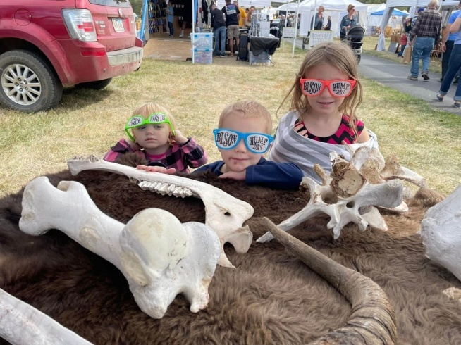
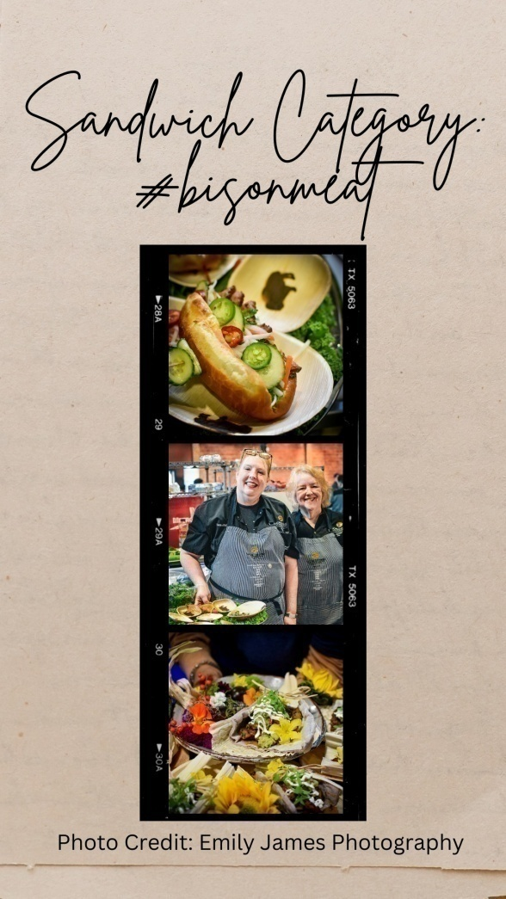

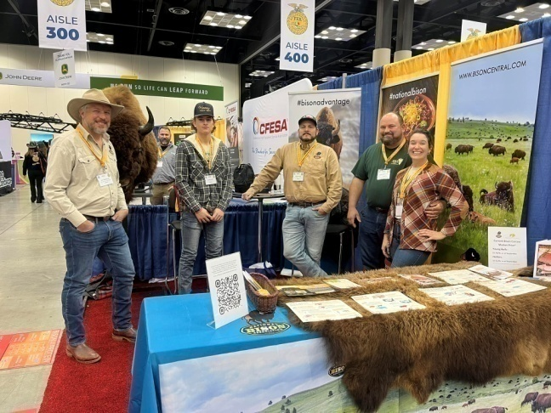
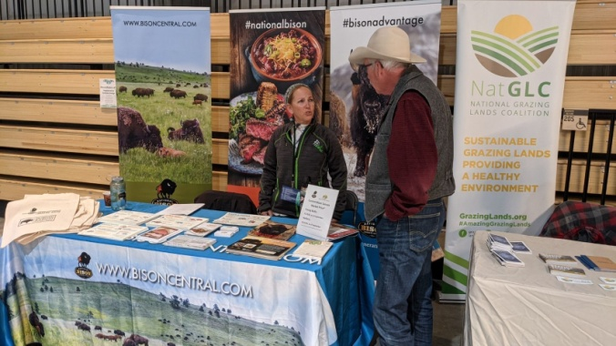
Bison 2022 Outreach Campaign

Slide 5


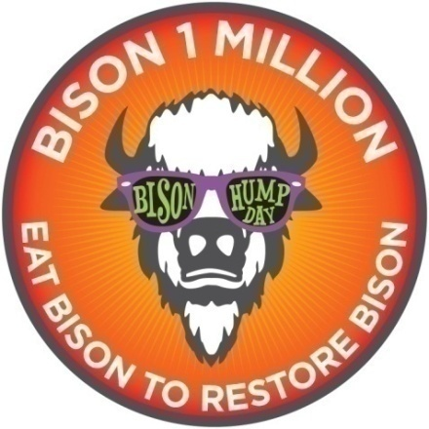
Regenerative by Nature
Promoting bison as the regenerative protein choice.
NBA trademarked the term “Regenerative by Nature” for its membership to utilize in their own marketing efforts.
  Graphics available online.
Bison are being recognized for their role in regenerating grasslands, soils and the species itself.
Key to capturing carbon
Helping consumer be a
“Partner in Restoration”

Slide 6
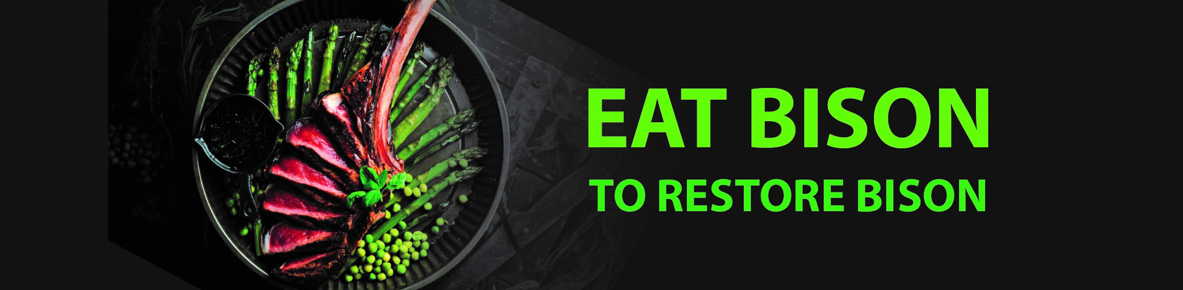
Eat Bison to Restore Bison Campaign
Pursuing a consumer campaign to raise awareness of bison meat to the general public
“Good for You, Good for Bison, Good for the Planet”
Three-month Google Ads campaign targeting search, websites and YouTube
Focusing on Taste, Nutrition, Restoration, Regeneration
Promoting bison as a North American Delicacy

Slide 7

Center of Excellence for Bison
Officially established Sept. 2020 at SDSU
  Collaboration between SDSU, NBA, and
  the National Buffalo Foundation
$324,194 awarded to eight projects in 2021
Two more herd health related studies funded in 2022
  Mycoplasma bovis and Bison Mineral Supplements
The Grass is Always Greener – USDA Climate Smart
  Begins in January 2022 - $80 million grant
  5 year project to develop market for Climate Smart bison
  $6MM bison portion administered by the NBA

Slide 8
Herd Health
Mycoplasma bovis
  2022 less severe than 2021 in northern Plains states
  NBA Fact Sheet/M. bovis taskforce
  US producers eligible for compensation for death loss
  USDA ARS Vaccine Development
  Assessing factors that influence the virulence of Mycoplasma bovis – Univ. of Wyoming/COE
Malignant Catarrhal Fever (MCF)
  USDA ARS vaccine development at WSU/UWY
  Vaccine very effective on rabbits, testing cattle now
  January 2023 – Univ. of Wyoming live bison trials
2022 USDA APHIS study – 2nd epidemiological survey

Slide 9
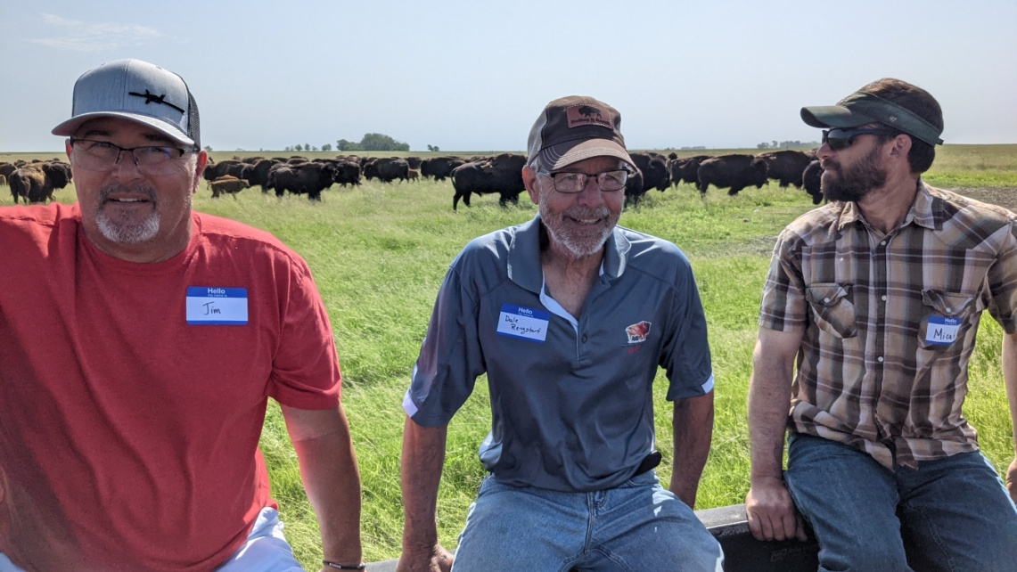

Regenerative Ranch Tour Workshops
NBA granted funding from North Central SARE program to conduct six field days on working bison ranches over next two summers
$40,000 – two-year grant
Six field days, three per summer:
  2022 – IL, ND, SD
  2023 – MN, OH, WI

Slide 10
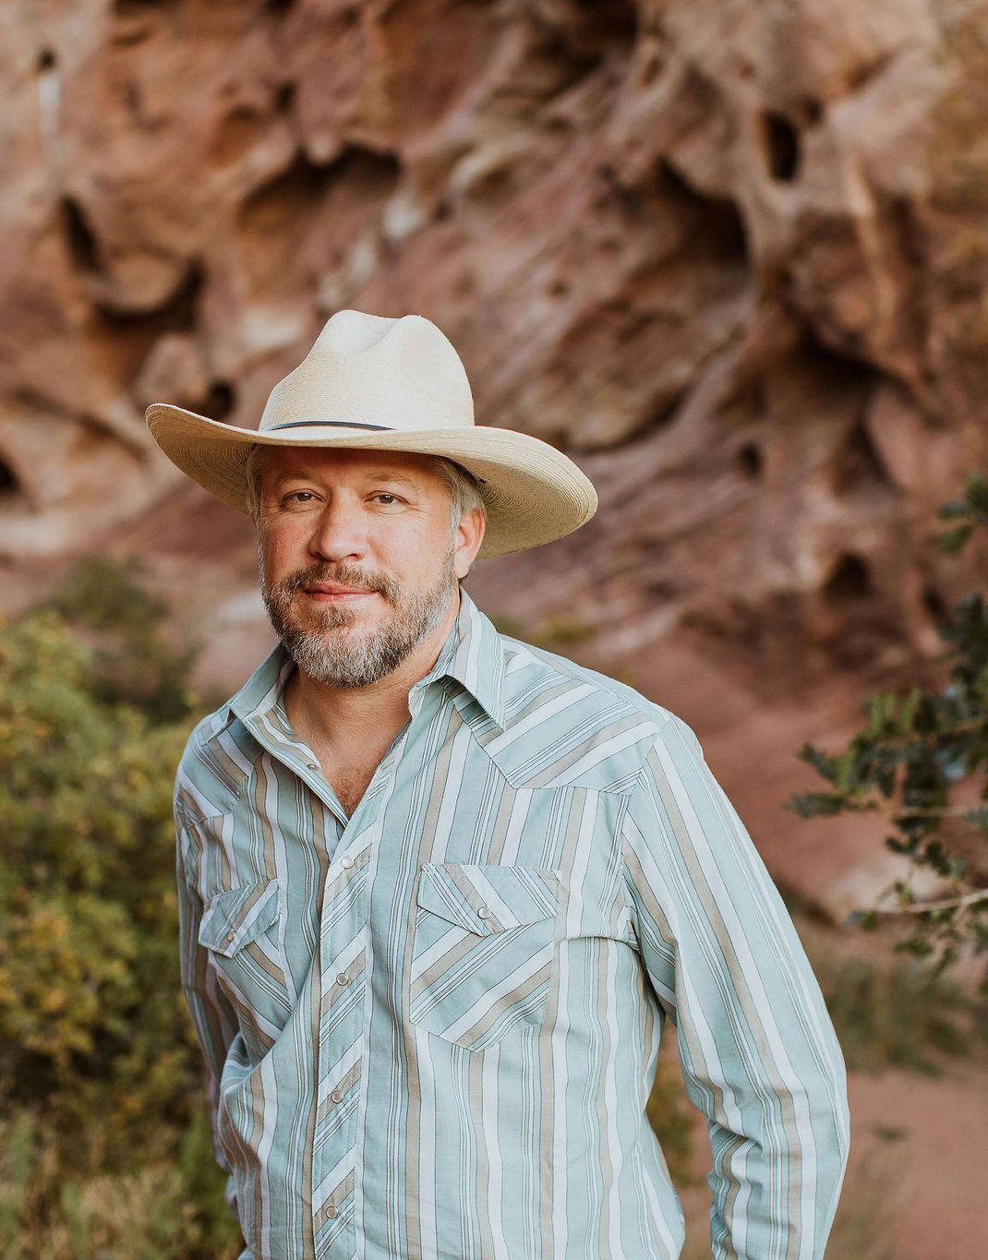
Thank you! Questions?
  Jim Matheson
  303-292-2833, ext. 700
  jim@bisoncentral.com
  www.bisoncentral.com
  @nationalbison

Slide 11
Bison as a non-amenable species
NBA Board of Directors did not adopt a position
May 2022 – USDA notifies NBA of listening sessions
  Commercial Marketers Committee – no support voiced
June 2022 – Listening Sessions in SD and CO
  SD – Tribal stakeholders
  CO – Commercial stakeholders
Concerns from membership:
  Field slaughter
  State-inspected product trade impacts
  Testing and use of “USDA-approved” labs
  30-month rule – no spinal column or high risk materials
  No carve-outs if bison becomes amenable
  USDA FSIS September meeting – no changes planned

