Slide 1


The
Canadian Journey to
Social License / Public Trust
The Dynamic World of Agri-Food
Kim McConnell C.M.
November 28, 2022

Slide 2

It’s a Changing World

Slide 3

It’s a world where …
Perceptions are real … & facts are negotiable
The gap between ‘science’ and ‘science fiction’ is getting narrower
…
      Yet the gap between ‘urban &rural’, and ‘East & West’ is widening
The ‘world of abundance’ is being replaced by ‘a period of scarcity’
We need to build infrastructure … but NIMBY

Slide 4
Water, land, air, and food are interlinked
‘Environmental stewardship/sustainability’ is as important to consumers as ‘nutrition and food safety’
Green energy is the future … but I need diesel fuel now!
Our food has never been safer … yet consumers have never been more concerned
The ‘AAA’s driving the global food system
    Availability
    Accessibility
    Affordability

Slide 5
Sustainability, supply chain and software are three important ‘S-words’ driving business
“I need a job” is being replaced by “I can’t find labour”
Cashflow is king … and inflation is concerning
‘Polarization’ is growing … and concerning!
  We seem to know what we’re against … but what are we for!!
  Anger is elevating
Everyone (and every country / province) is focused on ‘what’s best for me’ … today

Slide 6

People love ‘new and innovation’ … almost as much as they despise change
There’s no failure to innovate … but there is a failure to communicate.
Lawyers, courtrooms and insurance influence/drive decision making
Transparency is not only expected … it’s demanded
‘Values’ are as important as ‘value’
Trust is diminishing
… in everything

Slide 7
It’s a changing world!

Slide 8
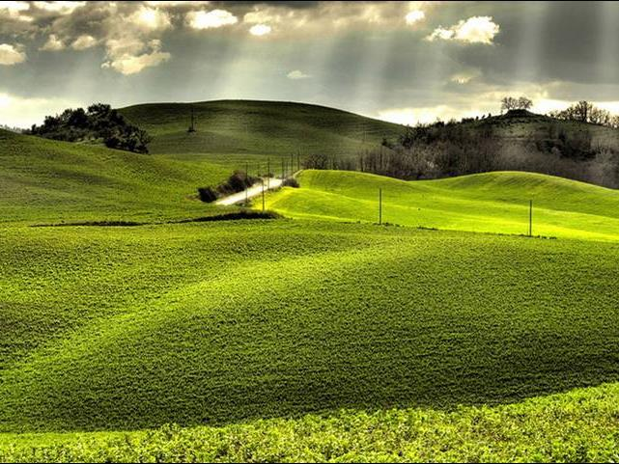
Proud to be in Agriculture
Notes:
Kim – Purpose of presentation
Goal – provide you with a brief overview of the exciting and changing world of agriculture in Canada
A few ‘Ah Hays’ or “I didn’t know that!” - in 20 minutes we won’t be getting in to a lot of detail
Also for those of you who work for McDonald’s AND those who work with McDonald’s, we thought we might offer a few insights on the great work that people like Jeff Kroll, Scott Gibson, Jeff Fitzpatrick-Stillwell and Ailene McDougall have been doing to advance and support Canada’s agricultural industry, we thought we would provide you a bit of an overview and explain why this is SOO important to our industry.

Slide 9
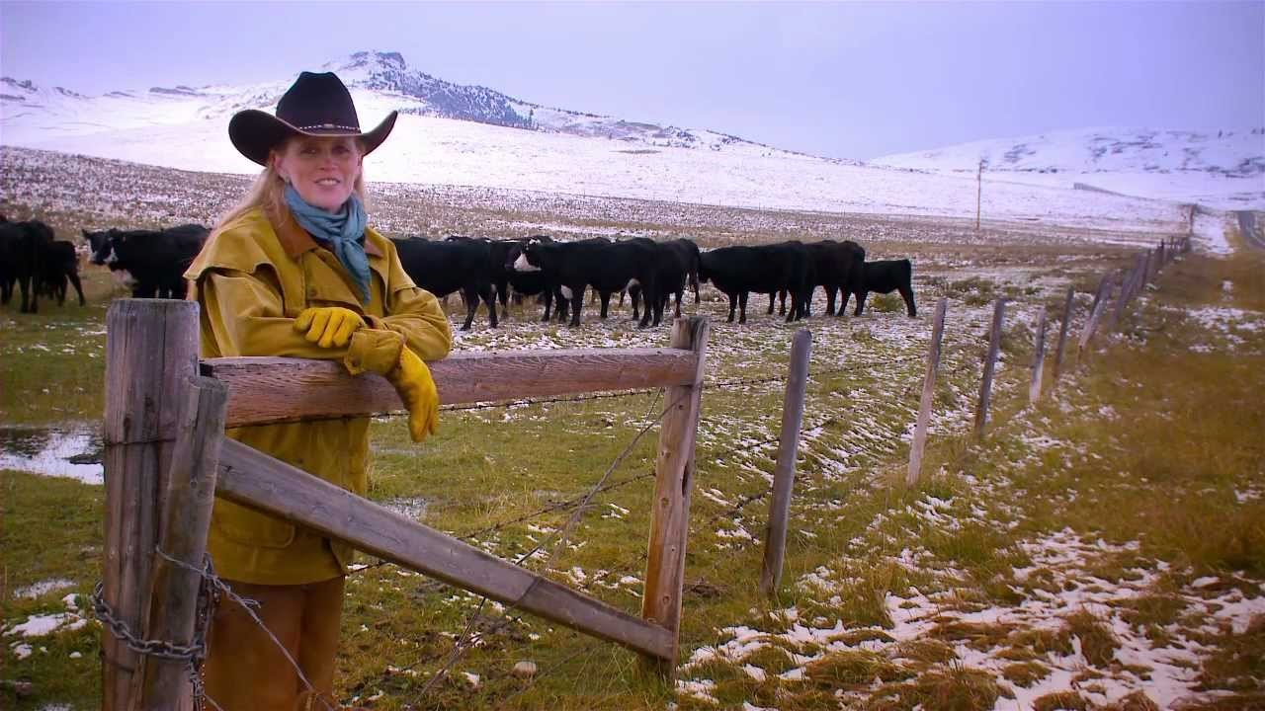

Slide 10
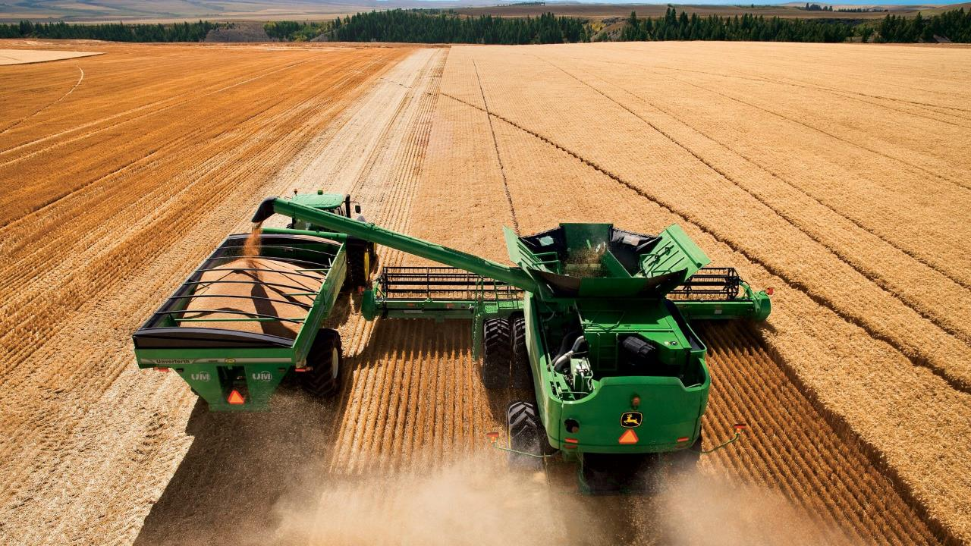
3.5 days - 3,600,000 loaves of bread
“No time in history has so few fed so many … and at so little cost
We grow food and feed people

Slide 11

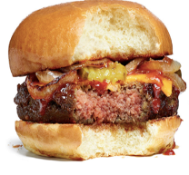
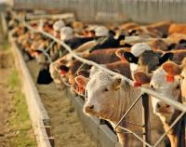

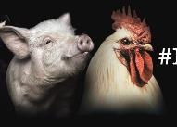
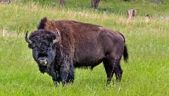
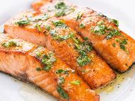
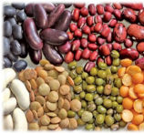
Protein Excellence

Slide 12
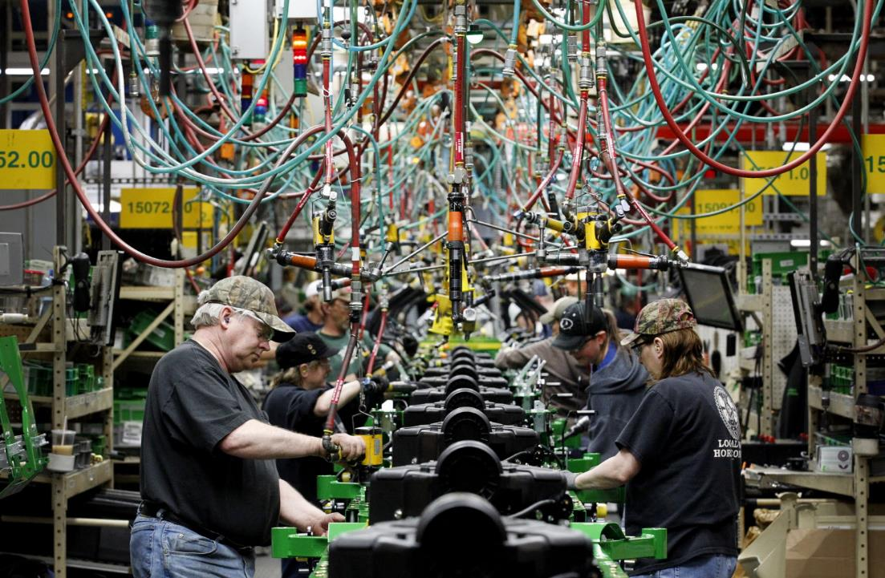
We create jobs

Slide 13
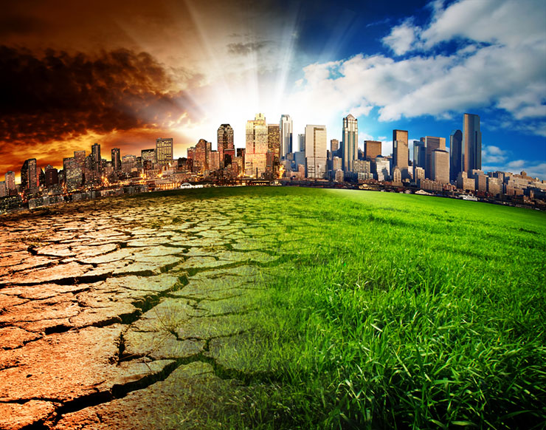
We are a
solution to climate change
Agriculture is an industry that can sequester more carbon than what Mother Nature’s already sequestering

Slide 14

Farmers are Super Heroes
Who else can feed the planet
AND
save it at the same time?

Slide 15


Slide 16

Game Changers

Slide 17


1. Covid-19
Reconnected public to food
Challenged supply chains
Who do you trust?
Enhanced attraction to a
rural lifestyle and real estate
We’re done with the Covid pandemic … but is it done with us?

Slide 18
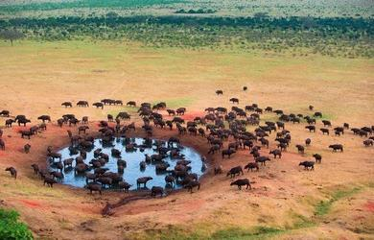
        2. African Proverb:
‘When the waterhole shrinks, the animals look at each other differently.’

Slide 19
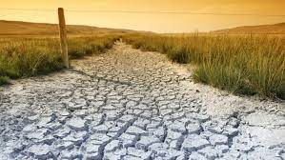

Slide 20
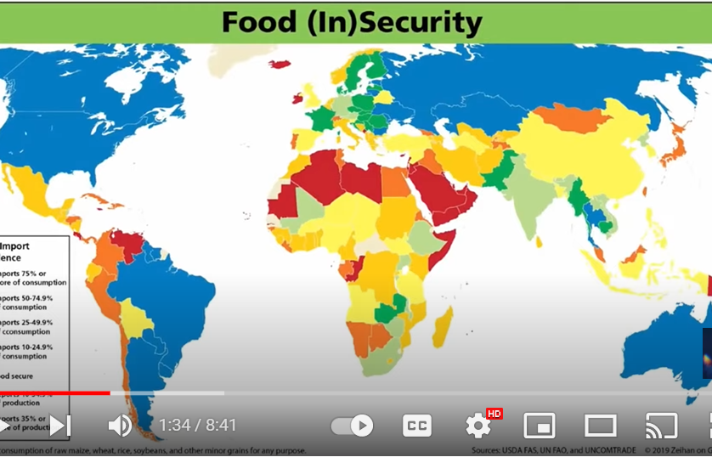

Slide 21
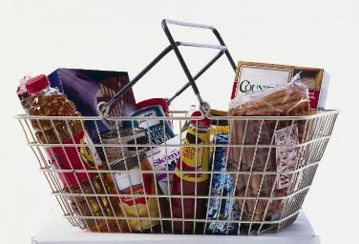
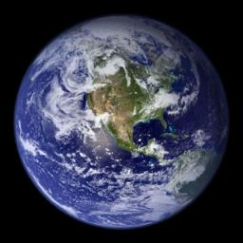
The Food Basket
Trip around the World
Type of food
Amount of food
Cost of food
Size of family
Typical home

Slide 22
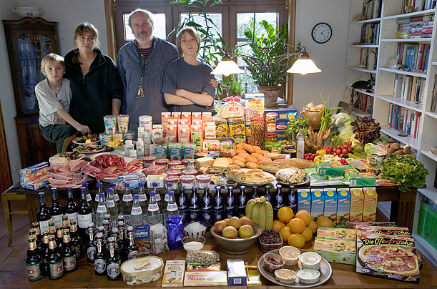
Germany: The Melander family of Bargteheide
Food expenditure for one week: 375.39 Euros or $500.07

Slide 23
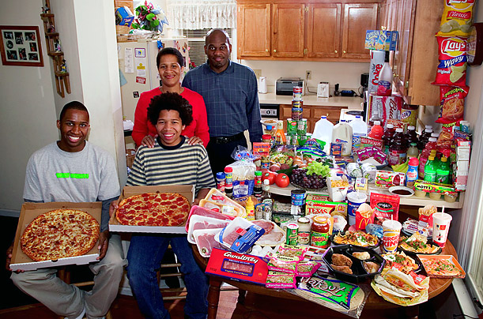
United States: The Revis family of North Carolina
Food expenditure for one week: $341.98

Slide 24
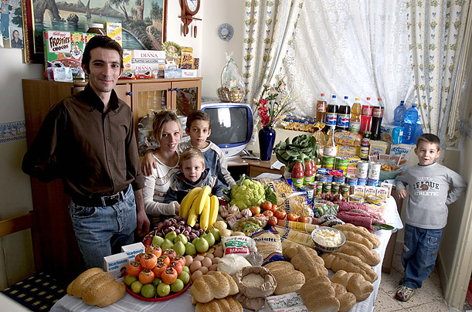
Italy: The Manzo family of Sicily
Food expenditure for one week: 214.36 Euros or $260.11

Slide 25
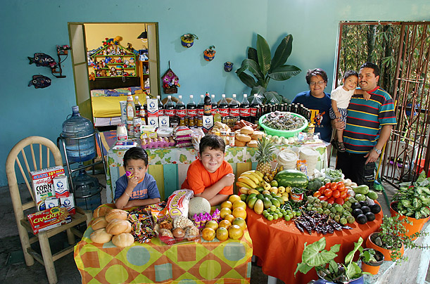
Mexico: The Casales family of Cuernavaca
Food expenditure for one week: 1,862.78 Mexican Pesos or $189.09

Slide 26
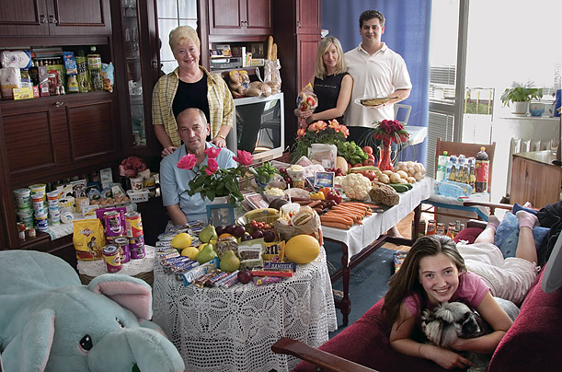
Poland: The Sobczynscy family of Konstancin-Jeziorna Food expenditure for one week: 582.48 Zlotys or $151.27

Slide 27
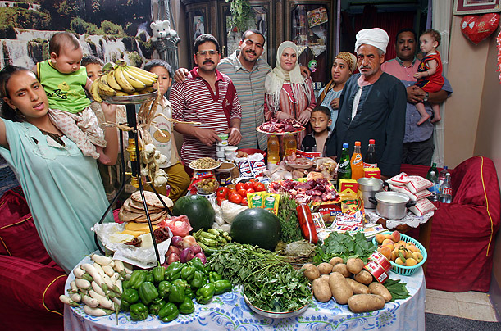
Egypt: The Ahmed family of Cairo
Food expenditure for one week: 387.85 Egyptian Pounds or $68.53

Slide 28
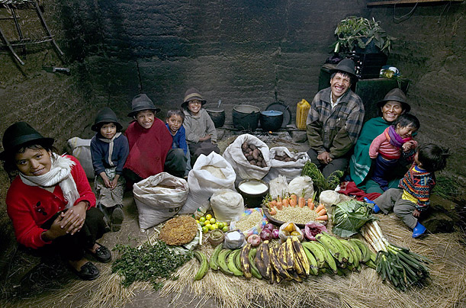
Ecuador: The Ayme family of Tingo
Food expenditure for one week: $31.55

Slide 29
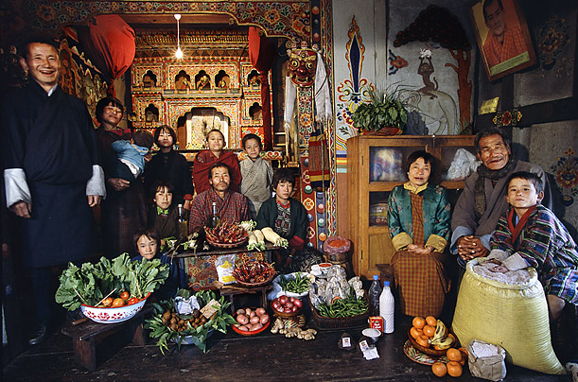
Bhutan: The Namgay family of Shingkhey Village
Food expenditure for one week: 224.93 ngultrum or $5.03

Slide 30
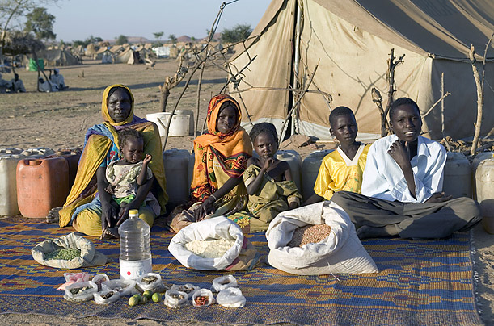
Chad: The Aboubakar family of Breidjing
Camp Food Expenditure for one week: 685 CFA Francs or $1.23

Slide 31
United States: The Revis family of North Carolina
Food expenditure for one week: $341.98

Slide 32
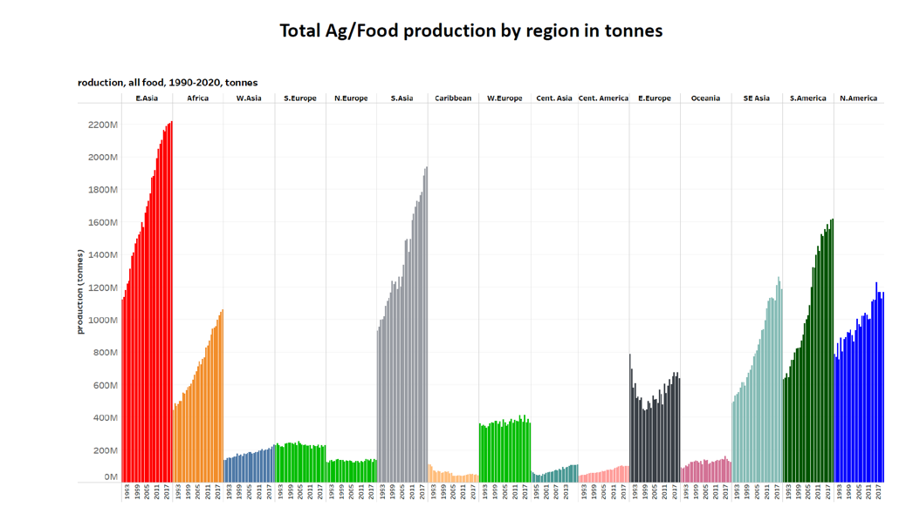

Slide 33
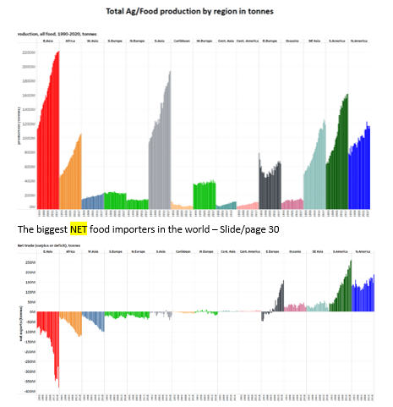

Slide 34

3. Geopolitical Issues

Slide 35
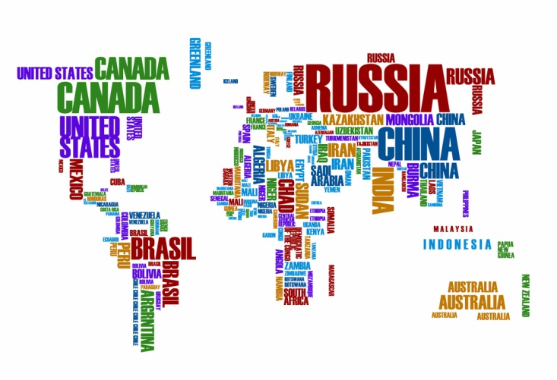
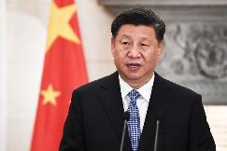
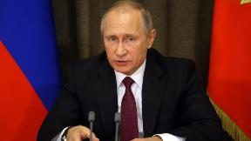
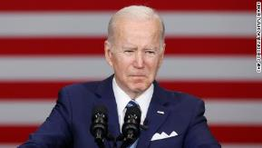

Slide 36
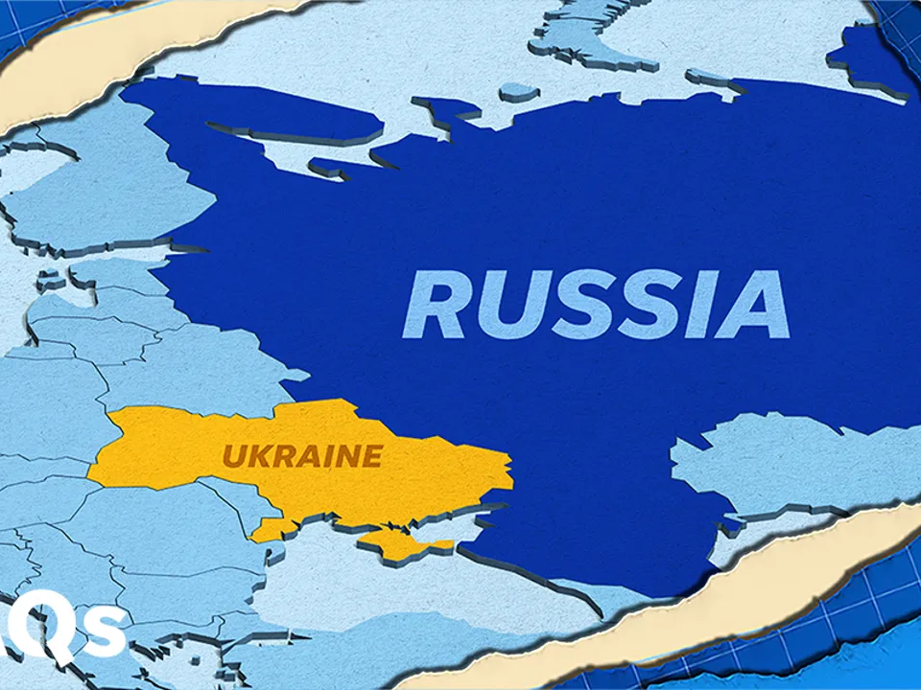

Slide 37
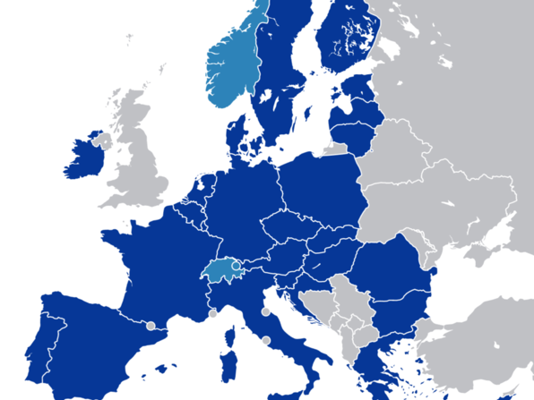
European Union

Slide 38


Slide 39


Slide 40
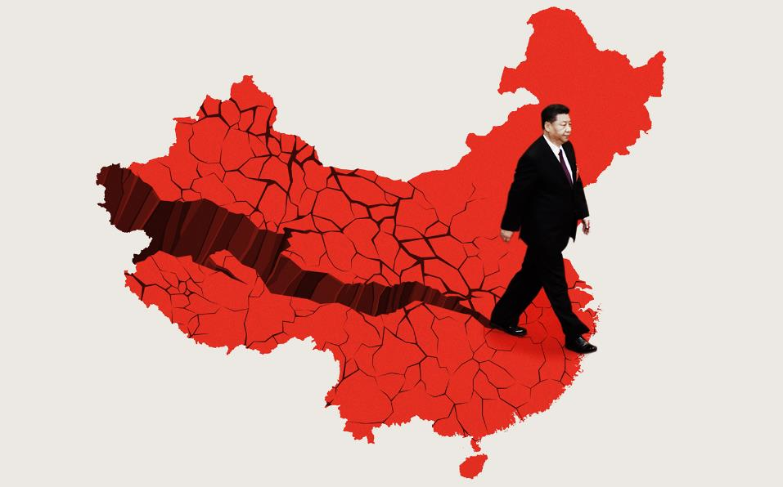

4. China

Slide 41
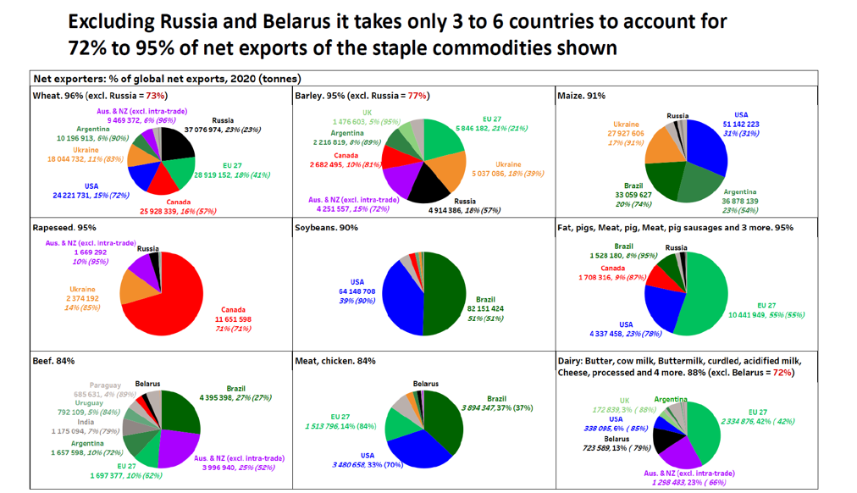

Slide 42
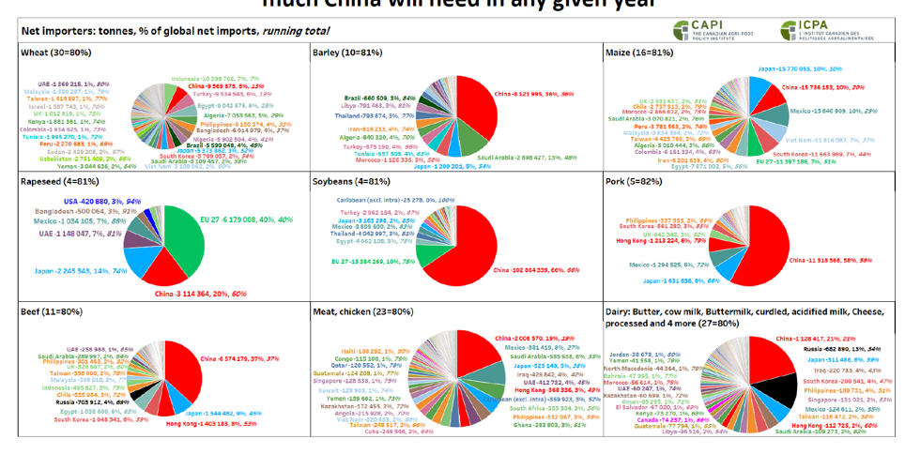

Slide 43

5. Sustainability

Slide 44

Sustainability is changing the food system
The Public wants to know:
How are you treating the environment?
How are you managing manure? … and nitrogen?
Are you treating animals humanely?
Do you have a traceability program I can trust?
What’s your carbon / GHG goals?

Slide 45




Slide 46
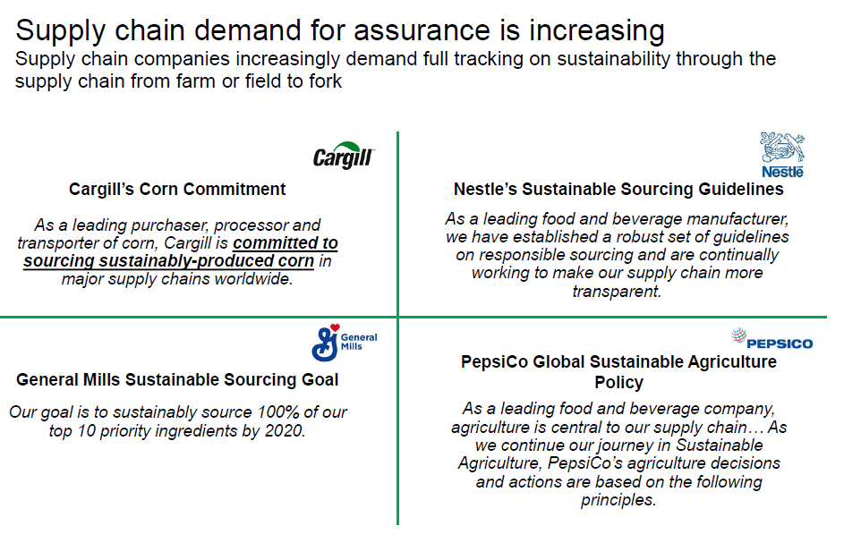

Slide 47





Slide 48
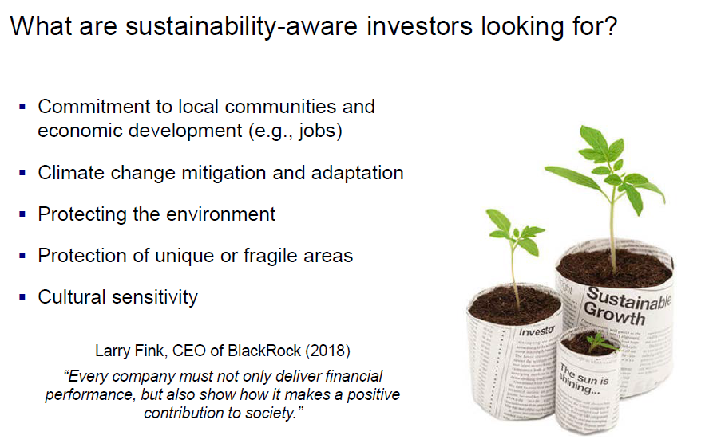

Slide 49

6. Inflation, Debt & Interest Rates

Slide 50

7. Food Affordability is #1
Notes:
Biggest issue facing many
Expectations of employees
Race for robotics and automation
We need to learn to retain and motivate employees

Slide 51
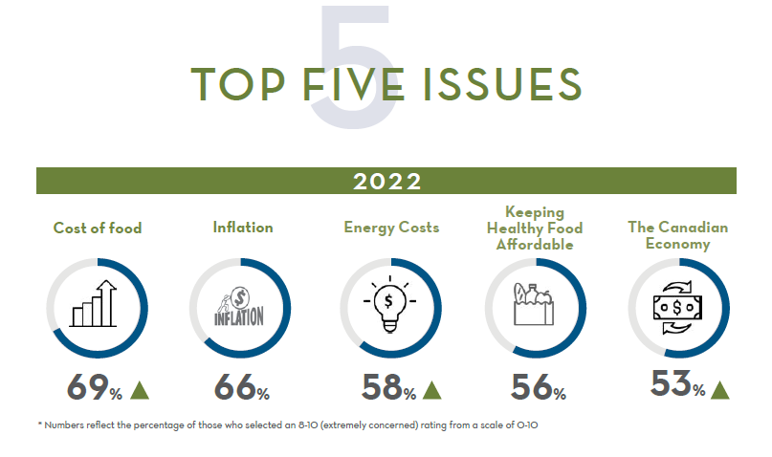

Slide 52
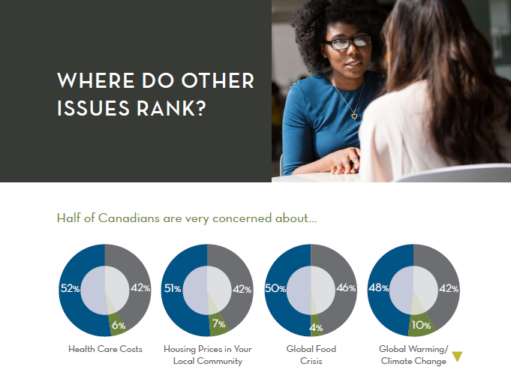

Slide 53

8. Labour

Slide 54

The Future

Slide 55


The Farm
  Bigger & Smaller
  Fewer & More
  Older & Younger
  Gender & Diversity
  New Neighbours
  Digital
  Robotics
  Professional business practices
  Supply chain  Value Chain

Slide 56

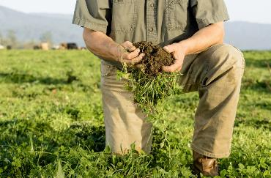
The Future - Farm
Regenerative

Slide 57
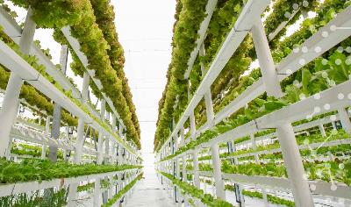
The Future - Farm
Indoor

Slide 58
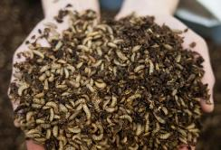
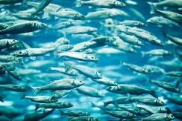
The Future - Farm
Non-traditional

Slide 59
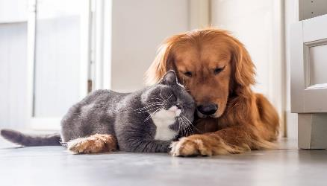
The Importance of Pets

Slide 60




The Future - Genomics

Slide 61

The Future - Digital

Slide 62
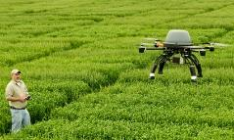

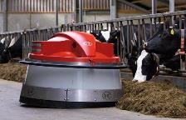
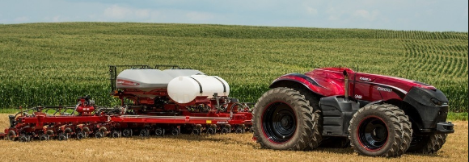

Slide 63
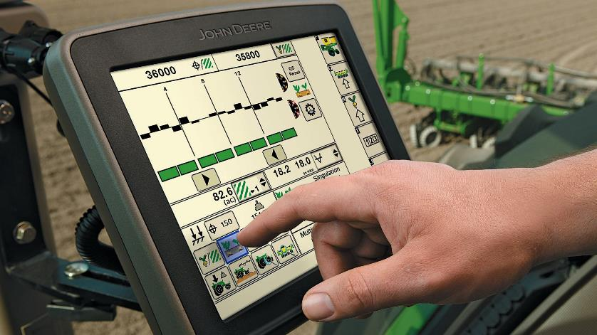

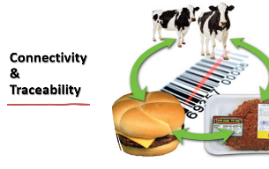

Slide 64

The Future - Biologicals

Slide 65


Bioplastics and Pharmaceuticals

Slide 66

The Future - Carbon
Carbon Market

Slide 67
It’s a changing world!

Slide 68

Thoughts on Bison
Niche market
  Risks and Rewards
The power of the STORY

Slide 69

Contemplations

Slide 70

1.
Perception Problem

Slide 71
Everyone thinks they know agriculture
Rarely mentioned … bad
Live in our own den
  East / West
Seldom invited to the table
Scared of smell

Slide 72


2. Under-Performing
  As a nation
  As an industry

Slide 73


Humanitarian Leaders

Slide 74

Innovation Powerhouse

Slide 75





Canadian Innovation
Telephone - 1874
Canadarm - 1981
Blackberry
1996
Insulin - 1921
Basketball - 1891

Slide 76



Canadian Innovation

Slide 77



Canadian Innovation

Slide 78




Agriculture – Equipment Leaders

Slide 79





Agriculture - Crops

Slide 80





Food

Slide 81



Food Processing

Slide 82
Suggestions

Slide 83

1. The Plan

Slide 84


Slide 85

The Great Philosopher
Mike Tyson

Slide 86

2.

Slide 87

New Generation Leaders

Slide 88

  Engage with the future leaders

Slide 89



Slide 90

3.
A Role to Play

Slide 91

Th
Its’ a Changing World
If you’re not moving forward, then you’re going backwards

Slide 92


Slide 93

The
Canadian Journey to
Social License / Public Trust
Kim McConnell C.M.
@kmcconnell1
kim@KimMcConnell.ca
403-862-5818

