Slide 1
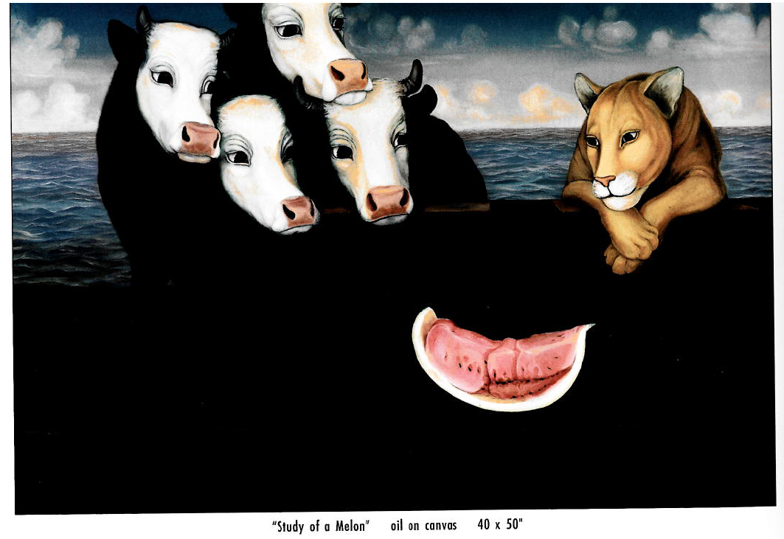

Modernization of Bison

Slide 2
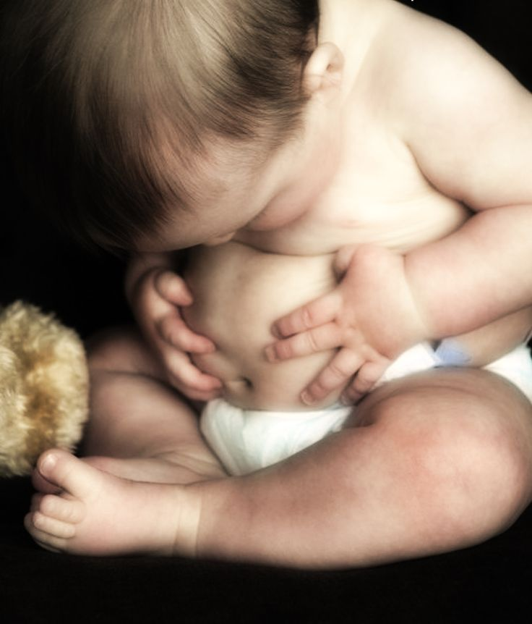
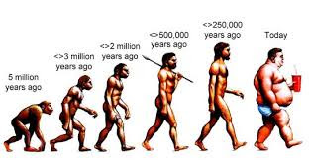

Slide 3
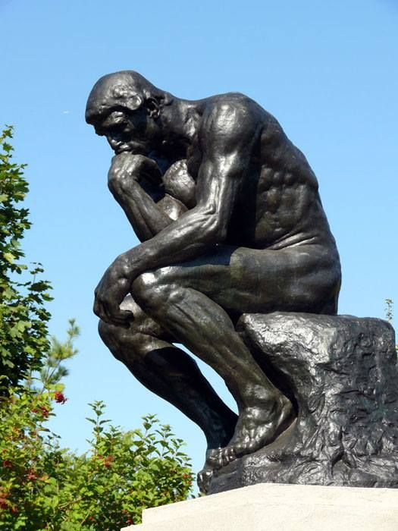
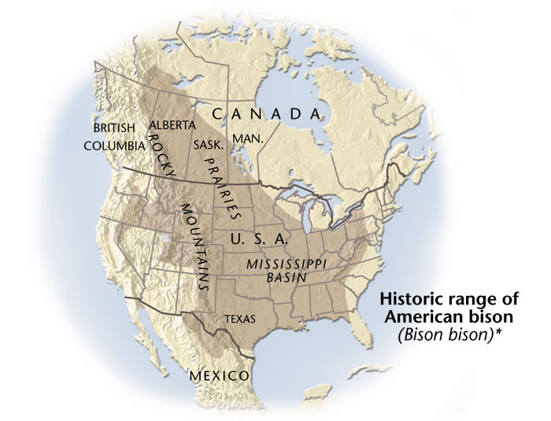
Modernization of Bison

Slide 4
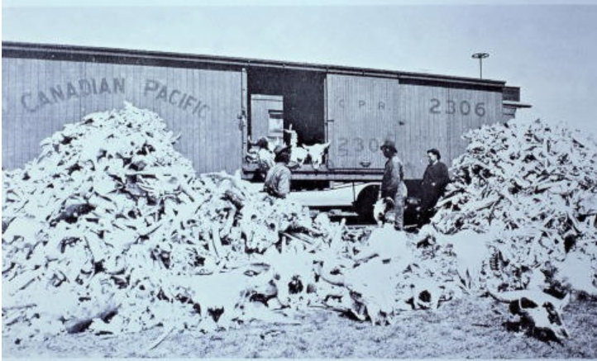
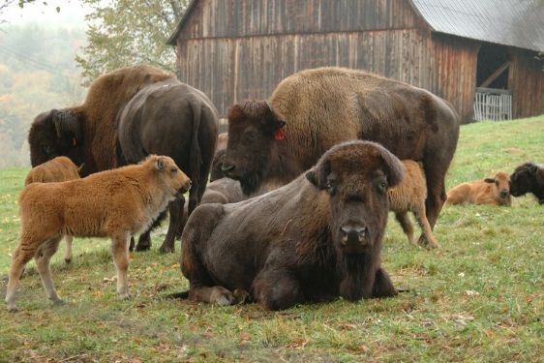
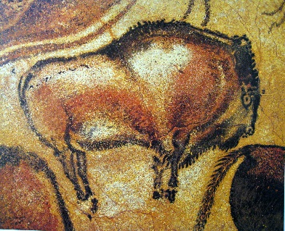
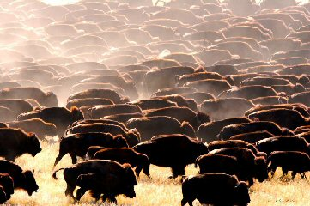
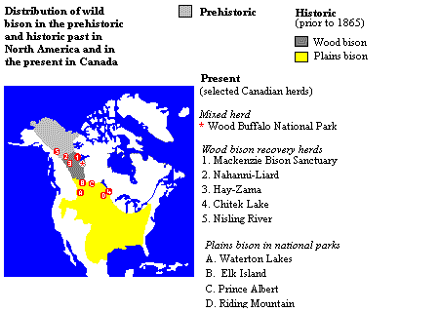
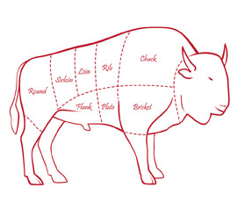
Background - Time Line
1880
1980
2025
Neolithic Super Abundance Annihilation Recovery Farming Industrialization
1800
1920
15000 BCE

Slide 5


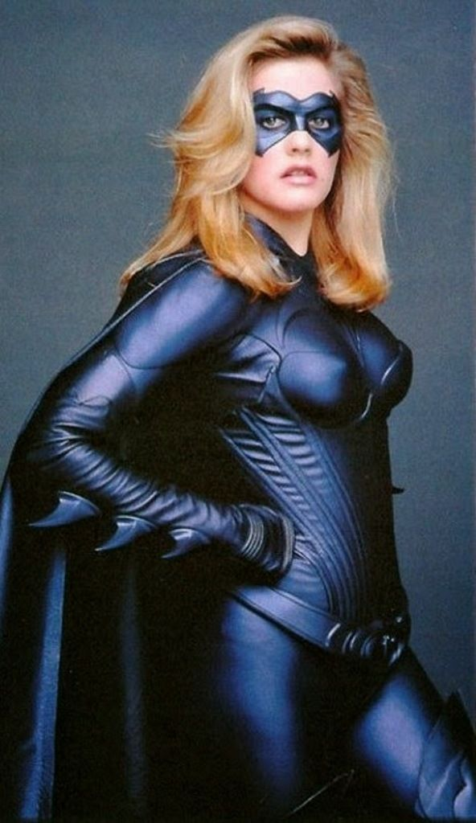
Thinking About Animals & Food
2010
Harper
2011
1997's Batman & Robin.
Market looking for meaning and moral acceptability

Slide 6


The small print
The Kind Diet: A Simple Guide to
Feeling Great,
Losing Weight,
and Saving the Planet
Mar 15 2011

Slide 7
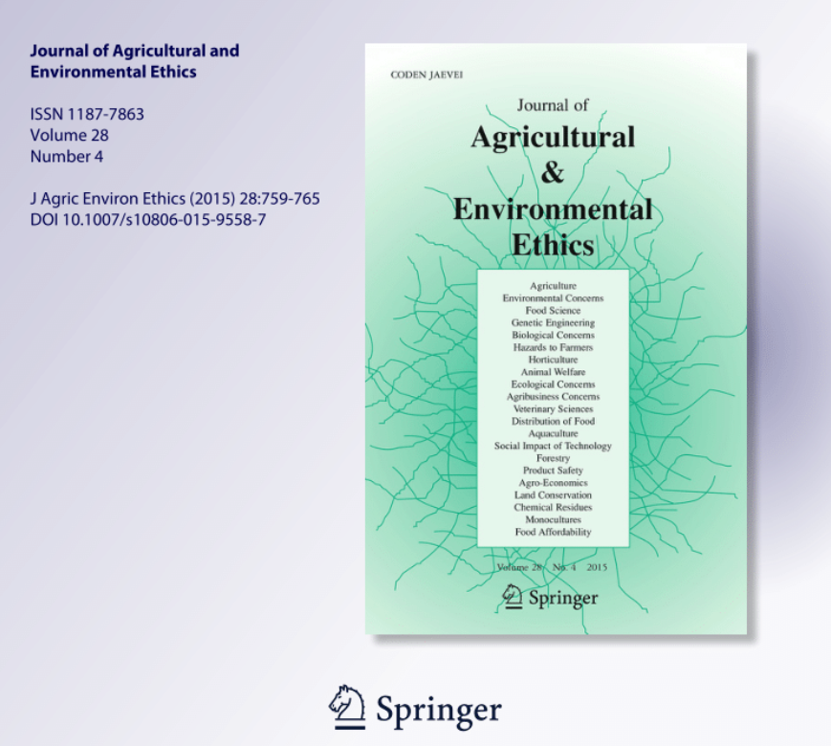

Slide 8
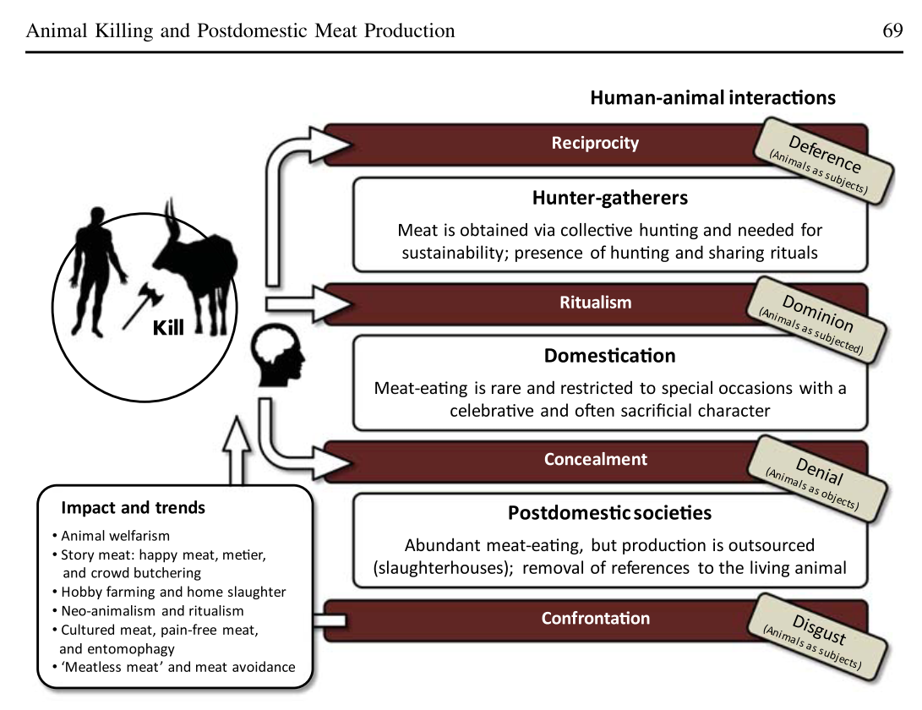
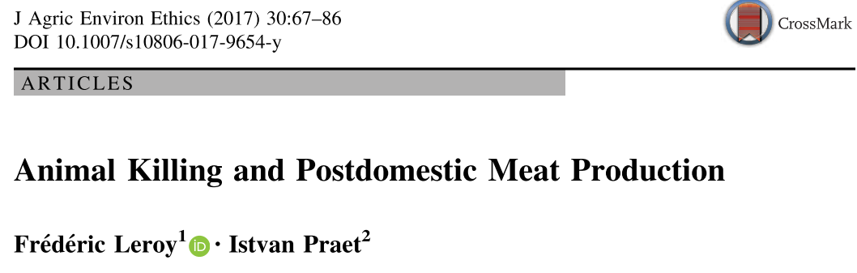

Slide 9
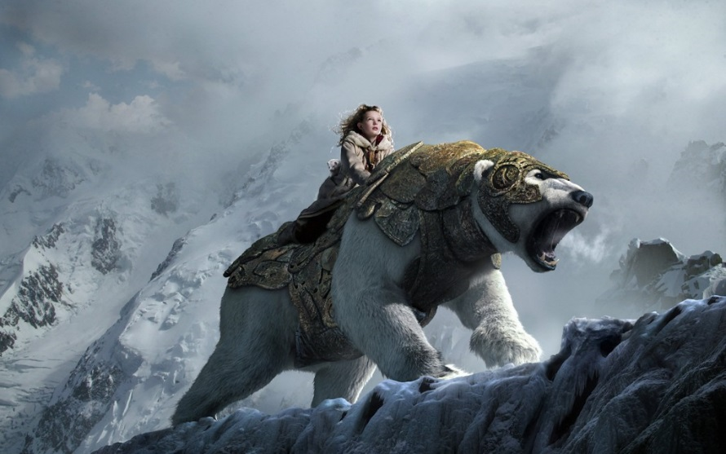
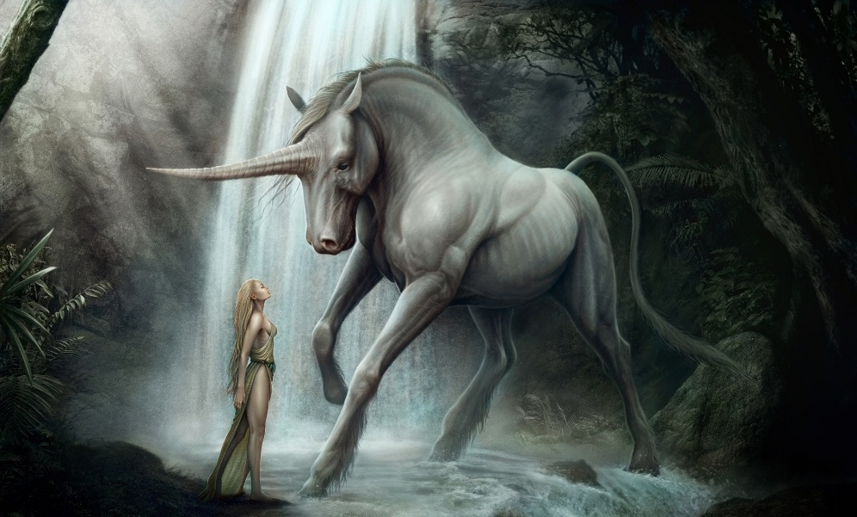
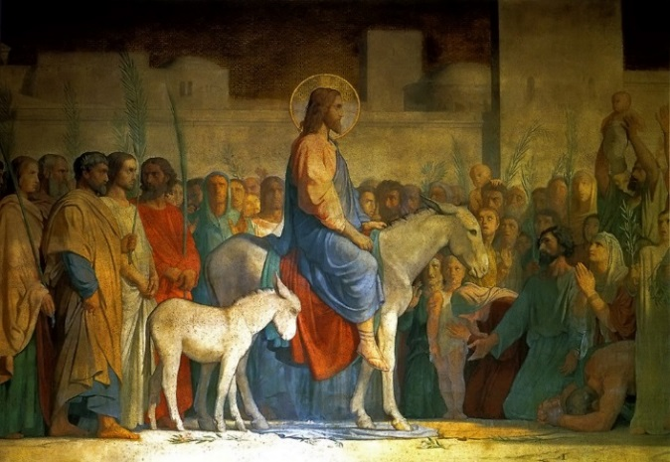
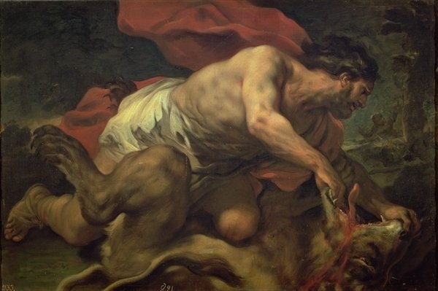
1 - Animals are “magic”

Slide 10
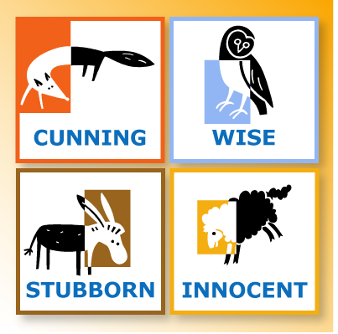

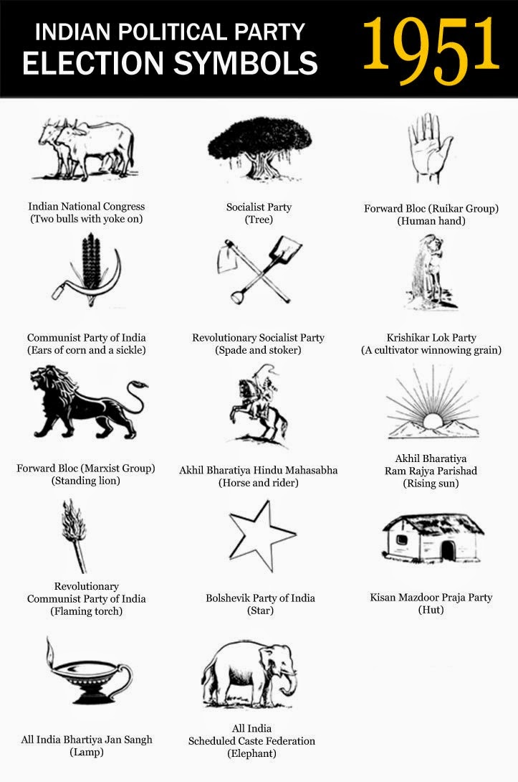


2 - Animals are “political”
4/11

Slide 11



Symbols of Faith - No tourists needed
Angola - Machete
Barbados - Trident
Belize - Two Clubs/Two axes
Guatemala - Two guns w/Bayonet
Kenya - Two Spears and a shield
Saudi Arabia - Sabre
Sri Lanka - Dagger held by Griffon
Swaziland - Two spears and shield
US Virgin Islands - 3 arrows
Flag of Mozambique
Distinct AK-47

Slide 12


Animals on Flags
Goat
Fox
Moldova – eagle.
Ecuador – condor.
Turks and Caicos Islands – lobster.
Albania – eagle.
Croatia – goat.
Christmas Island – golden bosun bird.
Spain – lion.
Saint Maaten – pelican.

Slide 13
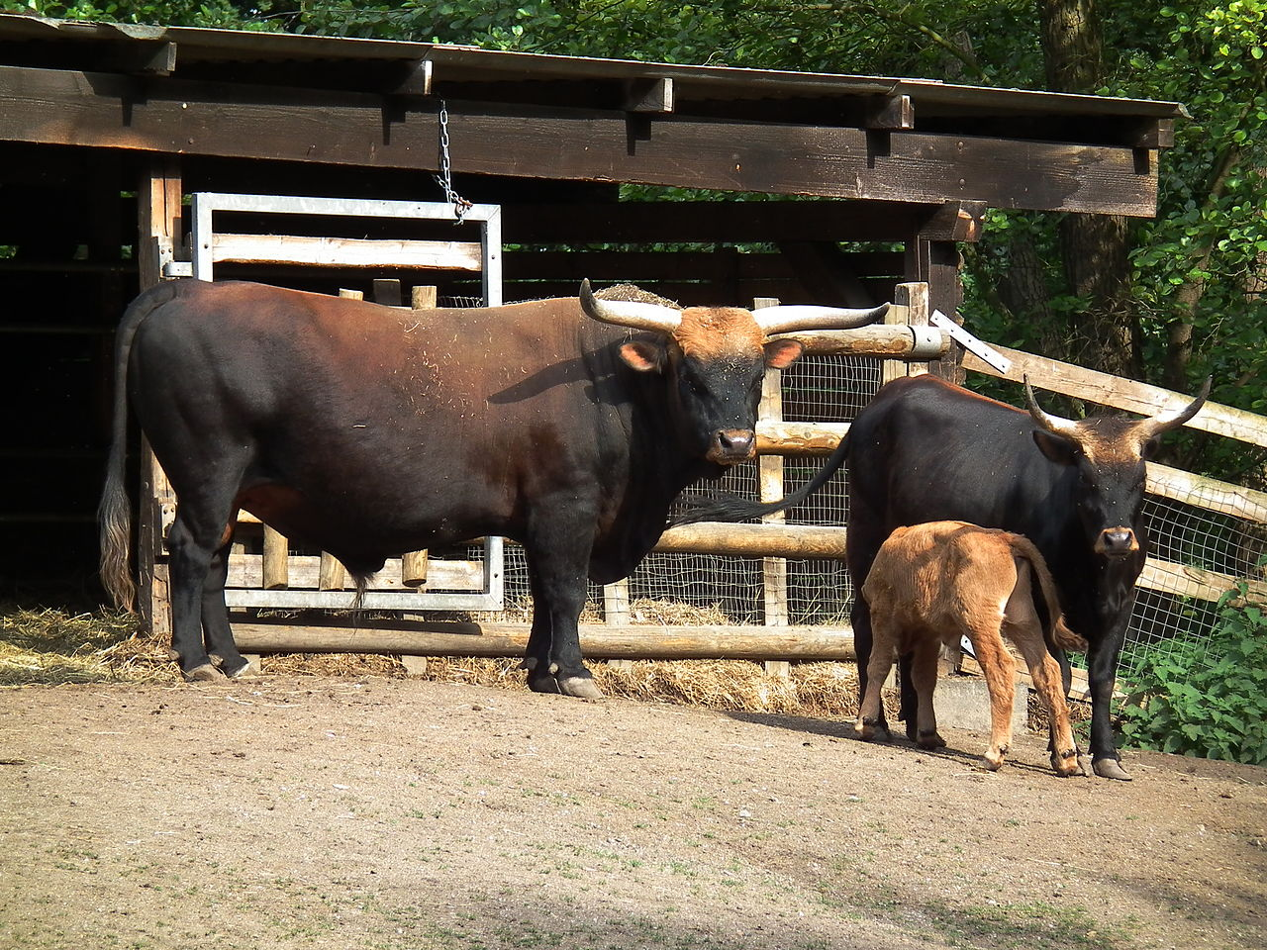

Animal Ideology

Slide 14
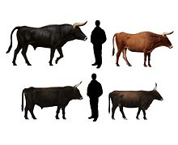
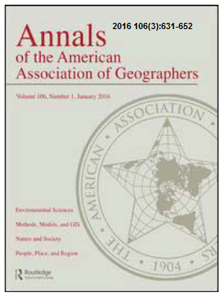
“Re-wilding”

Slide 15
Public Concerns With Agriculture
Animal Welfare
Naturalism
Poisons
Hormones
Antibiotics
Pathogens
Environmental
Degradation

Slide 16
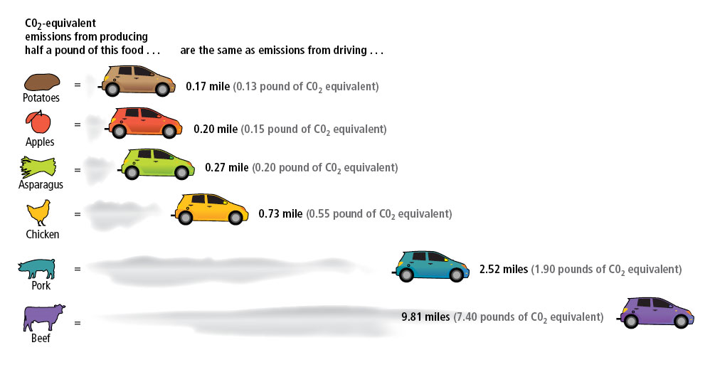
Disclaimer:
I have no idea if this is true or what it really means.

Slide 17
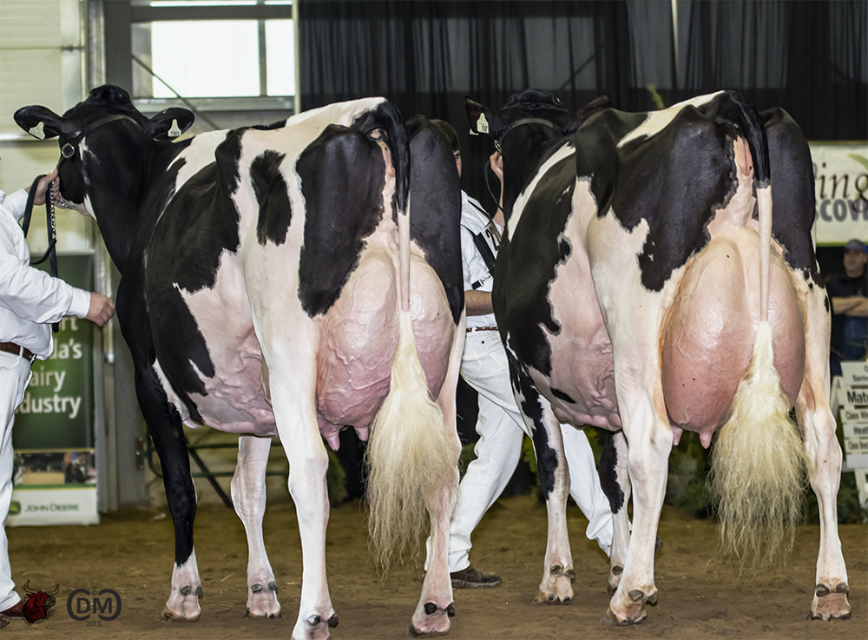
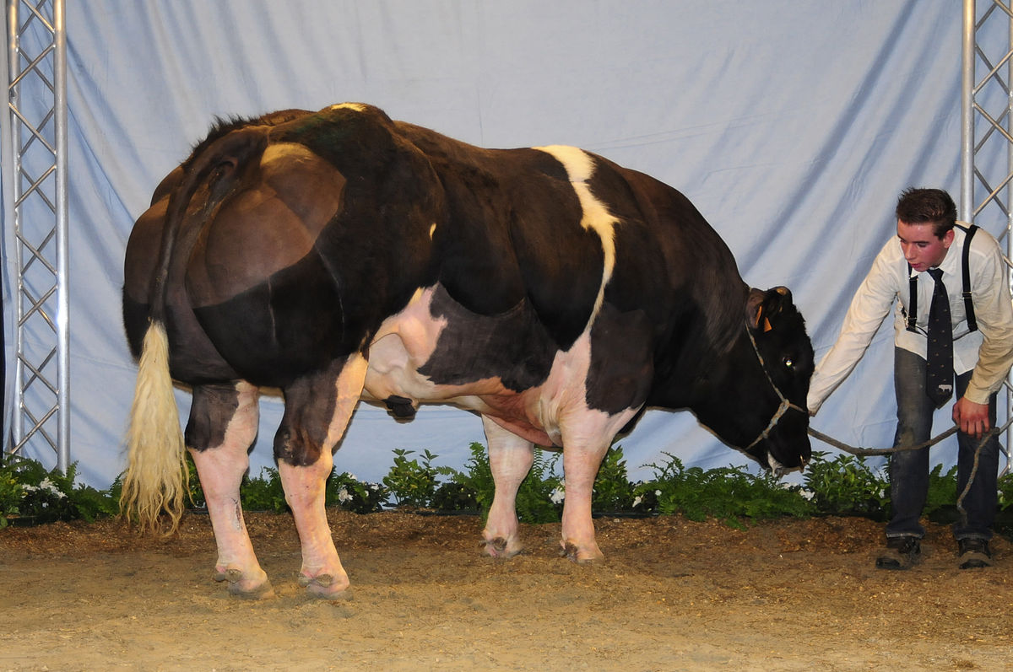
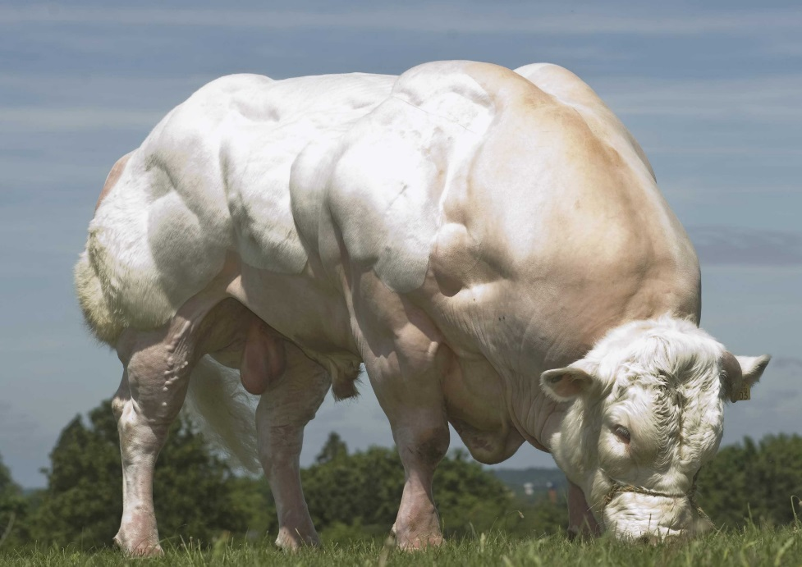
The Monsters of Domestication
Select 4 a Mutation
Selective Breeding

Slide 18
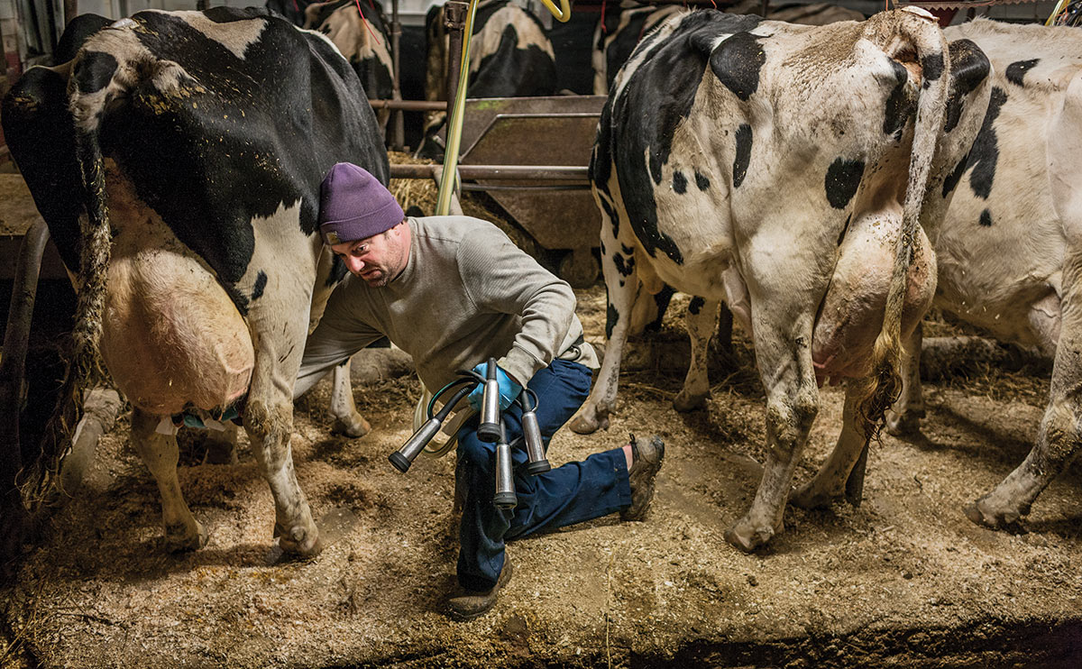
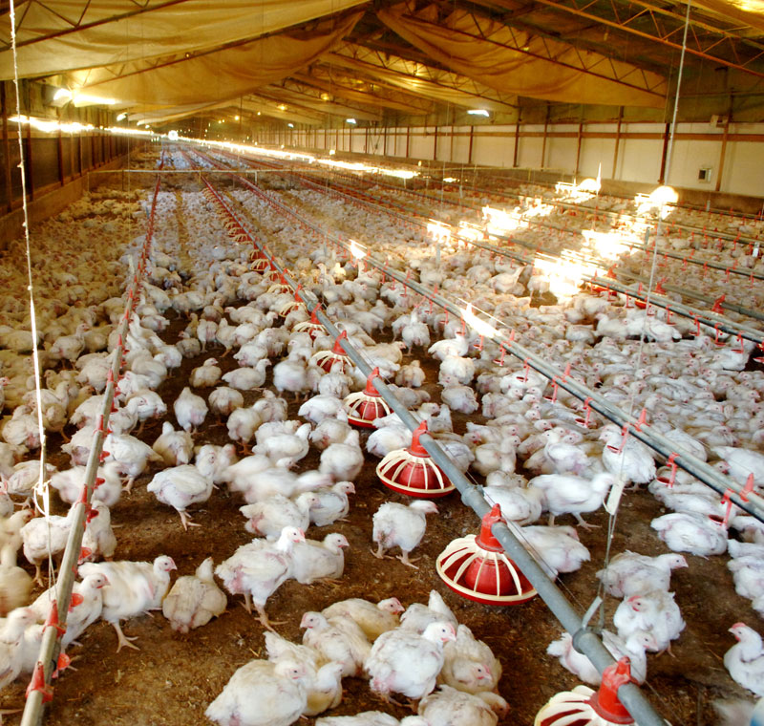
Agri-Crimes? [Against Nature]

Slide 19
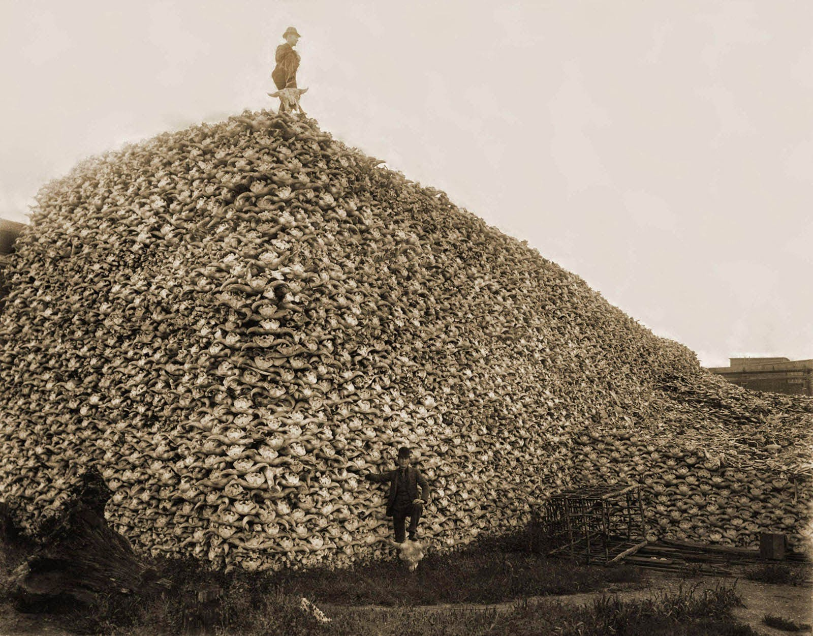
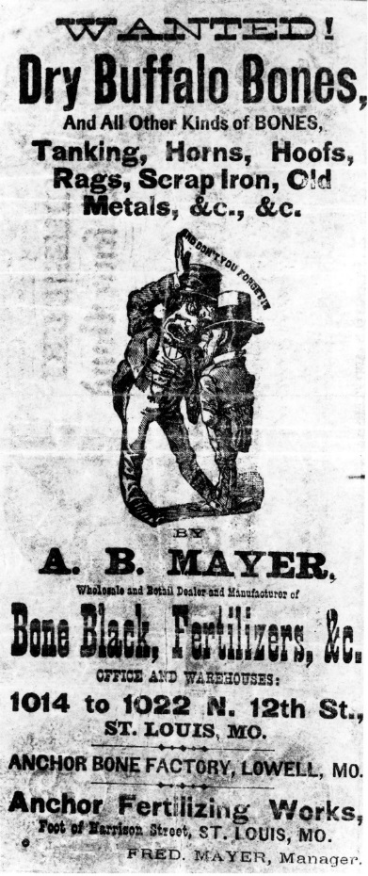
Bison skulls to be used for fertilizer, 1870
Ecological-Crime?

Slide 20
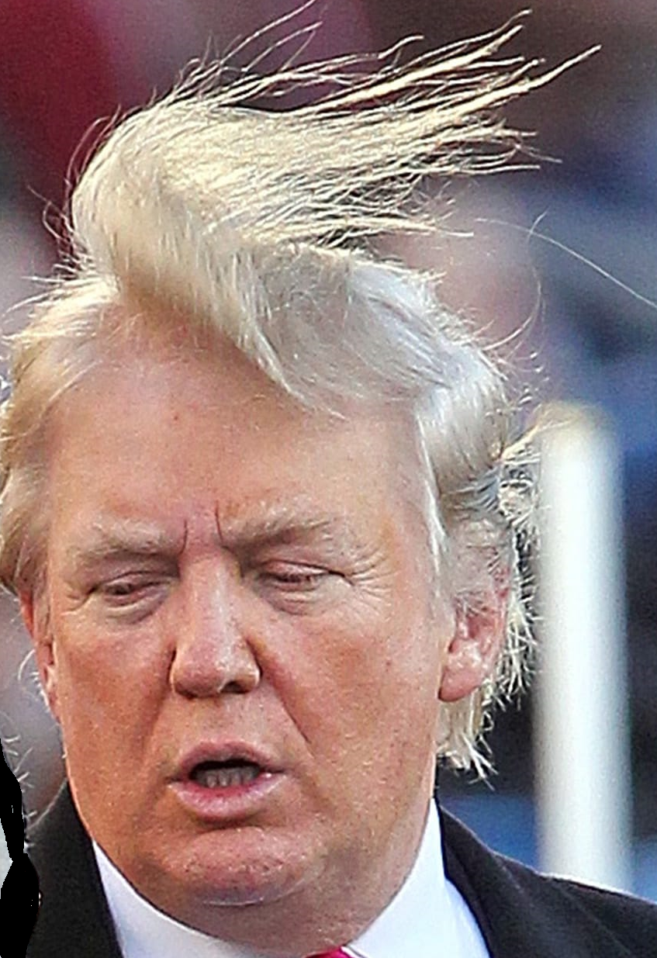
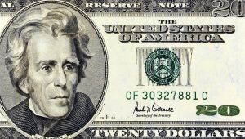
Indian Pacification
“It gives me great pleasure to announce to Congress that the benevolent policy of the Government, steadily pursued for nearly thirty years, in relation to the removal of the Indians beyond the white settlements is approaching to a happy consummation....
What good man would prefer a country covered with forests and ranged by a few thousand savages to our extensive Republic, studded with cities, towns, and prosperous farms . . . ?”
President Andrew Jackson message to Congress “On Indian Removal” (1830)
https://www.ourdocuments.gov/doc.php?flash=true&doc=25&page=transcript
Notes:
By the time of the post Civil War, this Indian campaign had been going on for 25 years.

Slide 21
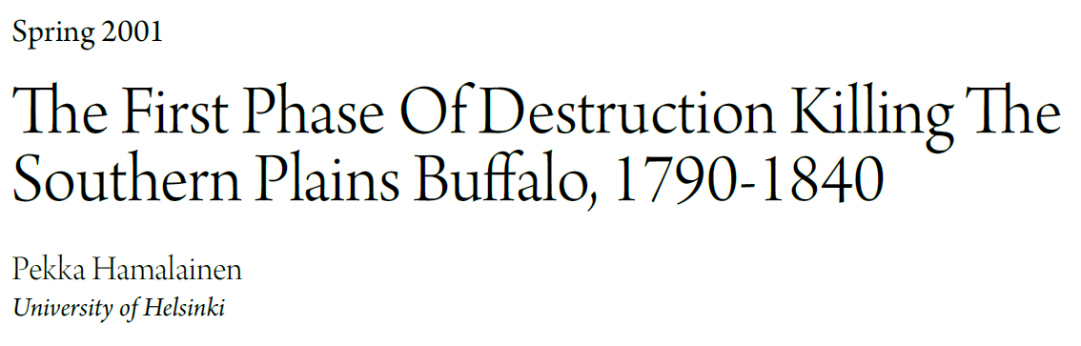
Great Plains Quarterly, 2001;101-114
Bodmer (French-Swiss) accompanied the German explorer Prince Maximilian zu Wied-Neuwied from 1832 through 1834 on his Missouri River expedition.

Slide 22
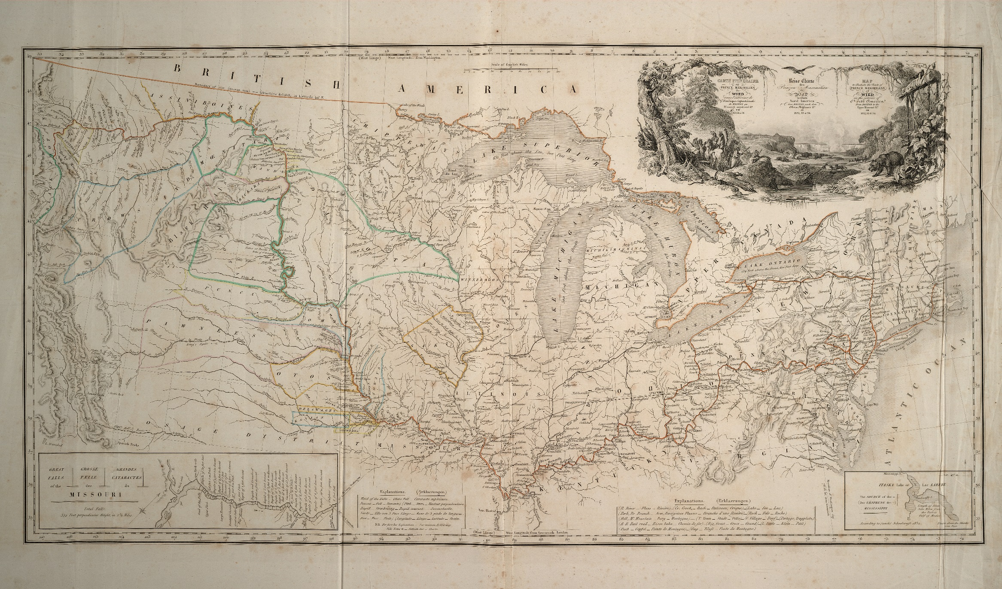
1836 Map
St. Louis

Slide 23
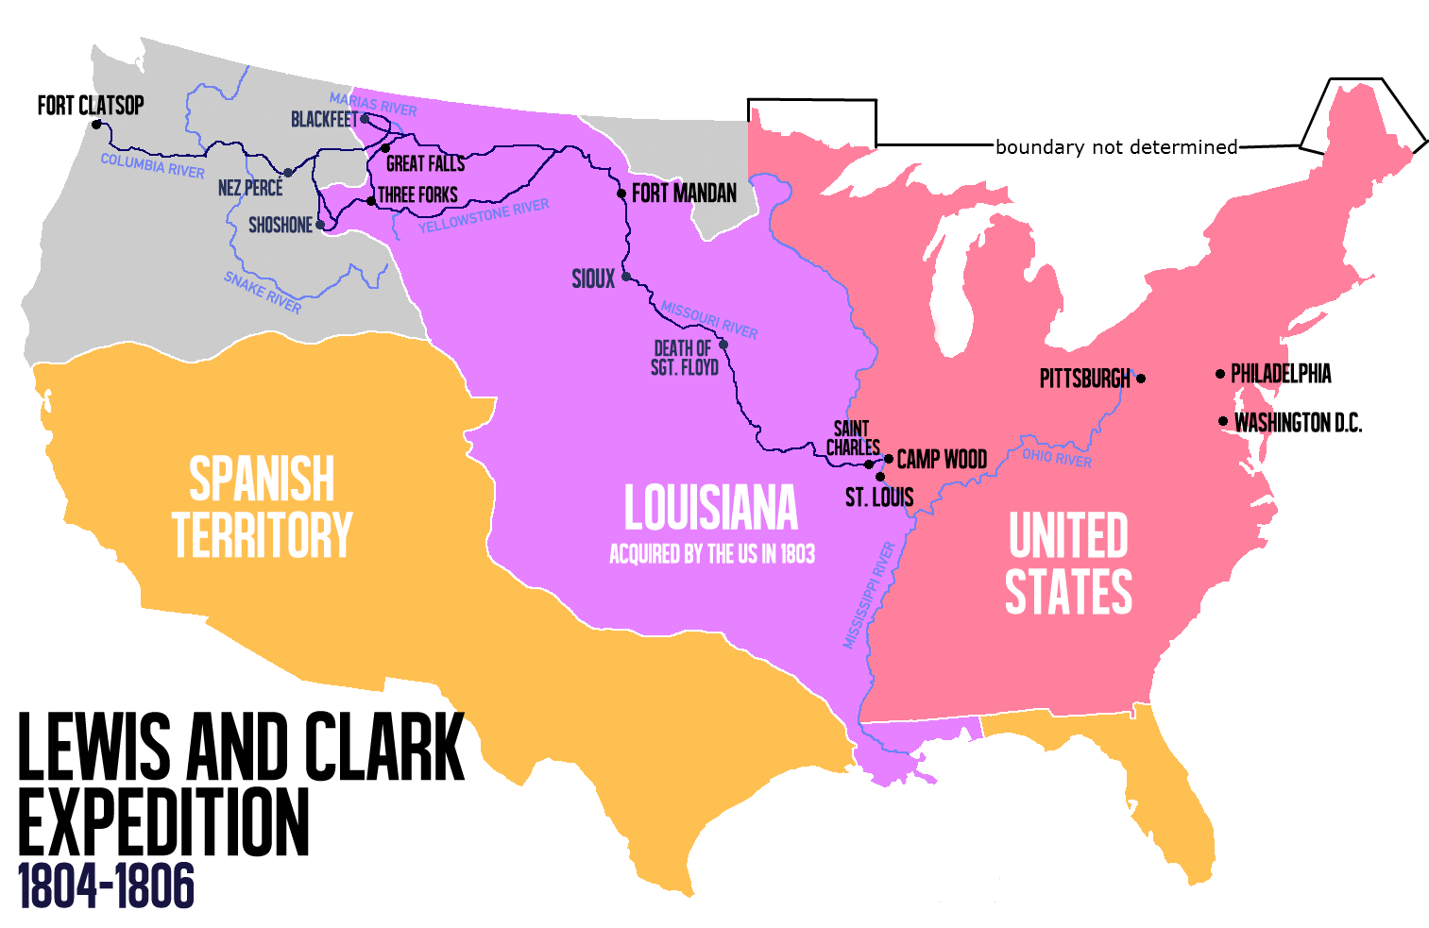

Slide 24
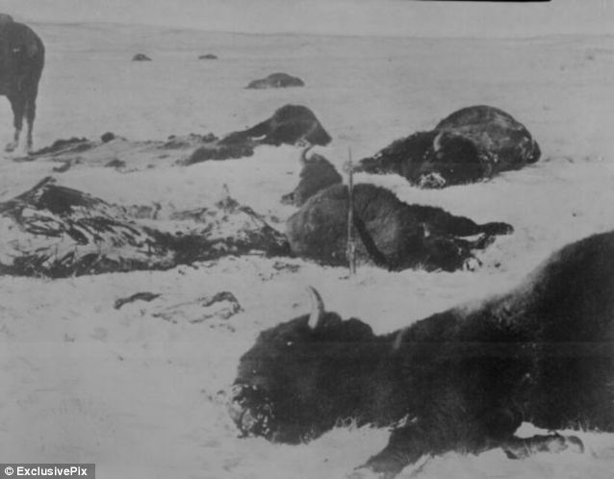
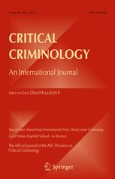

Slide 25
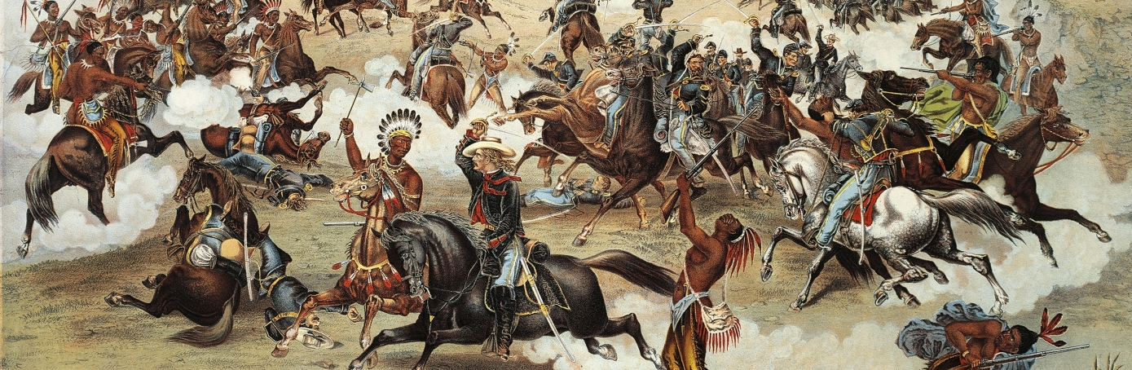

Slide 26
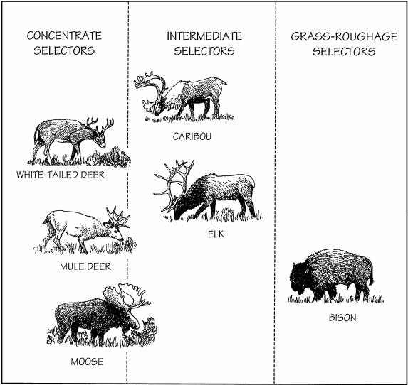
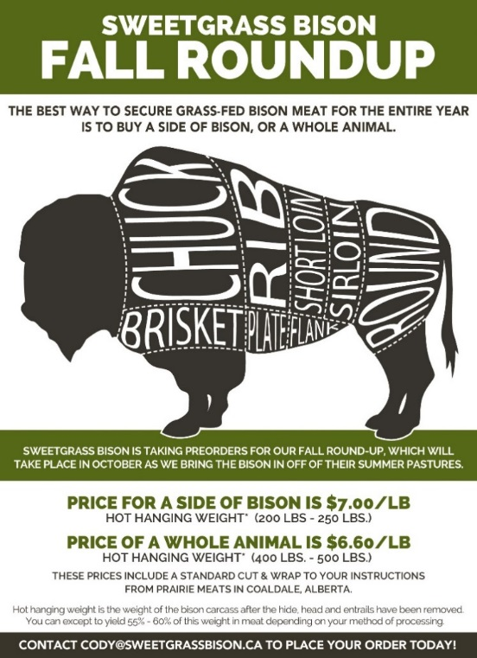
What is “bison”? geo-bio-enviro-ethic-politico-criminal-religious CONSTRUCT

Slide 27
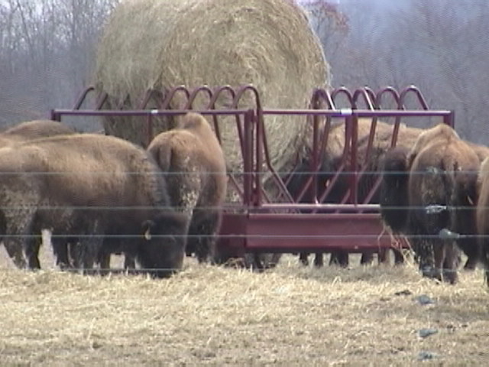
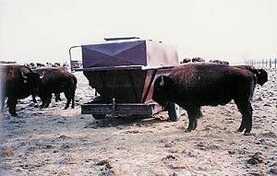
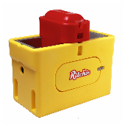
The “Free Choice
The “Free Choice” Paradox

Slide 29
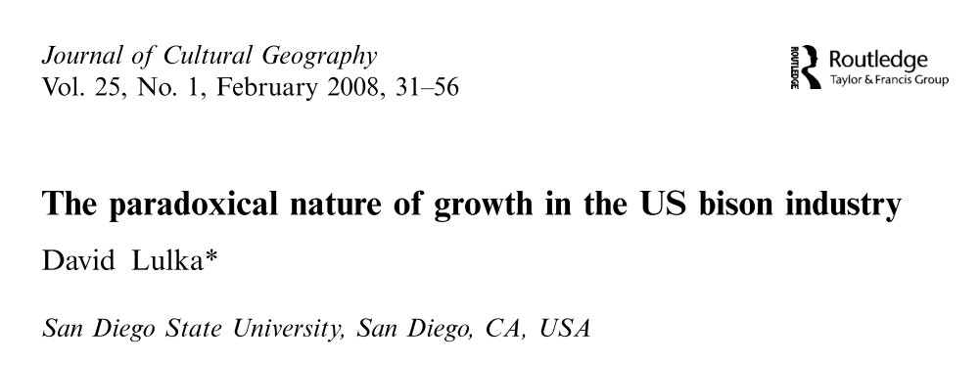
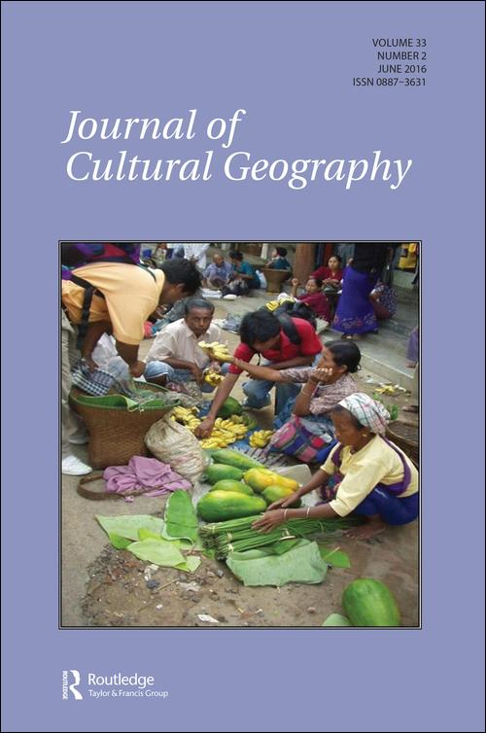

Slide 30
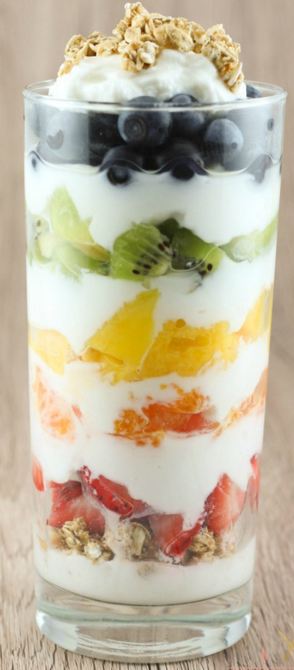

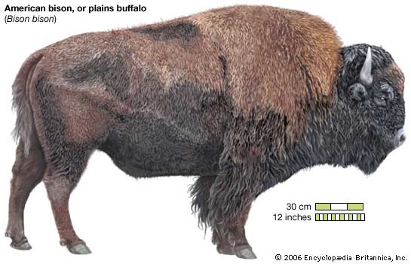
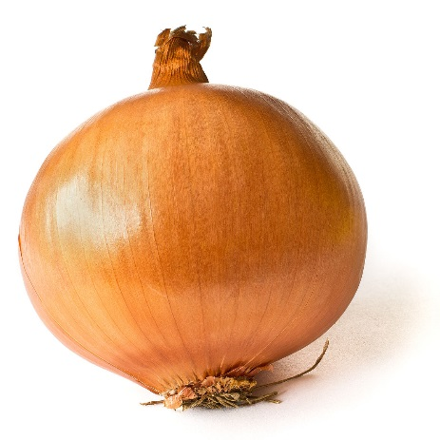
Bison (Industry) Has Layers

Slide 31

Self Identity – What Am I?
Bison Farmer
Bison Rancher
Produce a product competitive in the consumer market
Tolerate some industrial practices
Use grain to meet required meat quality standards
Growth-Driven
Raise a heritage animal in a most natural way possible
Eschew all taint of industrialized agriculture
Only essential industrial practices (eg. Blackleg vaccine)
Environmentally-embedded

Slide 32


Journal of International Food &
Agribusiness Marketing, 2002;14:3, 57-78.
Bison Farmer as FARMER
Bison attributes
Price
Fat content
Tenderness
Cooking convenience

Slide 33

Is this a True Equation?
Bison = Price + Fat Content + Tenderness + Idiot Proof Cooking
Is that all there is …. To a Bison?
Peggy Lee 1920-2001

Slide 34
Production - Types
Industrial Production
Post-Production Agriculture
Productivity efficiency increase through investment in R&D
Profitability – controlling input and output prices, control production loss government backed safety net
Competitive – seeking the globalized market share
Quality based on method of production values
Sustain the rural landscape
Enjoy social and government support?

Slide 35




2000, Vashon Island Press WA
Product Differentiation

Slide 36


2006;46(3):173-191
Is Bison Meat Really Different (ethically)?

Slide 37


Slide 38


Lie
Truth

Slide 39



Bison Farmer as RANCHER
Reva SD,

Slide 40


Slide 41

Post-Production Agriculture
https://www.westpac.co.nz/agribusiness/agri-information/

Slide 42


Images as Messages
Post Production
Modern Production

Slide 44



Slide 45



Slide 46


Crystal Ball
The Story of the turkey?
  contributed to the farmed food family since Columbus discovered America
    The Turkey
    Corn, Squash
    Peanut, Avocado, Beans
    The Potatoes (Monoculture ?)
    Bison?

Slide 47


Slide 48

The Remarkable Turkey
Now The Mexican turkey is the ancestor of all domestic turkeys consumed in the world today and Mesoamerica's only indigenous domesticated animal.
Then

Slide 49


The Remarkable Turkey
Then
Now

Slide 50



Not Turkey Ranching!
50-70 lb
A Turkey flock of 500 breeder hens inseminated with 100 μL of diluted semen (1:1) twice the week before the onset of egg production and once weekly thereafter for the 24 wk of egg production would entail 13,000 inseminations using 650 mL of semen. Semen collection and hen inseminations are labor intensive as each male and female must be handled each week.

Slide 51

Available after the Zombie Apocalypse?

Slide 52
Modernization of Bison

Slide 53
What can we hope to learn from a Turkey?
The turkey transformed from a mostly wild animal to a fully domesticated food animal in just over 300 years {most in the last 50 years}.
The pressures put on the turkey by markets & domestication are the same pressures currently on the bison industry,

Slide 54
What can we hope to learn from a Turkey?
You can’t farm-ranch if you can’t make money
Since 1945 Agriculture has been driven by the more-faster-cheaper mantra of what is now recognizable as the mantra of international capitalism.

Slide 55
What can we hope to learn from a Turkey?
Some experts identify a developing “post-production” market for foods of animal origin
There may be space to balance the pressures for economic efficiency with other rural-social values of lower input sustainable agriculture

Slide 56

What can we as an association do?
Keep eggs in more than one basket

Slide 57
Baskets
Restaurant Market buying bison as an input
The sector buying natural hormone free food
The sector buying animal welfare friendly food
The sector buying nutraceutical food
The sector buying nostalgia [wilding]
The sector buying religious food (probably not)

Slide 58
References and other Interesting stuff
Sanderson K, Hobbs JE, Shand P, Kerr WA. Consumer preferences in the emerging bison industry: Marketing implications. Journal of International Food & Agribusiness Marketing. 2003;14(3):57-78.
Froese D, Stiller M, Heintzman PD, Reyes AV, Zazula GD, Soares AE, et al. Fossil and genomic evidence constrains the timing of bison arrival in North America. Proceedings of the National Academy of Sciences. 2017;114(13):3457-3462.
Lulka D. Grass or grain? Assessing the nature of the US bison industry. Sociologia Ruralis. 2006;46(3):173-291.
Lulka D. The paradoxical nature of growth in the US bison industry. Journal of Cultural Geography. 2008;25(1):31-56.
Moloney CJ, Chambliss WJ. Slaughtering the bison, controlling Native Americans: A state crime and green criminology synthesis. Critical Criminology. 2014;22(3):319-338.
Kirillova IV, Zanina OG, Chernova OF, Lapteva EG, Trofimova SS. An ancient bison from the mouth of the Rauchua River (Chukotka, Russia). Quaternary Research. 2015;84:232-245.
Mooring MS, Penedo MCT. Behavioral versus genetic measures of fitness in bison bulls (Bison bison). J Mammal. 2014;95(5):913-924.

Slide 59

Acknowledgements
My attendance and participation at your AGM was made possible by the generous support of
  the Canadian Bison Association and
  the unwarranted faith and encouragement of Terry Kremeniuk
Terry Whiting
        Terry.whiting@gov.mb.ca

