Slide 1

Public Trust in Agriculture
Canadian Bison Association 34th Annual Convention
November 20, 2017
Clinton Monchuk

Slide 2

Farm & Food Care SK
Made up of commodity groups, manufactures, food processors, distillers, RMs, government and agri-businesses
Our mandate is to have conversations with consumers
  Make sure consumers have truthful information
Series of events to increase public trust in farming and agriculture

Slide 3
Do you think we should talk to consumers about how we raise our animals and grow our food?

Slide 4
Who really cares about agriculture?
Do consumers really care about what we do?
Notes:
As the question to audience, farmers care but what about others?

Slide 5
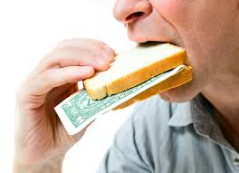
Canadian consumers really do care
Access to healthy, affordable food is a greater concern than energy or health care in 2017*
More than half of the population is unsure or certain that the food system is going in the wrong direction
Food concerns rank higher than climate change
* Canadian Centre for Food Integrity 2017 Research

Slide 6
Who drives the where the food industry goes?

Slide 7
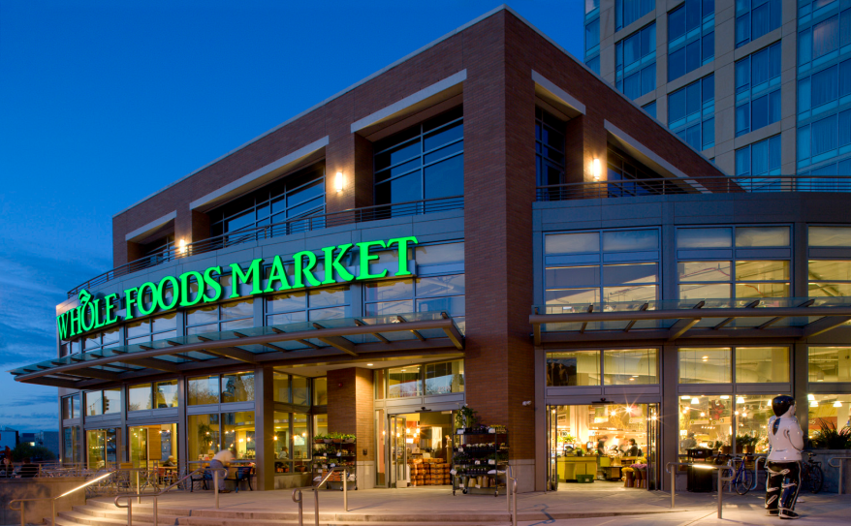


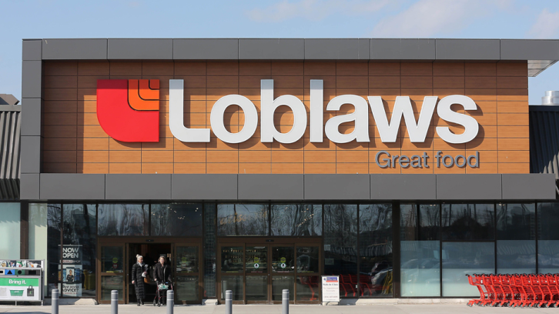
Notes:
Lots of feedback around the companies that are dictating what food they want in their stores… free of X, organic, local, etc
BUT… companies test markets to see what consumers want and what they’re willing to buy
A&W campaign was largely successful in Canada

Slide 8
Consumers are driving where the food industry goes and it’s not always based on facts!

Slide 9
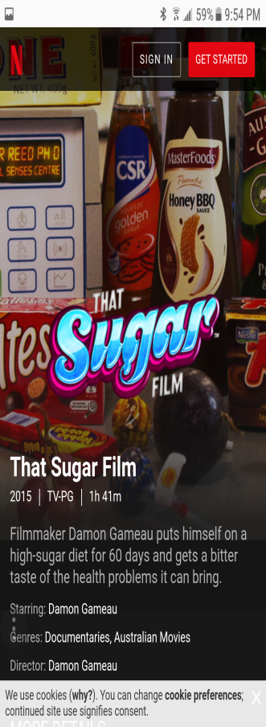
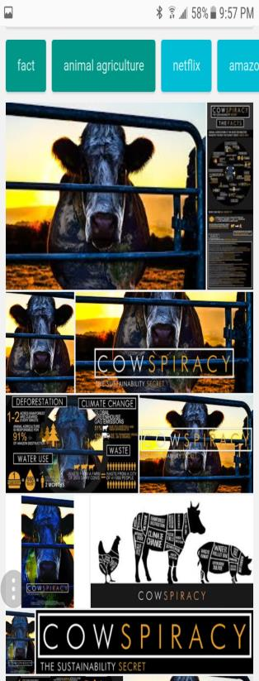
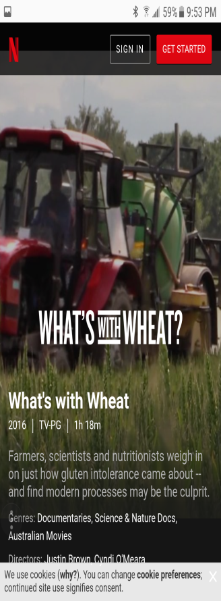

Notes:
Interesting way to get message out about anti-agriculture… documentaries that only look at part of the story.
Very anti-modern agriculture, anti-GMO, anti-animal agriculture
Kip Andersen, quote from his FB ‘As long as there are slaughterhouses, there will be battlefields’.

Slide 10


What do Canadian consumers believe?
73% of Canadians believe undercover videos of animal mistreatment are either representative of normal farms or unsure if they represent typical farms

Slide 11
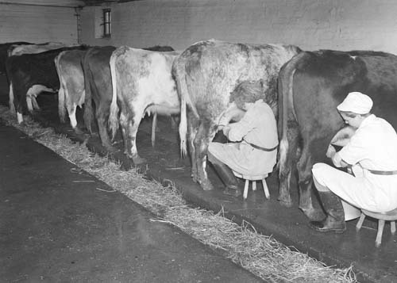
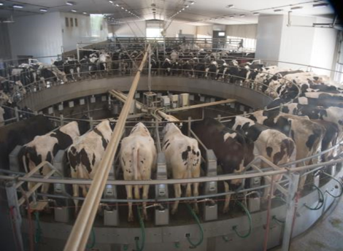
What are Canadian consumers thinking?
93% of Canadians know little or nothing about farming
View
Reality

Slide 12
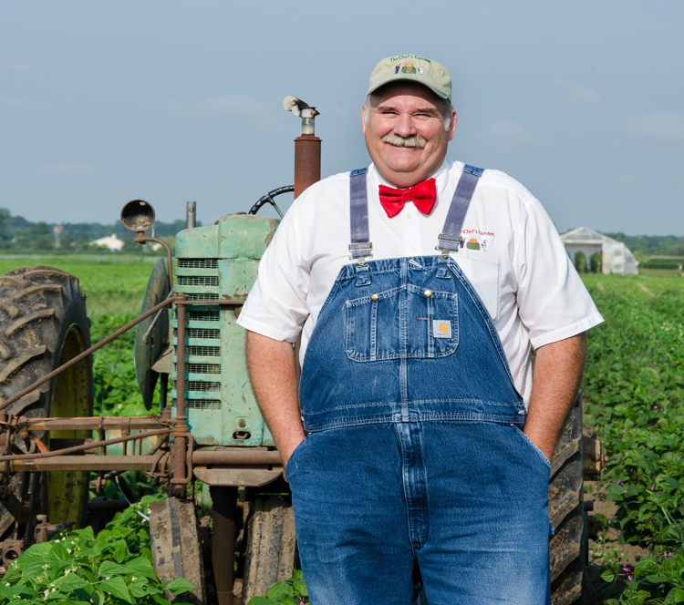
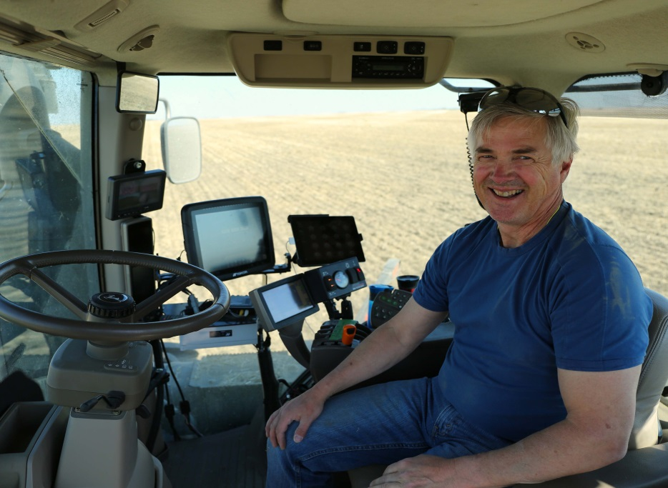
What are Canadian consumers thinking?
View
Reality

Slide 13
Disconnect to farming
Less than 3% of Canadian population has a direct tie to farming!
Farmers and agriculture industry historically haven’t spoken about how we produce food.
  Focused on science instead of why we’re doing what we do
Farmers are still trusted
Biggest concerns are GMOs, animal welfare and use of hormones and antibiotics

Slide 14










Changing technology and trends
Social media has the ability to influence consumers
  Don’t have to have the full story to post
  1.3 billion people use YouTube
  ~5 billion videos are watched daily on YouTube
Majority of population now get’s their information and news from social media
Hard to decipher between truth and mistruth
  American politics – confusion of facts (sometimes by same person)

Slide 15
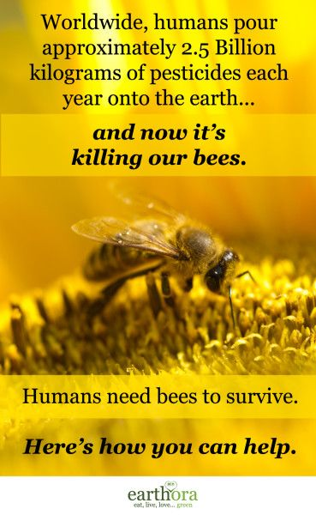
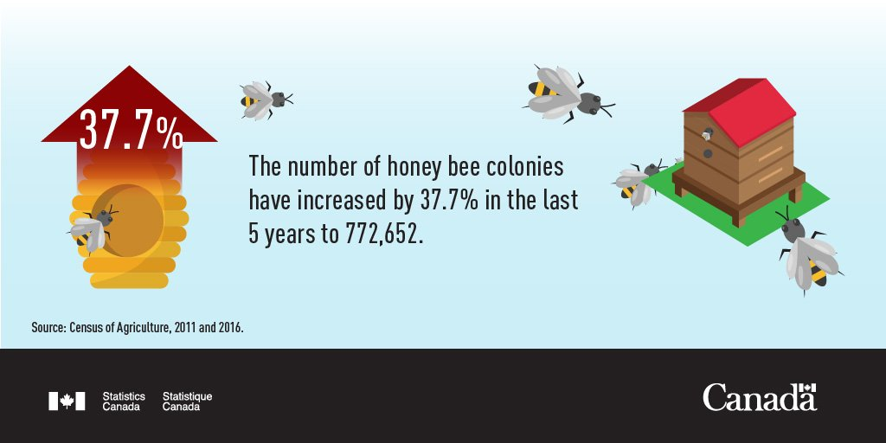
False social media becomes consumer truth

Slide 16
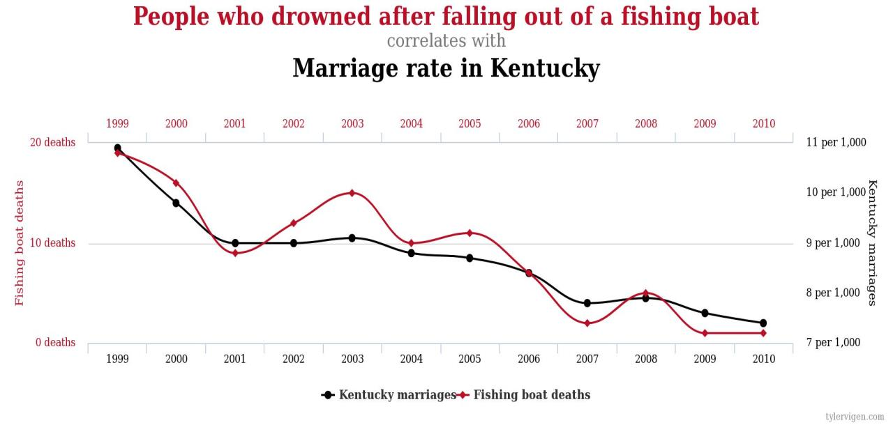
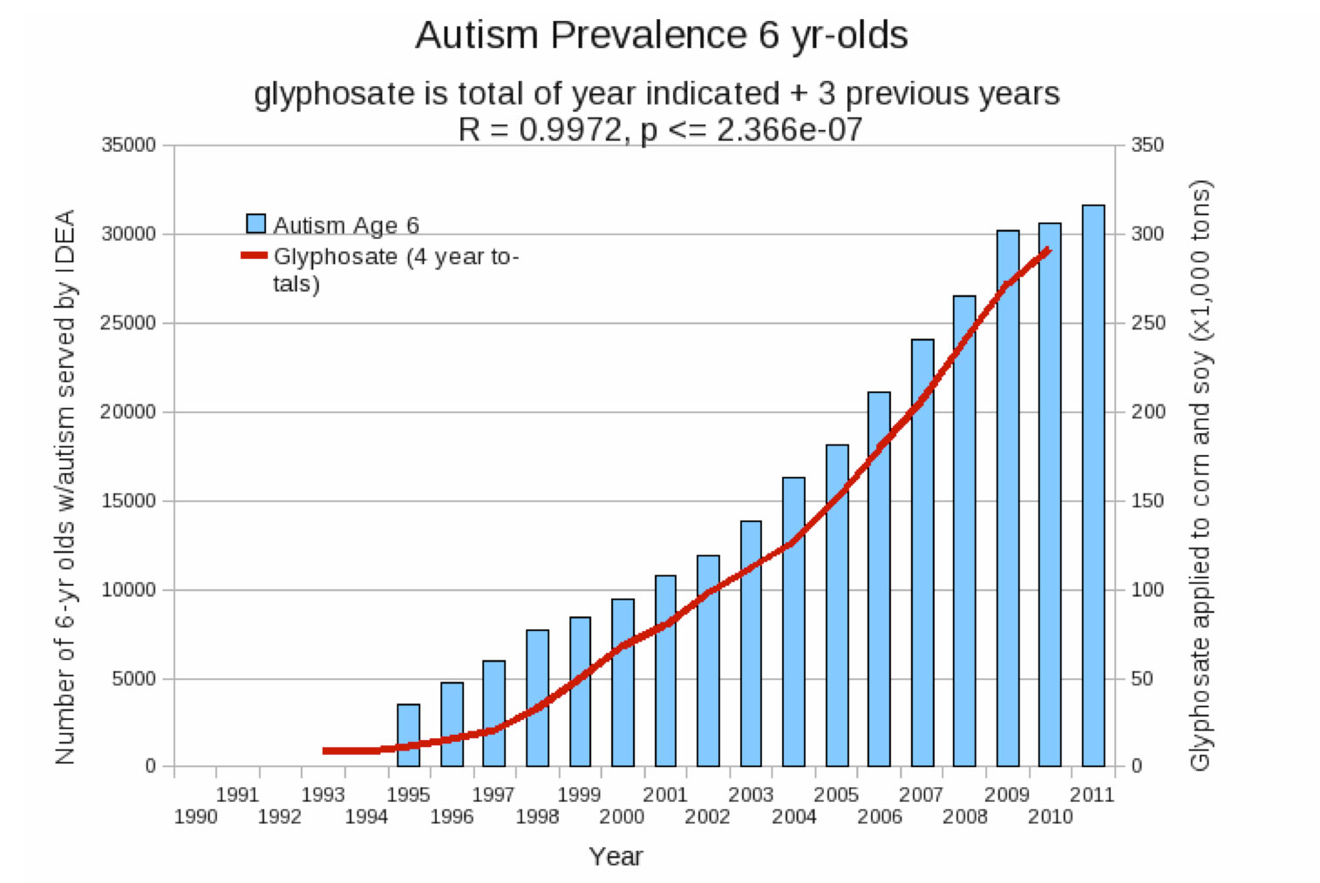
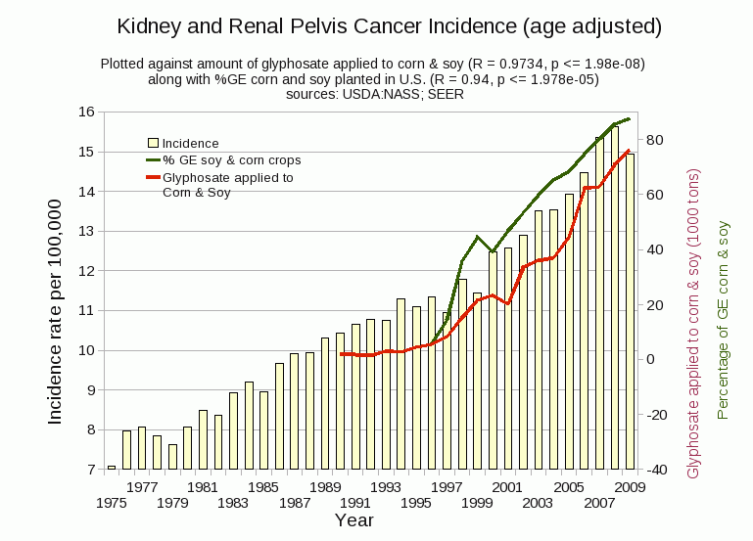
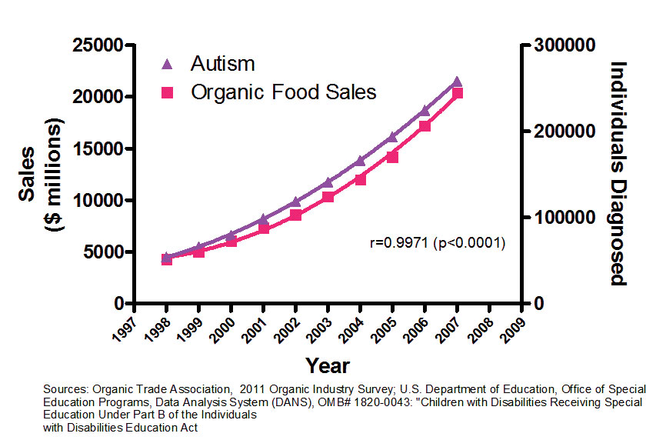
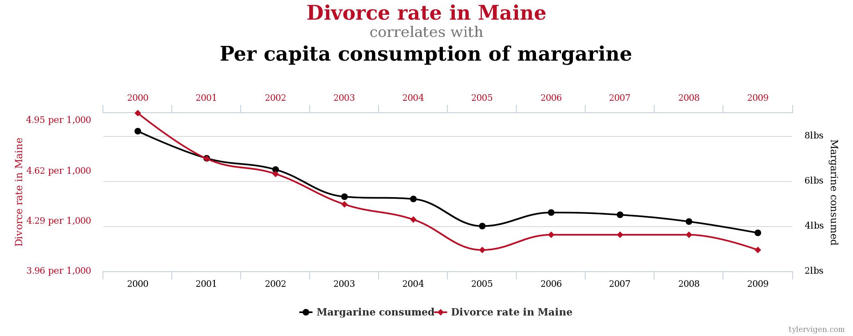
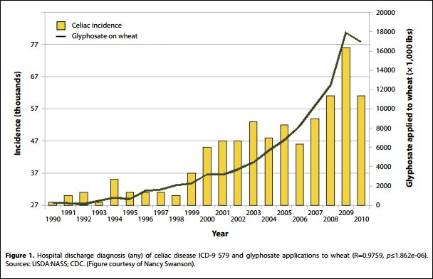
What about the discussion on glyphosate?

Slide 17
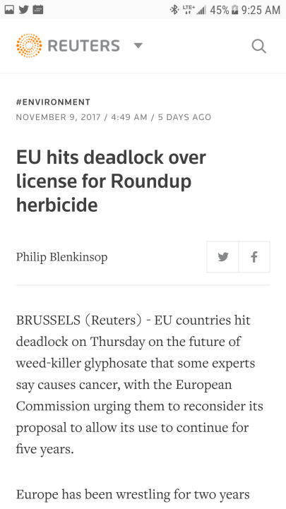
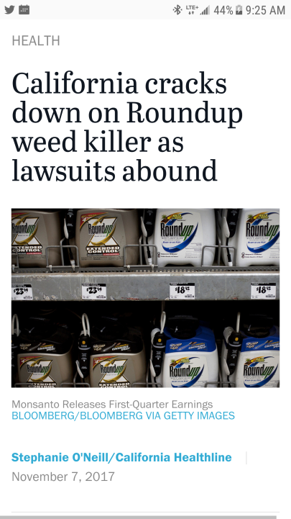

What about the discussion on glyphosate?
International Agency for Research on Cancer

Slide 18
The truth about glyphosate
Tested and verified safe by:
  United States Department of Agriculture
  Food and Drug Administration
  European Food Safety Authority
  European Chemical Agency
  Canadian Food Inspection Agency
  Health Canada

Slide 19

The overall finding from the re-examination of glyphosate in 2017:
  Glyphosate is not genotoxic and is unlikely to pose a human cancer risk.
  Dietary (food and drinking water) exposure associated with the use of glyphosate is not expected to pose a risk of concern to human health.
  Occupational and residential risks associated with the use of glyphosate are not of concern, provided that updated label instructions are followed.
  The environmental assessment concluded that spray buffer zones are necessary to mitigate potential risks to non-target species (for example, vegetation near treated areas, aquatic invertebrates and fish) from spray drift.
  When used according to revised label directions, glyphosate products are not expected to pose risks of concern to the environment.
  All registered glyphosate uses have value for weed control in agriculture and non-agricultural land management.

Slide 20
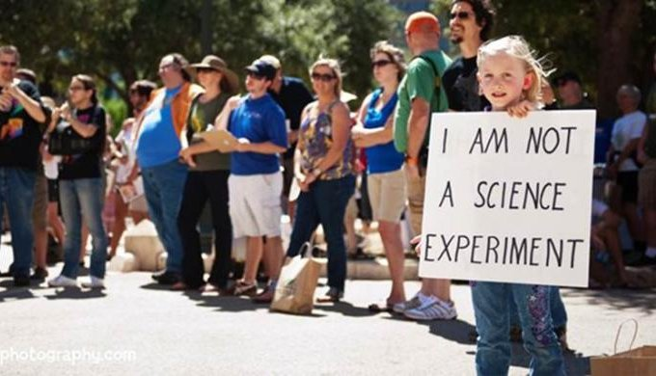


Even with Science on our side… the push continues against modern agriculture

Slide 21
How to building trust?
Outreach
  Canadians want to know about their food and how it’s produced
  Influencing the influencers
Shared values
  Farmers and ranches are trusted, but we’re also mothers, fathers, grandparents, brothers and sisters

Slide 22
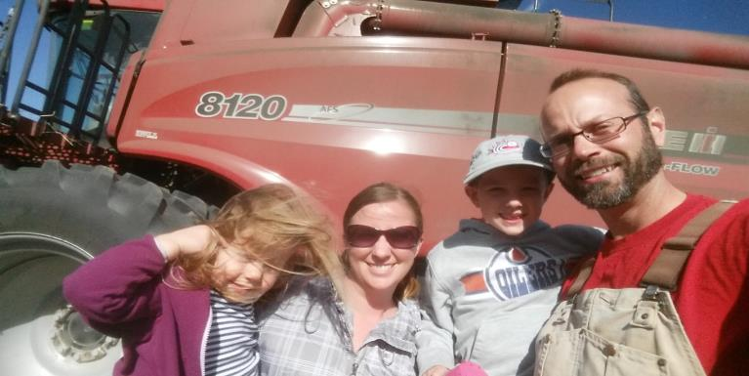
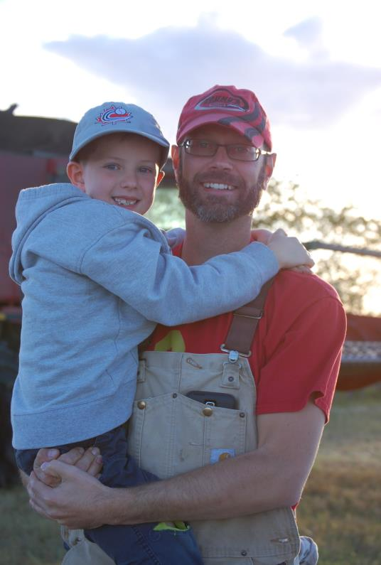
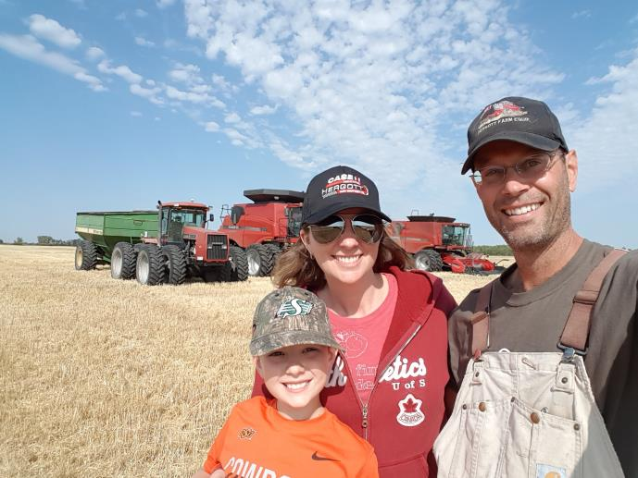
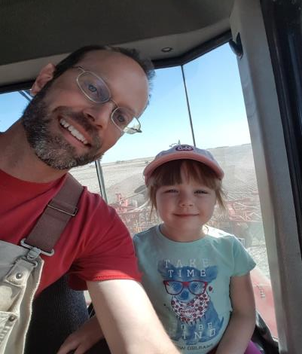

Slide 23
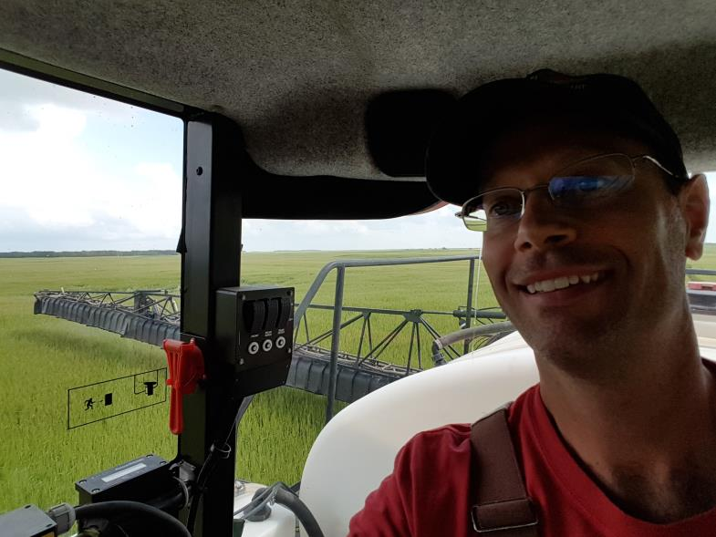
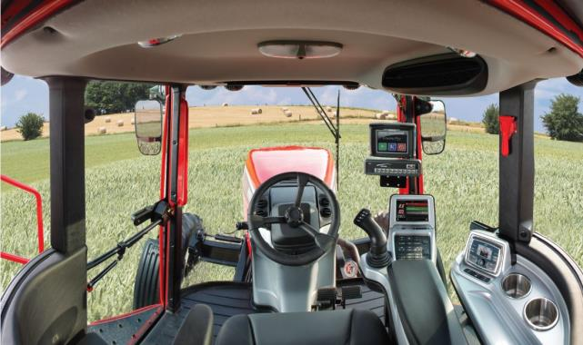
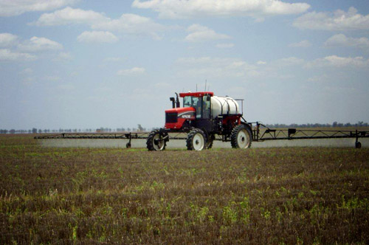

Slide 24
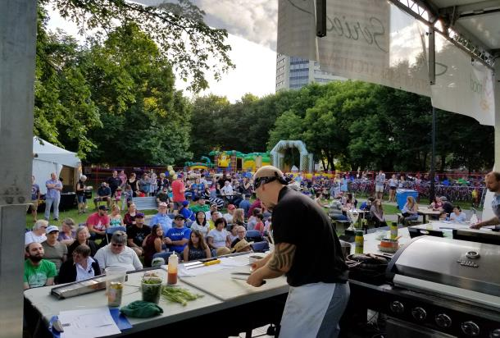
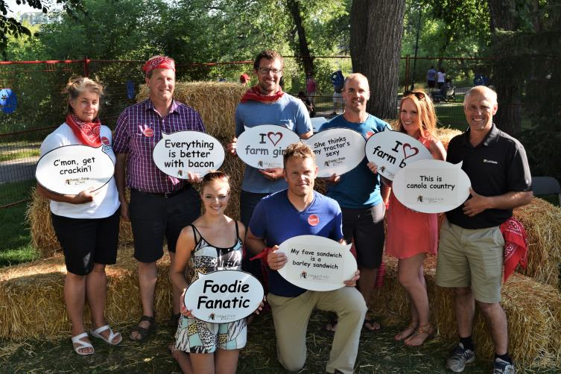
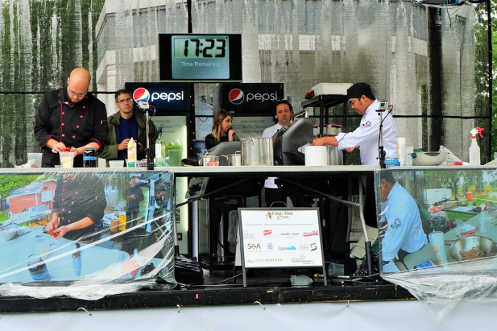
Chef’s Series at Taste of Saskatchewan
Exposure to 100,000 attendees
232 surveyed – 97% ‘Good’ or ‘Fantastic’
86% learned something about food/farming

Slide 25

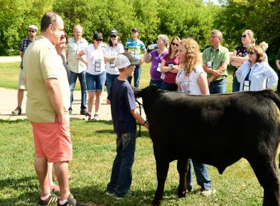
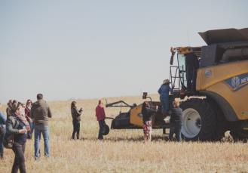
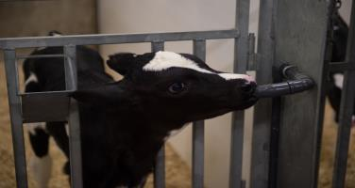
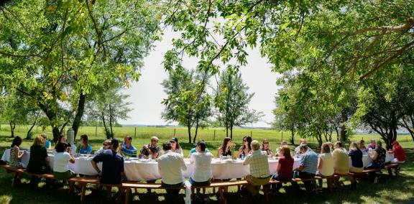
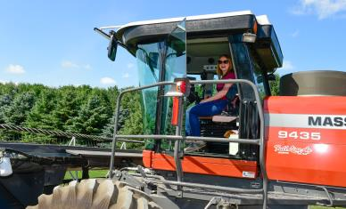
Food Influencer Program
  121 participated in 2017, VIP food influencers and students
  Social media: 111 posts to audience of 77,807 individuals
  Student perceptions of farming and food shifted: U of S Nutrition Students increased from 50% to 87% very positive
Notes:
One other project we’ve done here in Saskatchewan is to bring national/international food writers, international culinary academics and local chefs and other food experts onto farms and ranches to experience where and how food is produced in Saskatchewan.
The intent is to build relationships with key people who have influence on consumers and the food they eat.
This hands-on experience will help to set a foundation for lasting relationships with chefs and food writers.
Remember at the beginning when I mentioned that only 2% of the population has direct experience with farming? My experience with these tours is that when you bring people that don’t usually have a farm background—people who are writing and influencing others about the food they eat—when you bring these people to see the farm, to actually shake hands with the cattle producer or grain farmer, that is when minds are changed and attitudes are adjusted.

Slide 26


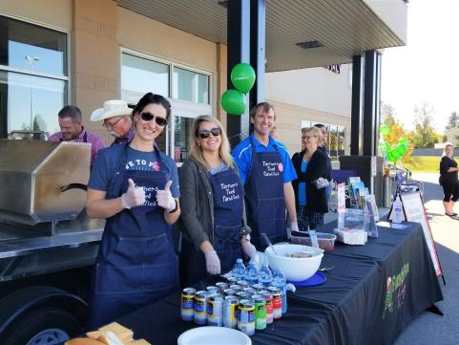
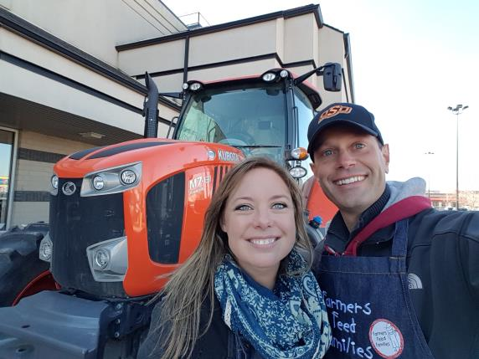
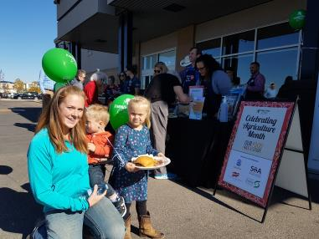
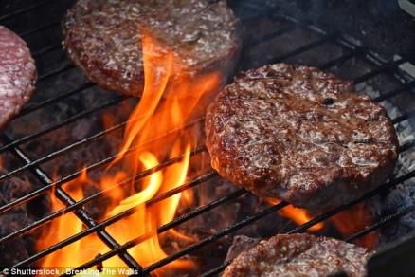
Agriculture Month
Notes:
Another program that is related to the Real Dirt on Farming booklet is the national speaker training program. The idea behind this is to help people in agriculture: farmers, ranchers, agrologists, food sellers—anyone who works in food production, and give them the skills and resources to go out and tell their story to consumers.
Lots of us have worked in agriculture for years, but would not necessarily have the materials at our fingertips if we were asked to speak about farming to the local chamber of commerce or the school or even just at the dinner table at Thanksgiving. This program provides a training manual and ready-made slides on five general topics:
Farming101
Farming Myths
Farming and the Environment
Food and Farming
Animal Care on the Farm
What we’re trying to do is empower people in our industry to get out and tell their own stories in their own communities –to get hundreds or thousands of people all talking about the positives in agriculture across Canada.

Slide 27
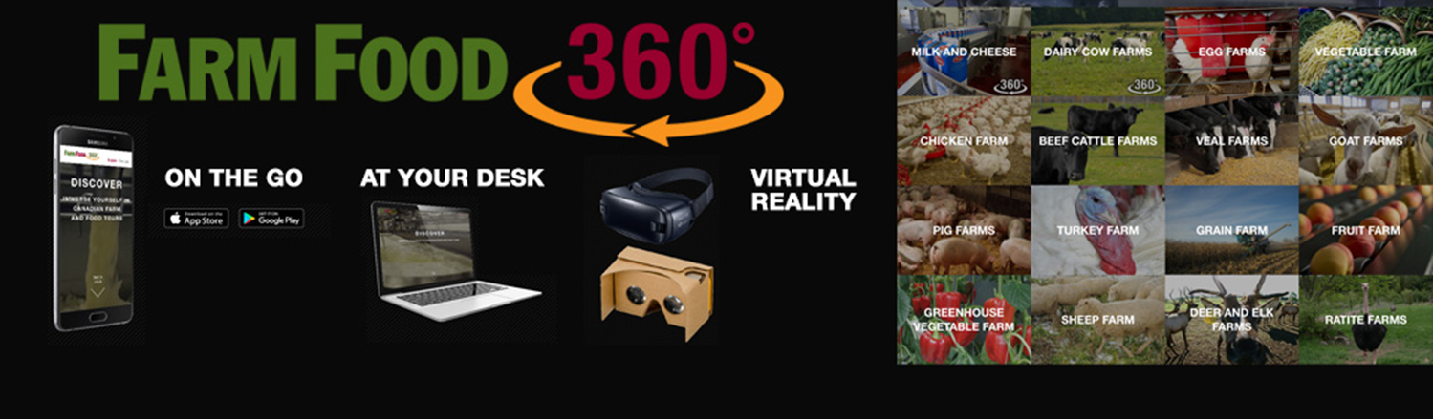
Notes:
Another program that is related to the Real Dirt on Farming booklet is the national speaker training program. The idea behind this is to help people in agriculture: farmers, ranchers, agrologists, food sellers—anyone who works in food production, and give them the skills and resources to go out and tell their story to consumers.
Lots of us have worked in agriculture for years, but would not necessarily have the materials at our fingertips if we were asked to speak about farming to the local chamber of commerce or the school or even just at the dinner table at Thanksgiving. This program provides a training manual and ready-made slides on five general topics:
Farming101
Farming Myths
Farming and the Environment
Food and Farming
Animal Care on the Farm
What we’re trying to do is empower people in our industry to get out and tell their own stories in their own communities –to get hundreds or thousands of people all talking about the positives in agriculture across Canada.

Slide 28


Opportunities to learn
December 13 & 14
Saskatoon Inn

Slide 29
Thank you for your sponsorship!

Slide 30

www.farmfoodcaresk.org
@FarmFoodCareSK clinton@farmfoodcaresk.org

